Slide 1
Primary Care
LGI Pathway Education
Part of the WCA 26/27 Primary Care Local Improvement Scheme
Helen Platts, GP Advisor WCA
Julie Lane, Lead Cancer Nurse DCH
Donna Sharland, Lead Nurse for GI Specialist Nursing
Notes:
Thank cancer champions on the amazing work that previous LIS' have done
Changes in urology pathways, lung cancer, smoking cessation
Also huge work that has been done with FIT accompanying LGI referrals via the IIF investment and impact fund - successfully reached FIT result with >80% LGI USC referrals
Questions at the end as the session is being recorded for you to use in your PCNs – please pop them in the chat or ask at the end
Cameras and mics off – pop on at the end

Slide 2
LIS Requirement 3: Improving the quality and appropriateness of LGI Cancer Referrals
Detail of activity required
Clinical champions will attend a 1-hour WCA webinar and receive a resource pack to support local education delivery.
Clinical champions will be responsible for sharing these key messages through locally held PCN or practice meetings, with the aim of reaching all referring clinicians.
Practice meetings to include a review/discussion of LGI referral quality (the last 5 referrals per practice minimum) against high quality examples provided.

Slide 3
How could this education be delivered within your PCN?
Traditional PLT session
Bite-sized updates
Recorded webinar
Case discussion at MDT/huddle
Clinical Cancer Champion cascade model
There is no single correct approach — choose the model that works best for your PCN and practice workforce.
Notes:
Resources will be provided – details later
They may have heard this – you are cancer champions but we know that often it is hard to disseminate info around the PCN
Trickle down

Slide 4
Referral Form Review
Practice education sessions to include a review/discussion of LGI referral quality (the last 5 referrals per practice minimum) against high quality examples provided.
Does the referral demonstrate all the components required for optimal triage and straight-to-test booking?
✓ Clear symptom chronology and duration
✓ Why cancer is suspected clearly stated
✓ Examination findings including DRE documented
✓ FIT, FBC and renal function included
✓ Previous investigations documented
✓ Frailty score recorded
✓ Patient informed and willing to undergo investigation
Notes:
What does a good quality (and realistic) referral look like?
How do referrals from your practice compare?

Slide 5
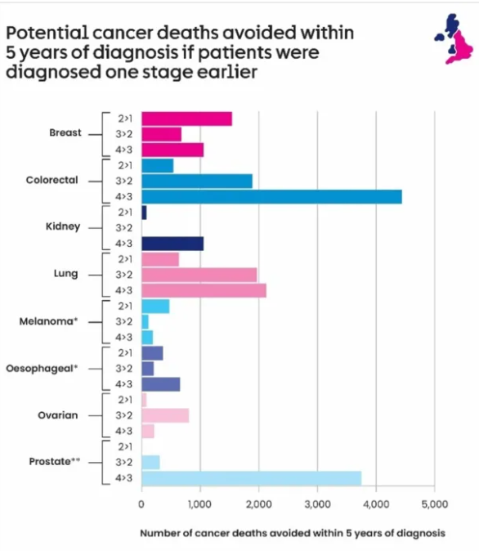
Why are we focusing on bowel cancer?
Bowel cancer is the fourth most common cancer in the UK, with almost 43,000 people diagnosed every year.
It is the second leading cause of cancer death in the UK accounting for over 7,500 deaths each year.
Analysis shows that the greatest number of cancer deaths could be avoided (approx. 4500) with a shift in bowel cancer diagnoses from Stage 4 to Stage 3.
Notes:
Bowel cancer is common, has one of the highest potentials for lives saved through earlier diagnosis, and we now have powerful tools available to us through screening and FIT-based pathways.
aligns perfectly with where we can make the biggest difference in primary care.

Slide 6
Why are we focusing on bowel cancer?
HIOW Colorectal Cancer Audit (25/26 LIS) and Bowel Cancer Pilot Projects
Primary care delays
Repeated consultations
FIT delayed/not requested
No DRE/examination
Anaemia not fully investigated
Knowledge gaps
Uncertainty around FIT<10
Alternative pathways underused
Variation in safety netting
Inconsistent frailty recording
Secondary care delays
Capacity constraints
Delayed investigations
Fragmented pathways
System opportunities
Improve referral quality
Earlier risk stratification
Consistent coding
Shared pathway understanding
Notes:
Over the last year we have reviewed over 1000 colorectal cancer diagnoses across HIOW. Whilst much excellent care was delivered, the audit identified recurring themes where earlier diagnosis may have been possible.
Alliance is also working in dorset really closely with the LGI pathway and doing a deep dive into the fast track pathway – similar patterns are emerging
Delays identified included missing FIT testing, repeated presentations, lack of examination and delays investigating anaemia.
Hopefully will help us diagnose more cancers earlier, reduce emergency presentations, and improve outcomes for our patients

Slide 7
Learning objectives
Optimise pre-referral assessment
Improve referral quality
FIT<10 guidance and alternative pathways
Further learning points – rectal bleeding/haemorrhoids and IDA
Safety netting

Slide 8
The patient pathway - Dorset
Symptoms → Primary Care Assessment → FIT/Bloods/Examination → Referral → FDS Triage → Investigation → Diagnosis/Treatment
DCH
Referrals triaged daily by CN/NP in the electronic patient record
Outcome – Virtual Clinic, F2F anyone, F2F Cons/Reg, Diagnostic first seen (STT CT)
Anal mass, anal ulceration or requiring consent form 4 – F2F with Cons/Reg
F2F with anyone if frail or likely to need CTC and PR not completed
UHD
Daily triage by ACP team
CFS 1-3, <85 with bowel symps/ WL/IDA and FIT+ve abdo pain to nurse tel assessment clinic
CFS 1-5 any age abdo pain or rectal mass to Nurse F2F, CFS 4-5 >85 nurse F2F, CFS 1-5 any age, translator, sens probs nurse F2F
CFS 1-9 anal mass/ ulceration/ consent form needed consultant F2F
FIT <10 with proven IDA – directed to IDA service
Notes:
Julie to explain

Slide 9
The patient pathway - HIOW
All referrals triaged daily by FDS nurses in ERS
Outcomes:
STT Colonoscopy/CTC
F2F OPA with Cons/Reg
Telephone OPA with Cons/Reg
Palpable mass or ulceration see in OPA
FIT negative asymptomatic IDA to IDA pathway
HHFT
Referrals graded by a band 8a nurse or consultant
Mandatory info checked inc previous refs inc multiple referrals
If all info present: STT / nurse led f2f / consultant f2f
IDA pts sent to GASTRO irrespective of raised FIT
PHU
Triaged by non clinical team against protocol
PS 0-1 Nurse led telephone assessment PS 2 – Nurse Led F2F
Palpable Abdominal mass, rectal or anal mass or very complex PMH or Consent issues to Consultant F2F clinic
IDA service run by Gastro Cons and tests arranged virtually with review if required
UHS
Notes:
Donna to explain

Slide 10
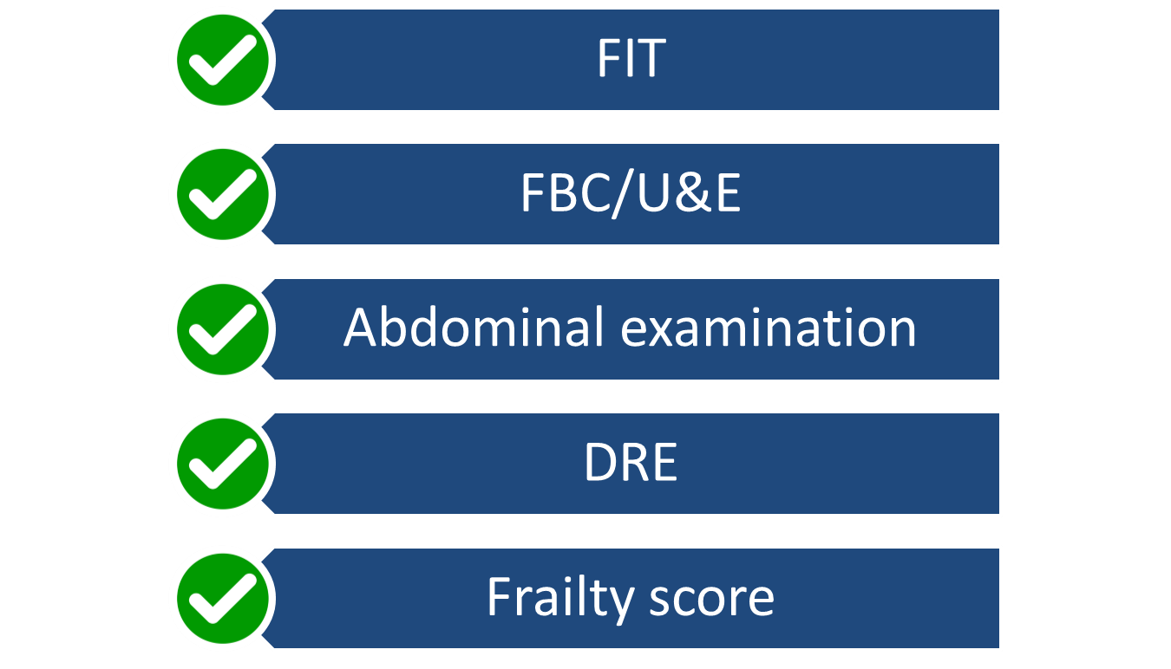
Essential pre-referral assessments
Notes:
Helen – explain we are going to ask why each aspect of the pathway are required?

Slide 11
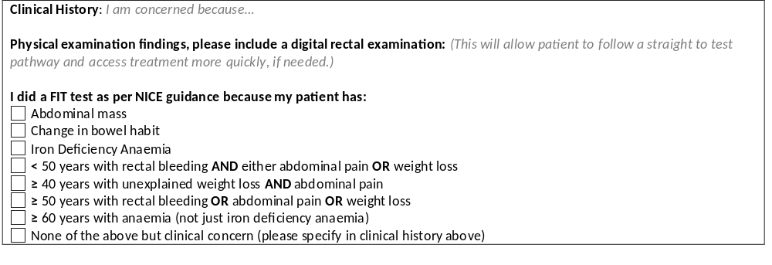
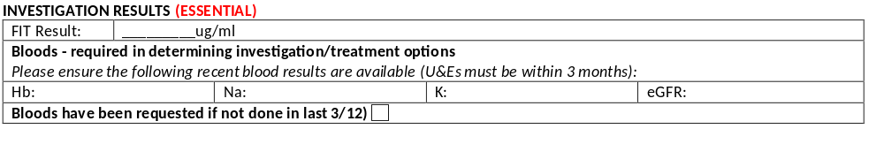
Essential pre-referral assessments
SYMPTOMS AND REASON FOR REFERRAL (ESSENTIAL)
Notes:
Helen to ask Julie

Slide 12
Examination changes the patient pathway
PR examination mandatory before CT colonography
Rectal/anal masses bypass FIT pathways
Document findings clearly
Key message:
If it isn't documented, it hasn't happened.
Notes:
Helen to ask Julie

Slide 13
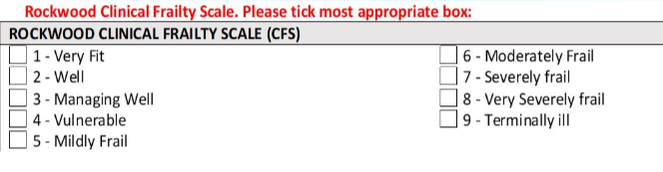
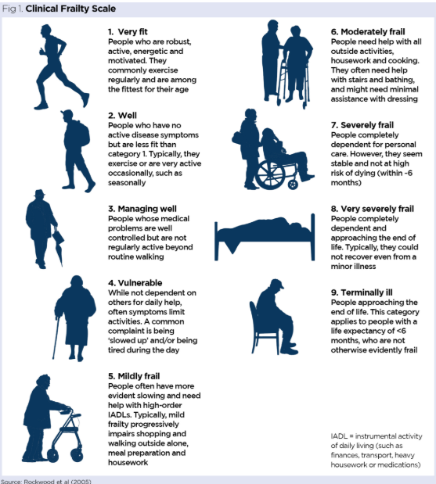
Frailty and decision making
Frailty scoring influences:
Investigation choice
Suitability for colonoscopy
Need for face-to-face review
Shared decision making
Notes:
Helen to ask donna

Slide 14
Previous investigations and coding
Include previous:
• Colonoscopy/endoscopy
• CT imaging
• USC (2WW) referrals
• Relevant specialist reviews
Code investigations accurately
This is likely to be added to the Wessex USC LGI form
Notes:
Helen to ask Julie
Ask about time scales – eg what would we do if patient had been via LGI 2ww 1yr ago no findings??

Slide 15
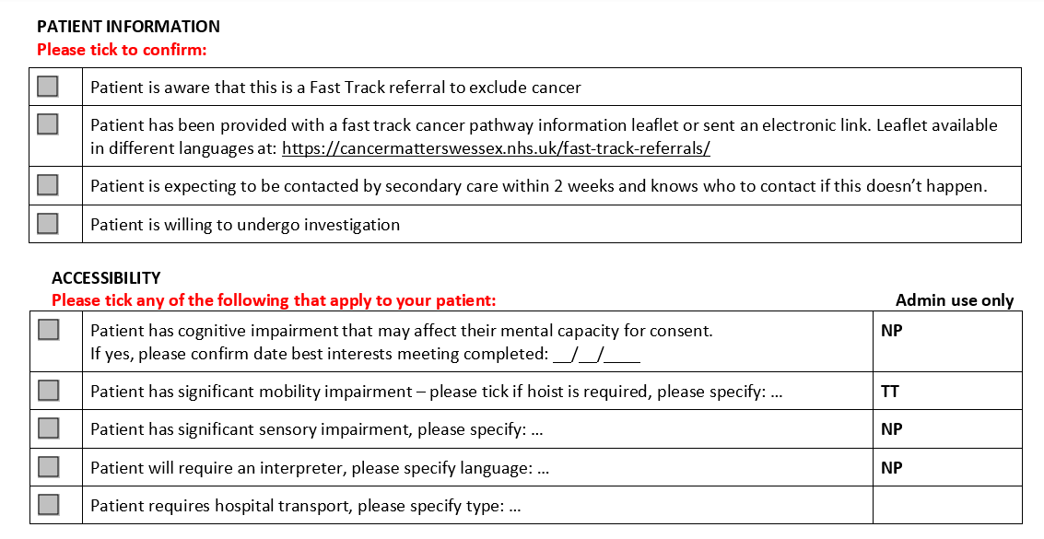
Further patient information – why does this matter?
Notes:
Helen to ask donna

Slide 16
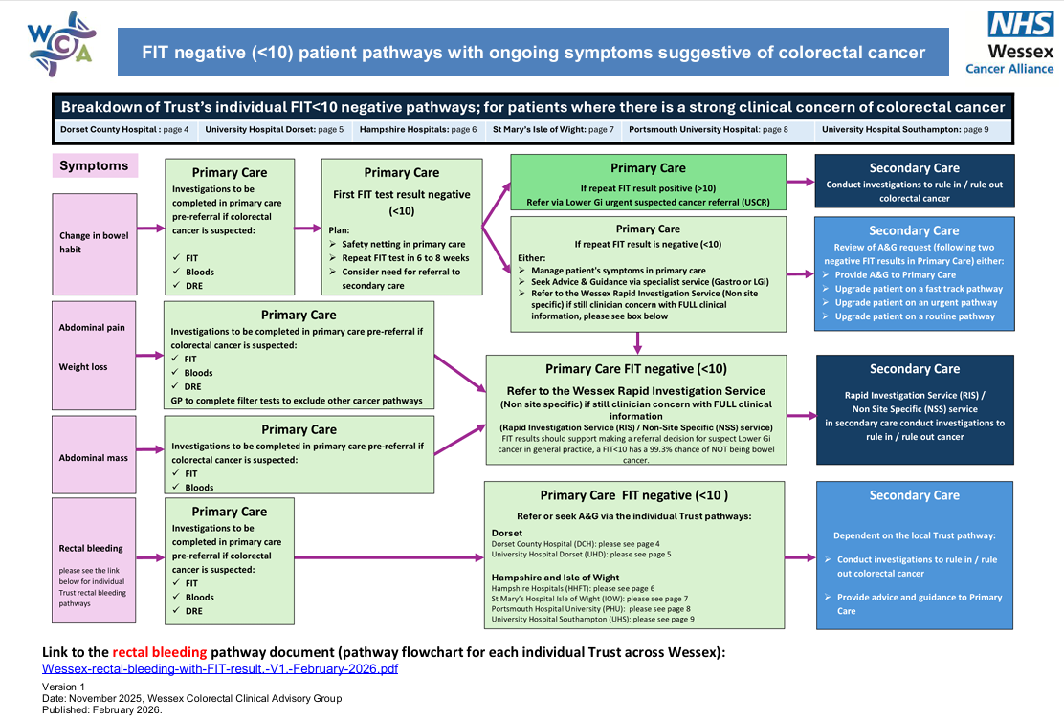
FIT <10 guidance and alternative pathways
FIT negative (<10) patient pathways with ongoing symptoms suggestive of colorectal cancer
Notes:
helen

Slide 17
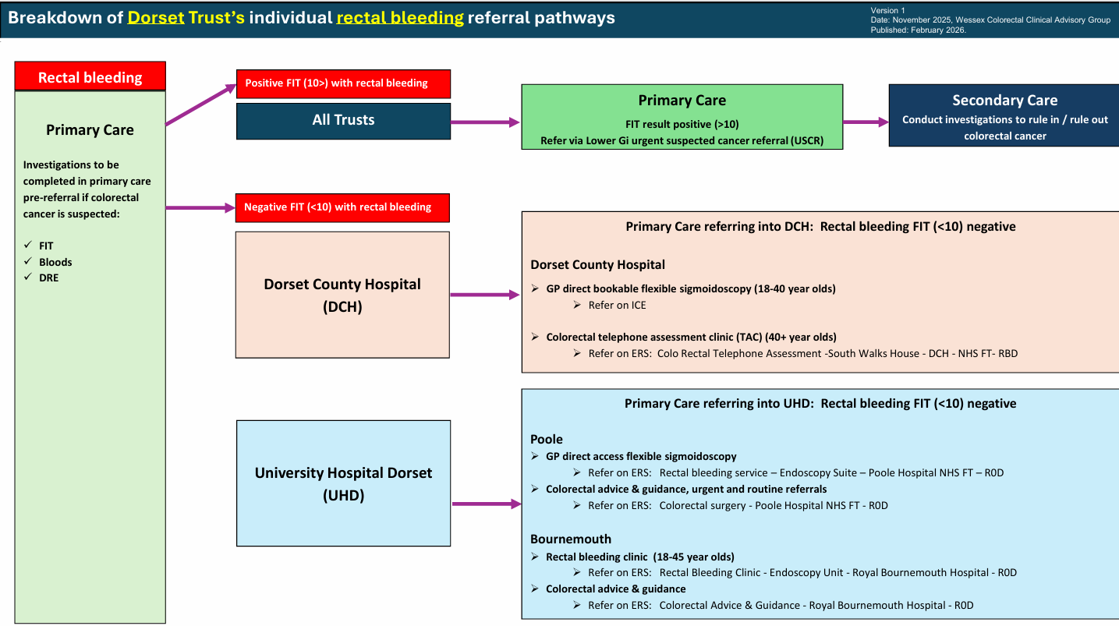
Rectal bleeding pathways - Trust specific information
Wessex-rectal-bleeding-with-FIT-result.-V1.-February-2026.pdf
Notes:
helen

Slide 18
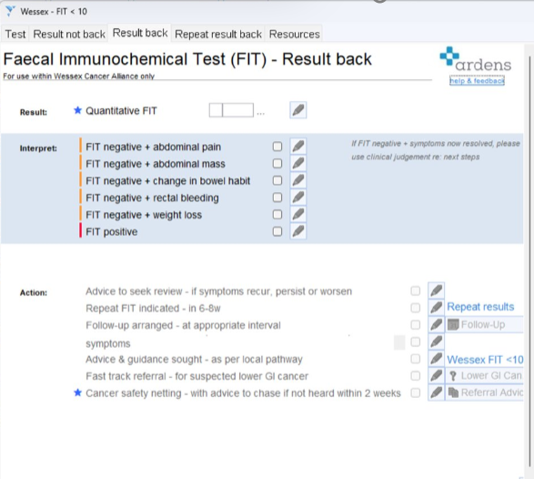
FIT <10 Pathway Support
This new template in Ardens has been designed to support the Wessex LGI pathway.
Notes:
helen

Slide 19
Iron Deficiency Anaemia
IDA was found to be significant delay factor in primary and secondary care in the HIOW 24/25 CRC audit.
All patients who presented as an emergency had IDA at the time of admission
8–10% CRC yield in new IDA (Pengelly et al., 2013; Snook et al., 2021)
Longstanding or recurrent IDA following prior negative gastrointestinal investigations is associated with a lower, but clinically significant, CRC yield of 2-5% (Ayres et al., 2019; Pengelly et al., 2013)
IDA should override negative FIT
Notes:
New IDA BSG guidance 2025 is that iron deficiency anaemia is different from other lower GI symptoms. Although FIT should be used in primary care now a negative FIT does not exclude significant pathology and should not prevent appropriate investigation.
In Dorset, asymptomatic IDA referrals continue to follow the dedicated IDA pathway, even if the FIT is positive, whereas across HIOW there is greater variation in local pathways.

Slide 20
FIT in Iron Deficiency Anaemia (IDA): What Should We Do?
BSG Recommendations
https://fg.bmj.com/content/early/2025/10/14/flgastro-2025-103329
FIT should be performed in primary care for patients with IDA
A negative FIT does NOT exclude significant pathology
FIT should not replace investigation of IDA (most patients generally still require both upper and lower GI investigation)
Coeliac serology should be requested before referral
Key message : Investigate the anaemia, not just the FIT result
Patients with IDA still require appropriate investigation.
Notes:
Julie to explain further from a secondary care perspective – understanding that there are some local differences in pathways

Slide 21
Haemorrhoids & Diagnostic Overshadowing
Haemorrhoids were found to be a significant delay factor in the HIOW CRC audit 24/26
DRE absent/misleading in 75%
All patients who were incorrectly diagnosed with haemorrhoids in this cohort reported rectal bleeding
In 75% of cases there were additional red flags present
Unsurprisingly anal cancer was over-represented
Key messages :
Don’t let haemorrhoids close the diagnostic process​
Look for additional red flags​
Examination ​
Use FIT appropriately ​
Safety net effectively
Notes:
Helen
Rectal bleeding should not be attributed to haemorrhoids without full assessment.

Slide 22
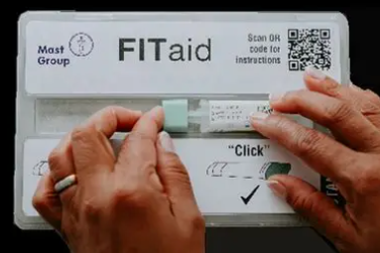
FIT & Inequalities
Evidence highlights gaps in the uptake and completion of FIT tests, with people in the most deprived areas, most ethnically diverse areas, males, and younger patients less likely to return tests (BJGP 2026).
It is important to try and minimise any potential exacerbation of cancer inequalities through:
Providing clear instructions on how to complete the kit, including translated materials for non-English speakers
Encouraging patients to return a sample or offer them a further test if the kit has been lost
Implementing robust tracking systems for unreturned tests
How does your practice support patients who might have difficulty completing their FIT tests?
Notes:
Helen
Print out labels – remember date ??

Slide 23
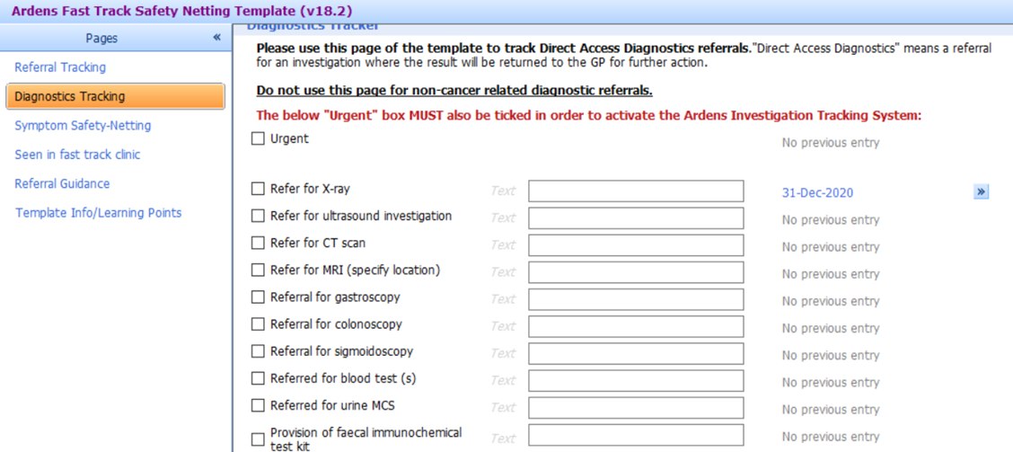

FIT Safety Netting
Primary care systems now offer electronic methods for tracking and safety netting patients who have received a FIT.
Electronic templates can provide a centralised, efficient approach and can be used by the whole practice team.
FIT Safety Netting is available in both Ardens and CTheSigns.
Notes:
A small number of practices in Hampshire are testing a new FIT safety netting template in Ardens, as part of a project led by the national cancer programme. We will share details and learning from this as soon as we are able to.

Slide 24
Key messages
Examination and DRE matter
Frailty influences pathways
FIT<10 pathway and referral support – low risk of CRC but requires safety netting
High-quality referrals improve patient care

Slide 25
Useful Information
Referral guidance
NICE NG12 Guidelines: Suspected Cancer Recognition and Referral
NICE HTG690 (formerly DG56) FIT testing to guide colorectal cancer pathway referral in primary care
Wessex FIT & LGI Pathway Information
Wessex FIT<10 pathway and Rectal bleeding pathway
Further education resources
• WCA Cancer Academy – LGI Education
Notes:
Links to be added

Slide 26
Next Steps
We will share the following resources to support delivery of this content:
Copy of LGI pathway education session slides
Education session recording
LGI referral form examples
Links to online surveys to support evaluation
- Practice session attendees
- Clinical Champion - reflections

Slide 27
Questions

