Slide 1
Bowel Cancer Awareness Month
Communications Toolkit
April 2026
Notes:
Standard title slide

Slide 2
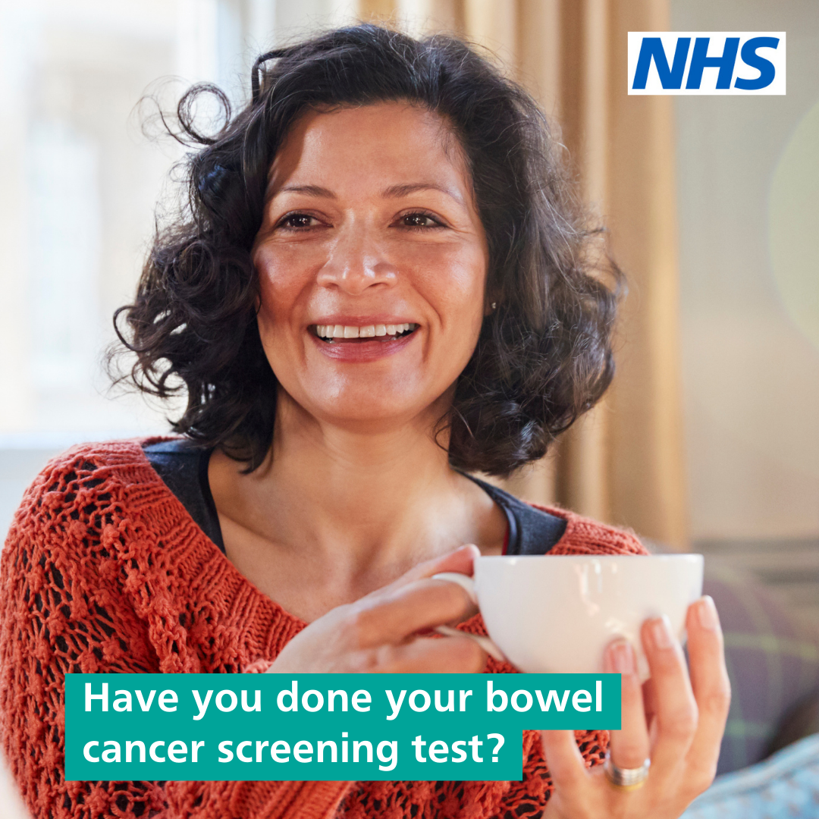
Contents
About this toolkit
20 years of bowel cancer screening
Timeline
Key messages – bowel cancer screening
Key messages – completing your FIT kit
Key messages – Lynch syndrome
Useful information
Posters
Digital display screen assets
Web banners
Email signature banners
Social media assets
Example posts
Case study - Stephen
Case study – Phil
Case study- Grace
Bowel cancer screening example copy
Translated bowel cancer screening materials
Social media quote cards
Articles on bowel cancer and screening
Useful links

Slide 3
About this toolkit
This toolkit is designed to support communications around Bowel Cancer Awareness Month in April 2026, which
marks 20 years since the start of the NHS Bowel Cancer Screening Programme.
Every April, Bowel Cancer Awareness Month gives us a chance to raise awareness about bowel cancer and bowel cancer screening.
It’s a crucial opportunity to educate people about the disease and its symptoms, and to support people affected by bowel cancer.
Please use the materials to increase awareness of the importance of bowel cancer screening among your networks by:
ensuring relevant health services have this toolkit to support their communications
including information in your newsletters
incorporating messages in internal communications (eg emails, staff bulletins and intranets)
ensuring information on bowel cancer screening is up to date.

Slide 4
20 years of bowel cancer screening
The impact of the NHS Bowel Cancer Screening Programme
DATA TO FOLLOW

Slide 5
Timeline
How the NHS Bowel Screening Programme has evolved
2006 — The NHS Bowel Cancer Screening Programme launches in England, becoming the first cancer screening programme in England to invite both men and women. Eligible people aged 60–69 registered with a GP are automatically invited. The faecal occult blood test (FOBt, also known as the guaiac test) kit is sent to participants to detect small traces of blood in stool samples.
2008 — Bowel cancer screening is gradually extended to include people aged 60–74.
2019 — The FIT (faecal immunochemical test) kit replaces the FOBt across England. The FIT is simpler and more convenient to complete as it requires only one sample rather than three. The switch results in national uptake rising from around 59% in the two years before FIT to 67% in the first year after its introduction.
2021 — The process to start lowering eligibility to everyone age 50 begins, starting with 56-year-olds.
2023 —The NHS Bowel Cancer Screening Programme starts to invite people with Lynch syndrome for a colonoscopy every two years to check for signs of bowel cancer. Lynch syndrome increases the risk of getting bowel cancer by up to 80% but regular surveillance prevents between 40 and 60 out of every 100 people from getting bowel cancer.
2026 — The FIT screening threshold is being reduced from 120µg/g to 80µg/g. With an increase in the sensitivity of bowel cancer screening, an estimated 600 more bowel cancers are expected to be identified each year in England as well as 2,000 more people with high-risk polyps in their bowel. To boost uptake and improve accessibility, new digital communications start to be rolled out.

Slide 6
Key messages – bowel cancer screening
Bowel cancer is the 3rd most common type of cancer.
Bowel cancer screening is available to everyone aged 50 to 74.
The NHS automatically invites people once they become eligible for bowel cancer screening.
Bowel cancer screening is offered every two years.
97 or 98 out of 100 people who use their bowel cancer screening kit do not need further tests.
2 or 3 in 100 people are asked to go to hospital for further tests.
7 to 10 in every 100 people who have a colonoscopy turn out to have bowel cancer.
Download the NHS App to get your future messages about bowel cancer screening straight to your smart device.
Find out more about bowel cancer screening is available on the NHS website.

Slide 7
Key messages – completing your FIT kit
If a FIT kit is sent to you, it's meant for you. Even if you don't have symptoms, it can detect signs of cancer of bowel cancer before you do.
The kit can be completed in the privacy of your own home by following the simple instructions on the underside of the box lid.
You only need to collect one tiny sample of poo using the plastic stick provided. Pop it in the sample bottle and post it back for free, to be tested.
Maybe you think it’s messy or awkward, but by following a few simple steps, a tiny sample is all it takes.
Your next poo could save your life. So, if you're sent a kit, join the millions completing theirs.
If you receive a kit when you're eligible, help yourself by remembering to complete it. Put it by the loo. Don't put it off.

Slide 8
Key messages - Lynch syndrome
Lynch syndrome is an inherited condition that increases the risk of certain cancers, including bowel cancer.
An estimated 1 in 400 people in England have Lynch syndrome (around 175,000 people), but just 5% are aware they are living with the condition.
People with Lynch syndrome have a higher risk than the average person of getting bowel cancer.
Around 1,100 bowel cancers are caused by Lynch syndrome each year in England.
People diagnosed with Lynch syndrome are invited for a colonoscopy to check for signs of bowel cancer by the NHS Bowel Cancer Screening Programme.
People with Lynch syndrome will be automatically invited for a surveillance colonoscopy every 2 years.
Out of 100 people with Lynch syndrome, colonoscopy surveillance every 2 years prevents between 40 and 60 people from getting bowel cancer.

Slide 9
Useful information
The Faecal Immunochemical Test (FIT) kit is available through the NHS Bowel Cancer Screening Programme to everyone aged 50 to 74.
People aged 75 and over can request a kit by phoning the NHS Bowel Cancer Screening helpline on 0800 707 60 60.
Since the FIT kit was introduced into the screening programme in 2019, national uptake has increased from 65.2% to 67.8% (Q1 2024/25).
The FIT kit is convenient to use as it only requires one sample which is done in the privacy of your own home and returned in a sealed bottle.
In the UK, every 30 minutes, someone dies from bowel cancer.
Bowel cancer screening is offered to eligible people every two years.
Find out more about bowel cancer screening at nhs.uk/bowel

Slide 10
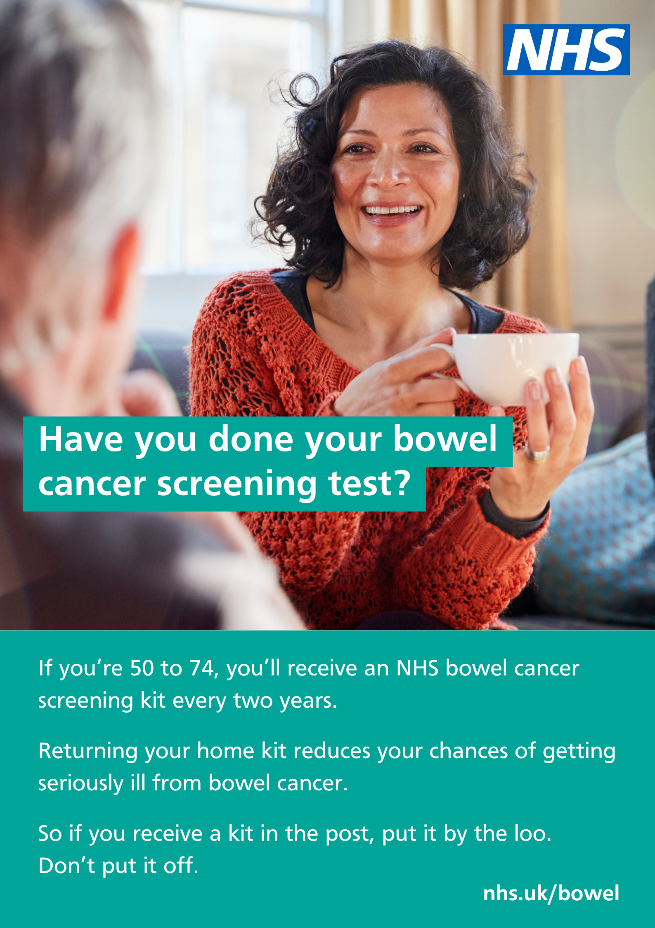
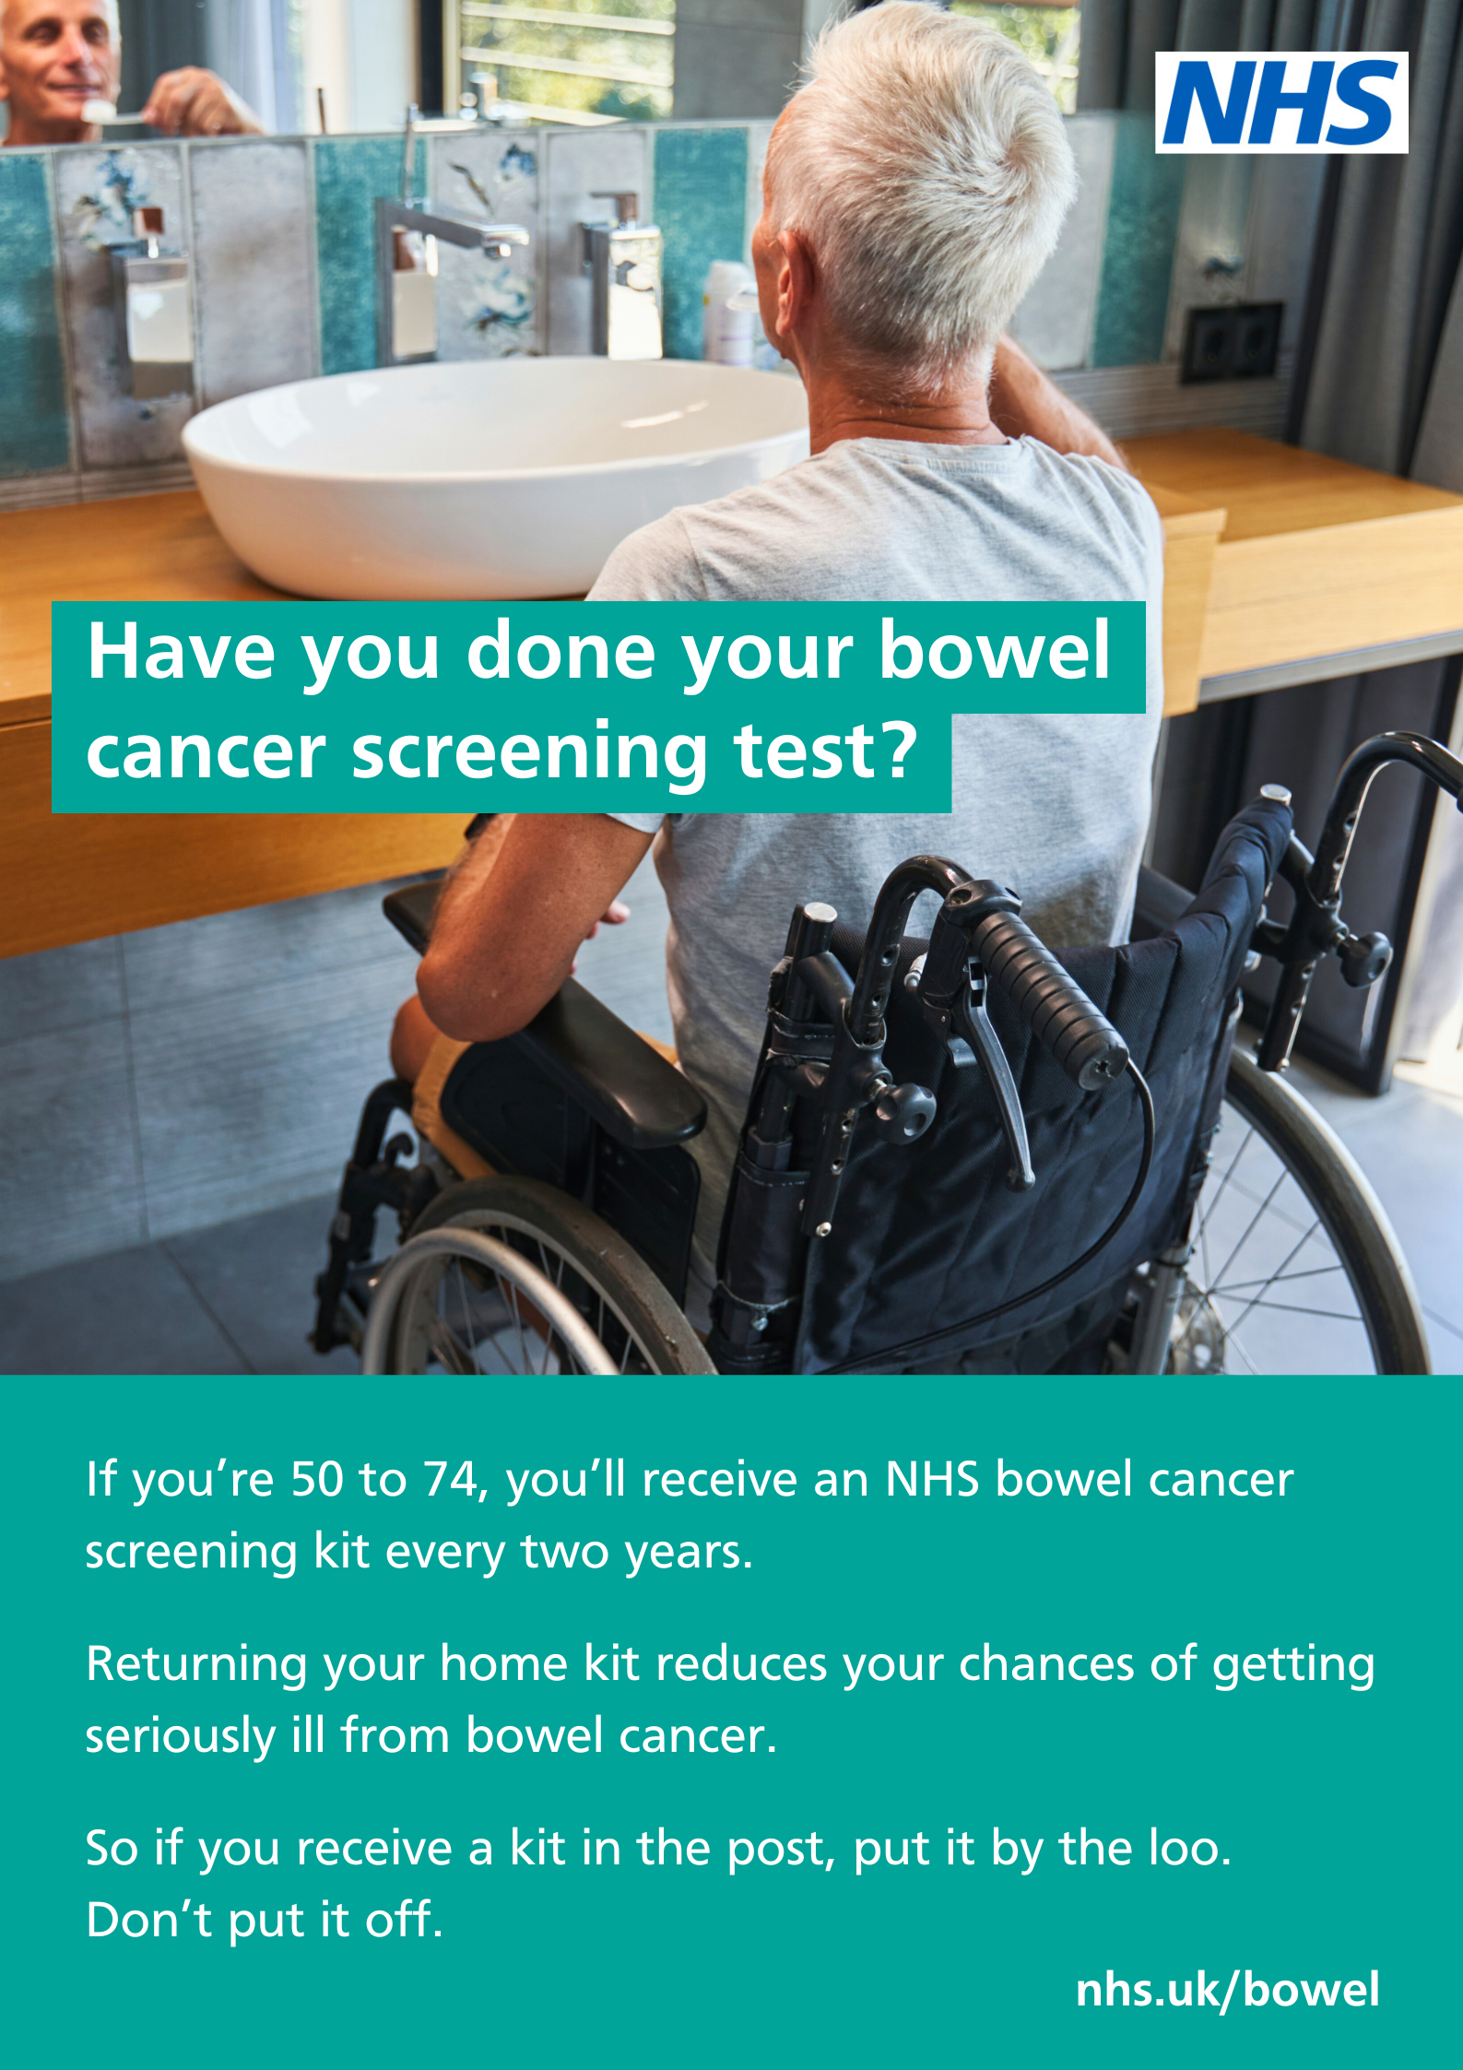
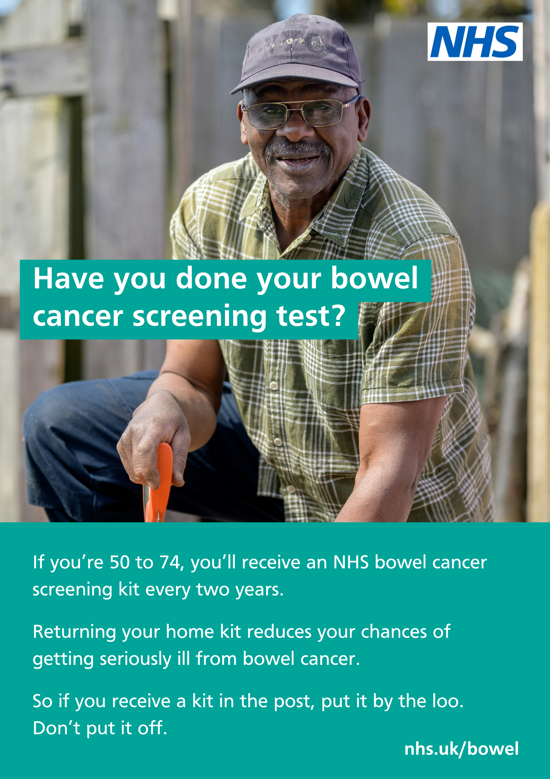
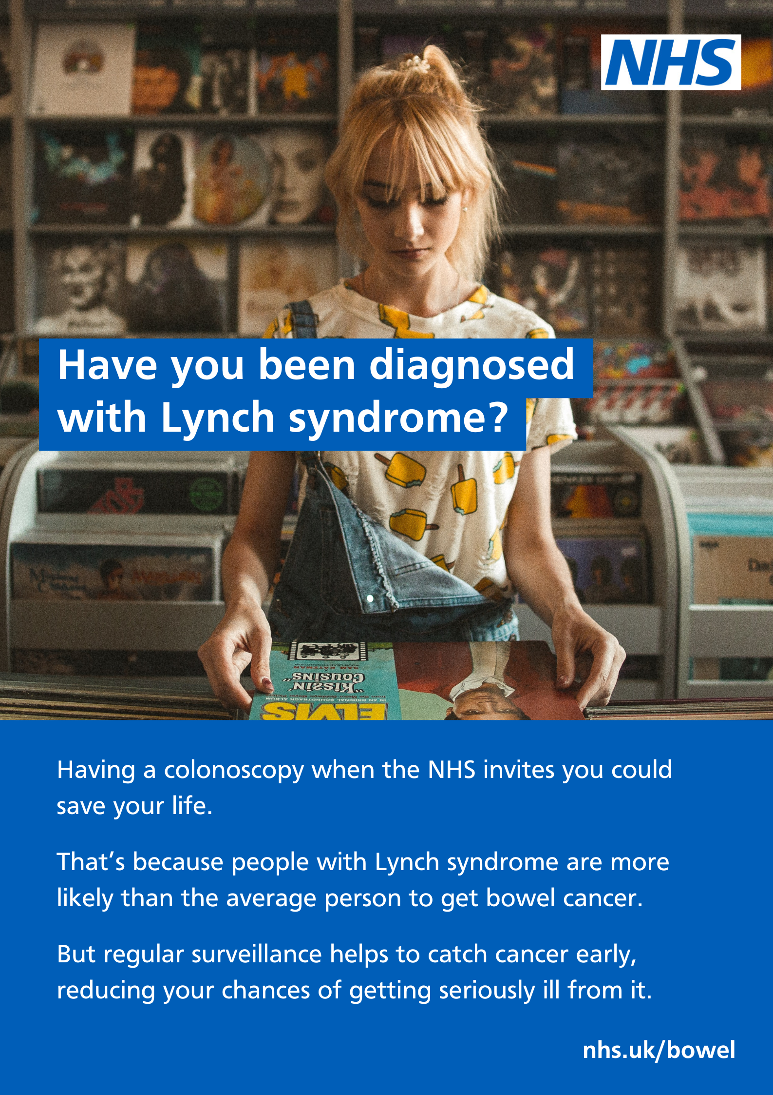
Posters
For public areas such as GP and hospital waiting rooms
Download these posters on CommsLink, Future NHS, or the Campaign Resources Centre

Slide 11
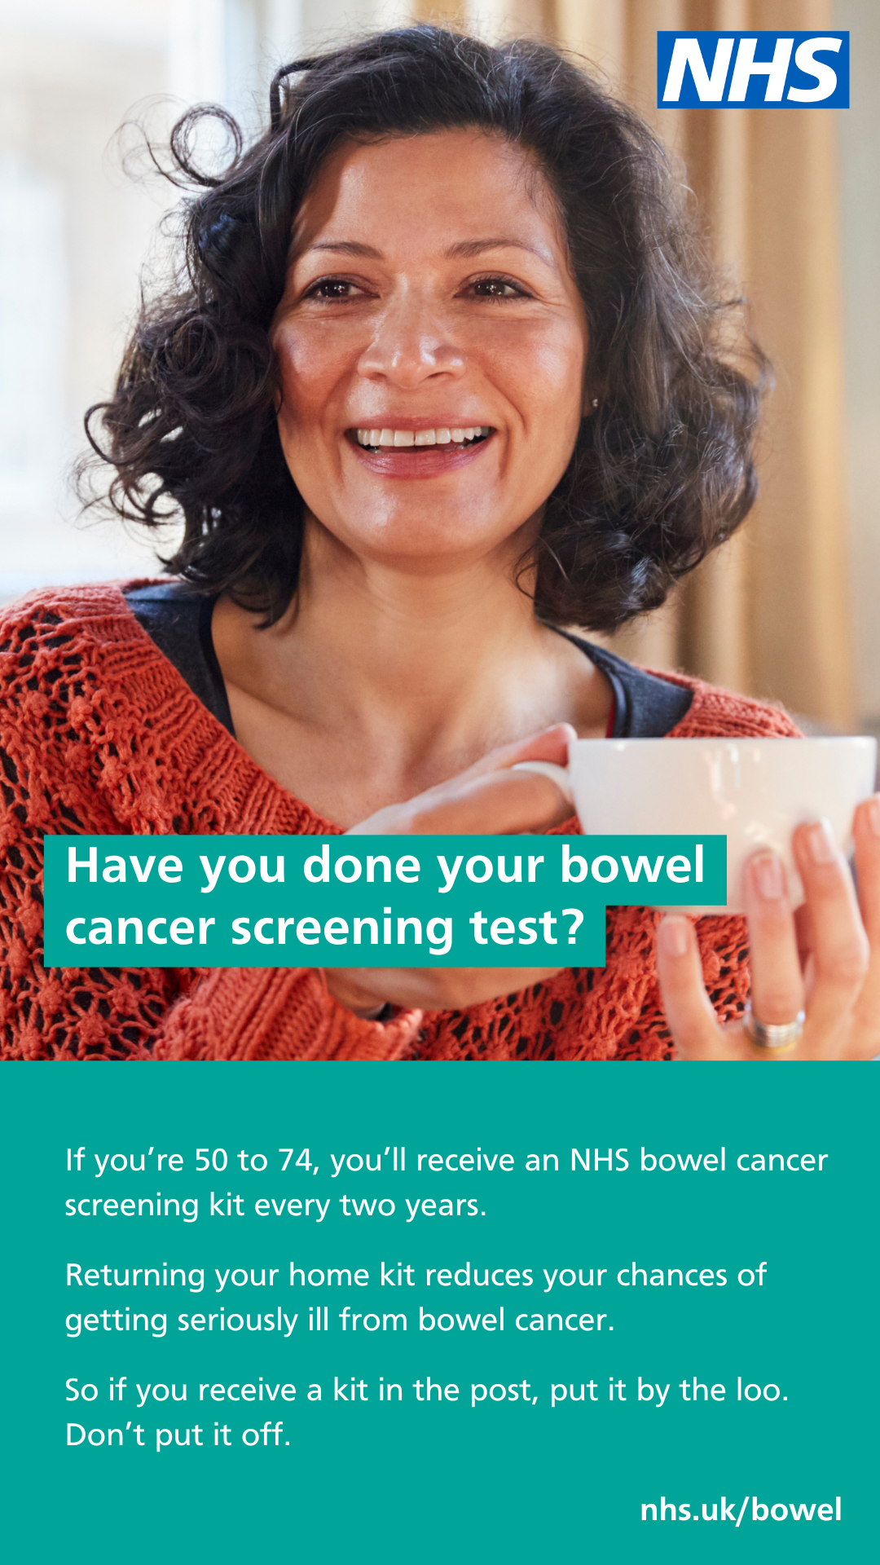
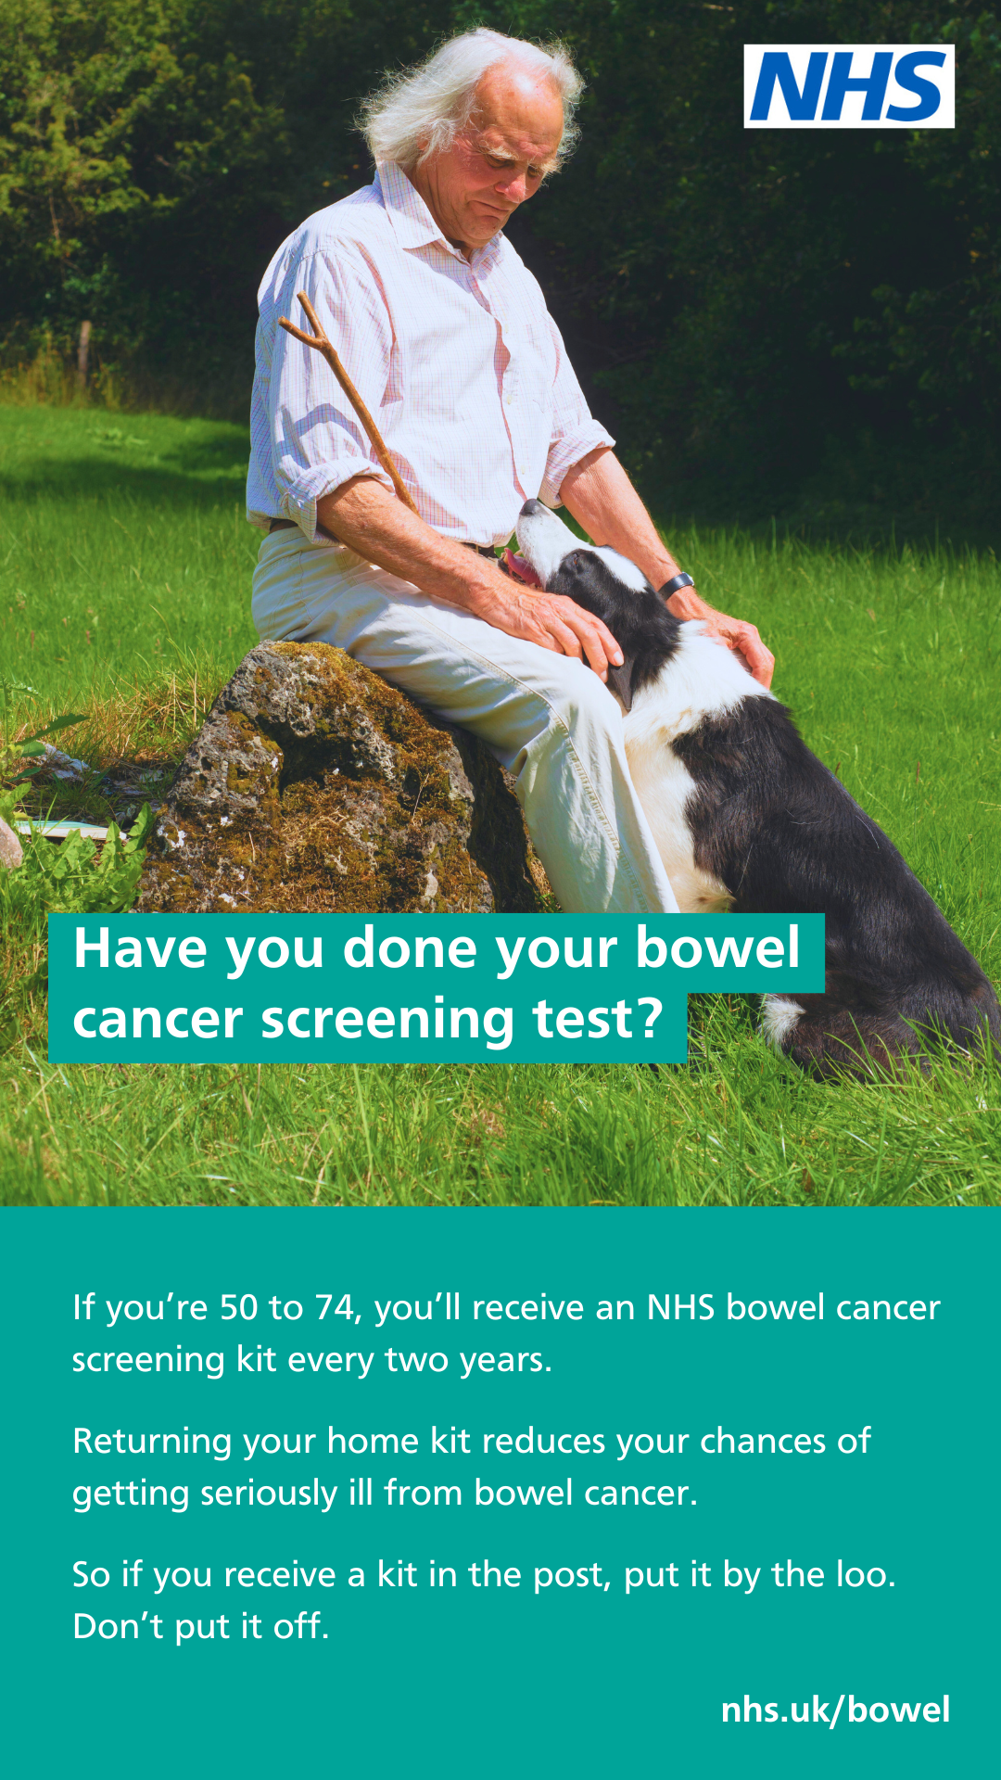
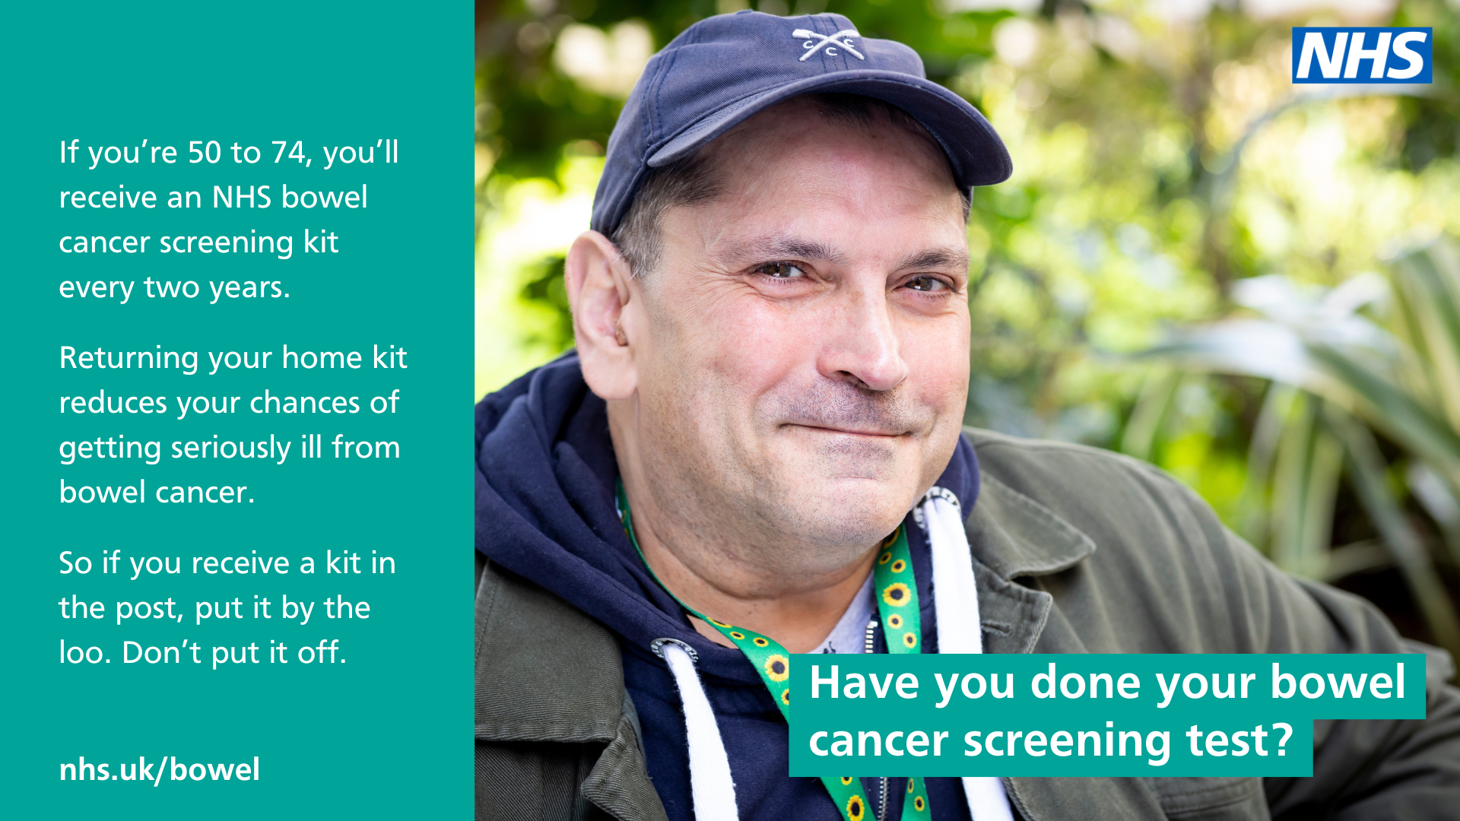
Digital display screen assets
For screens in public areas including GP and hospital waiting rooms
Download a selection of display screens on CommsLink,
Future NHS or the Campaign Resources Centre

Slide 12
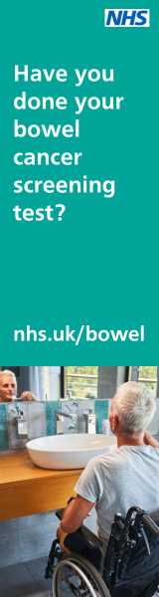


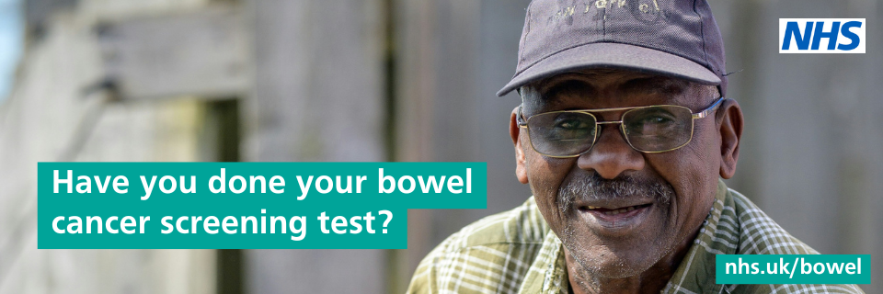
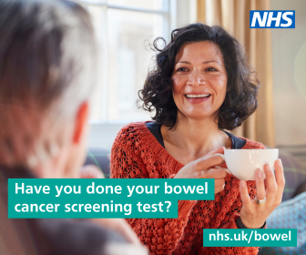
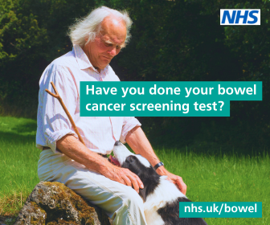
Web banners
In various sizes to encourage people to consider screening

Slide 13
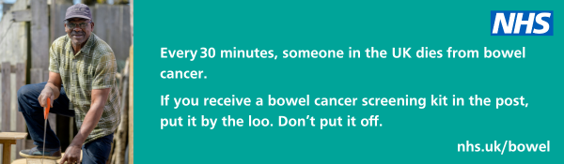
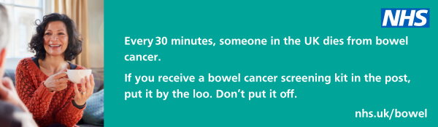
Email signature banners
Include a banner in your email signature to promote the uptake of screening
Download assets on CommsLink, Future NHS,
or the Campaign Resources Centre

Slide 14
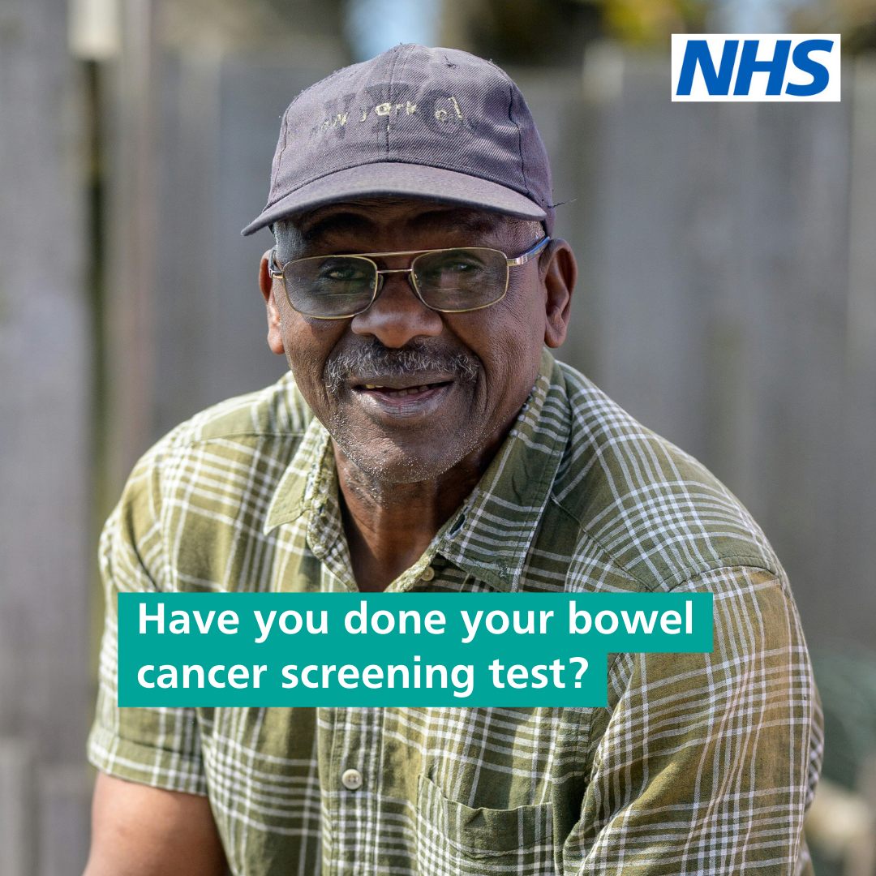
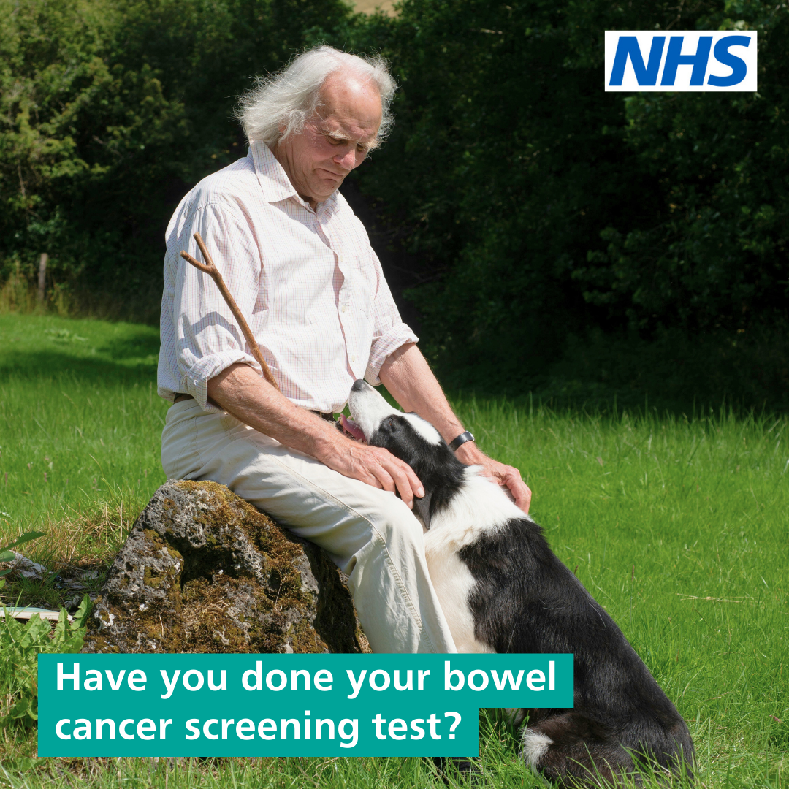
Social media assets
Suggested text to accompany these social cards are on the next slide
Download a selection of social cards on CommsLink,
Future NHS, or the Campaign Resources Centre

Slide 15


Example posts
Suggested text to accompany the social media assets on the previous slide
If you’ve had a #BowelCancer testing kit through the post, don’t forget to send it back. Your next poo could save your life. Find out more: nhs.uk/bowel
If you’re 50 to 74, the NHS will send you a #BowelCancer testing kit. Catching bowel cancer early reduces your chances of getting seriously ill from it. So, don’t just leave it in the back of a drawer - send it back today. Find out more: nhs.uk/bowel

Slide 16
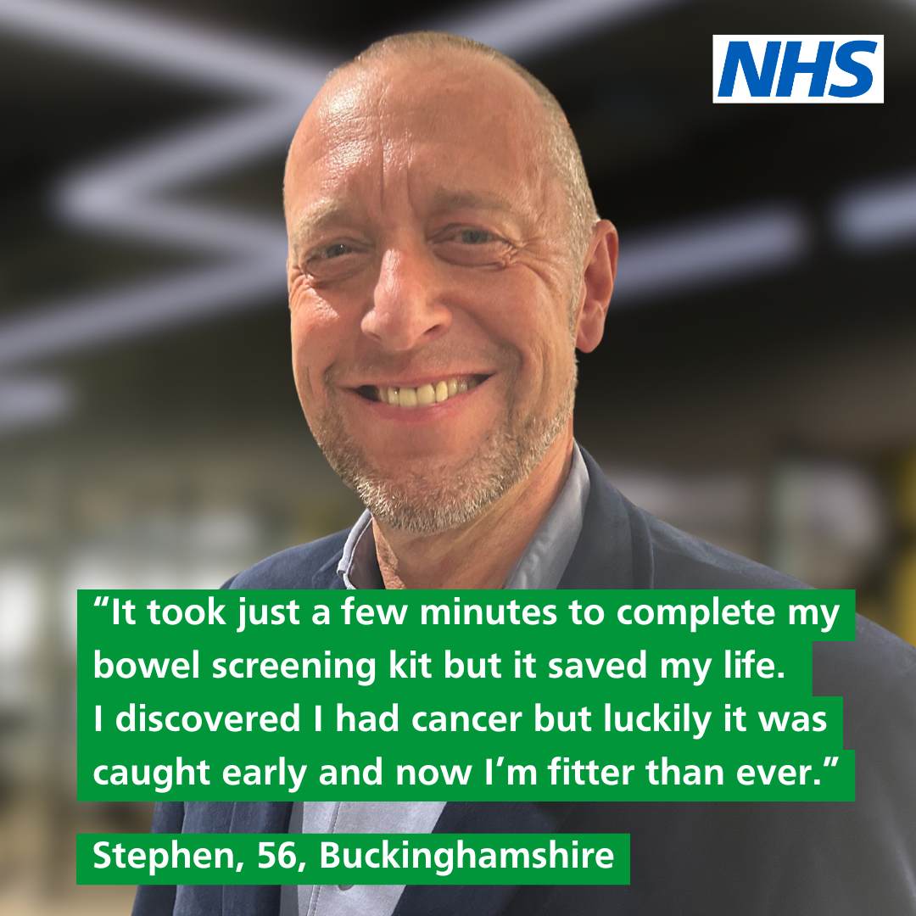
Case study - Stephen
Share Stephen’s story to encourage people to take up the offer of screening
“I’ve always been in good health and eaten well so I never thought I’d get cancer. But I did.
When I received an NHS bowel screening home test kit in the post I made sure I completed it.
I assumed everything would be ok… but a couple of weeks later I was invited for a colonoscopy and they found a malignant tumour in my bowel. I couldn’t believe it - I had no symptoms.
It turned out I had stage 2 bowel cancer. I was devastated.
Soon after, I had bowel surgery. It was successful and luckily the cancer hadn’t spread. I’ve recovered and have started boxing. I feel as fit as I was before my diagnosis and surgery.
If you do have bowel cancer, finding out early is crucial because the sooner it’s found, the better the outcome.
So, if you’ve got a test kit at home in the back of a drawer, do it today. The chances are there’s nothing to worry about. But it might just save your life!”

Slide 17
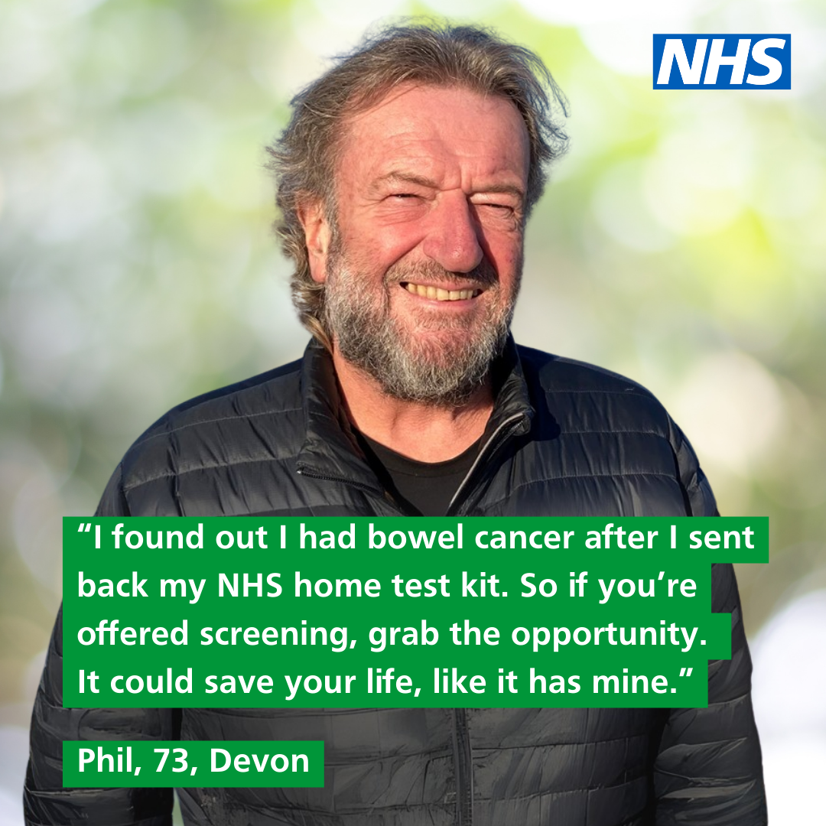
Case study - Phil
Share Phil’s story to encourage people to take up the offer of screening
“I was 69 and in the best of health. I had no symptoms. I did wonder if my poo was
looser and a bit more frequent, but the change wasn’t alarming.
I was due my bowel screening test and usually got a letter a few weeks later saying everything’s fine. Not this time. Very quickly I had a colonoscopy appointment at the Royal North Devon Hospital.
I discovered that I had stage 3 lower rectal adenocarcinoma spreading into two or
more local lymph nodes.
Treatment was chemotherapy and radiotherapy five days a week, for six weeks.
I had three big operations. As the stoma nurses say, ‘We take a year of your life –
and then give you back your life.’
Looking on the bright side is the most important advice I could give anyone.
Depression, worry and fear is as much an enemy as the cancer itself.
If you’re nervous about bowel screening I’d say why are you waiting? Grab the opportunity. It can save your life. Symptoms or not, put your mind at rest. It’s a no-brainer.
Now my stomas have been removed. I had one of the worst stages of cancer but
thanks to screening, I’m clear of cancer, and I’m here.”
.

Slide 18
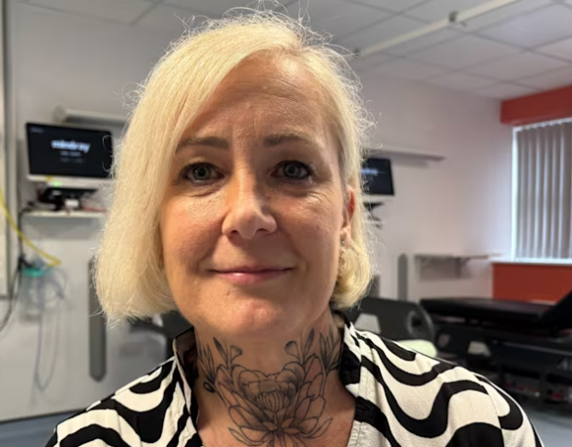
Case study - Grace
“I truly believe the NHS bowel cancer screening programme saved my life. I’m 54, fit and healthy — a non-smoker and non-drinker who regularly runs, swims and lifts weights — and I had absolutely no symptoms.
“My husband had completed his screening kit around six months before mine arrived in the post in August 2025. His result was normal, so when I sent mine off,
I expected the same outcome. But within a week, I received a call from a nurse at Royal Cornwall Hospital. My FIT test had come back positive, with traces of blood found in my stool. I would need a colonoscopy.
“During the colonoscopy in September, several polyps were found and a biopsy confirmed that one contained cancer. When the hospital called asking me to come in to discuss the results, I already knew it wasn't good news. My whole world fell apart. I had my first ever panic attack and could only think about how I was going to tell my husband and two sons.
“But later scans brought me some relief. The cancer was confirmed as stage 1 — it hadn’t spread to other organs. In November, I had an anterior resection to remove the cancerous polyp, along with a temporary ileostomy to allow my bowel to heal. I’ll have annual colonoscopies for the next five years.
“My physical recovery has been good, which I put down to my fitness, but the emotional impact has been much harder so I’m having weekly counselling. I still feel very shocked about the diagnosis and having to deal with the stoma is a constant reminder. But I was very lucky that it was found early and has been dealt with.
“So my message to anyone who receives a bowel cancer screening kit is simple: please do it. You have nothing to lose, and it could save your life.”

Slide 19
Bowel cancer screening example copy
Suggested newsletter text to encourage people to take up the offer of screening
Is your bowel cancer screening kit sitting at the back of a drawer?
If you’re 50 to 74, you should have received your NHS bowel cancer screening (FIT) kit through the post. That’s because the NHS automatically sends a kit every two years to everyone in that age range.
Out of every 5,000 people who use their test kit, nine turn out to have cancer. But if it’s spotted earlier, the chances of recovering from bowel cancer are higher.
The test can be done in the comfort of your home and only needs a tiny sample of poo to test for signs of cancer.
April is Bowel Cancer Awareness Month so there’s no better time to dig out the bowel cancer testing kit that you hid in that bottom drawer or look out for it in the post. And then put it by the loo. Don’t put it off.
Find out more about bowel cancer screening at nhs.uk/bowel.
Notes:
Exampl

Slide 20
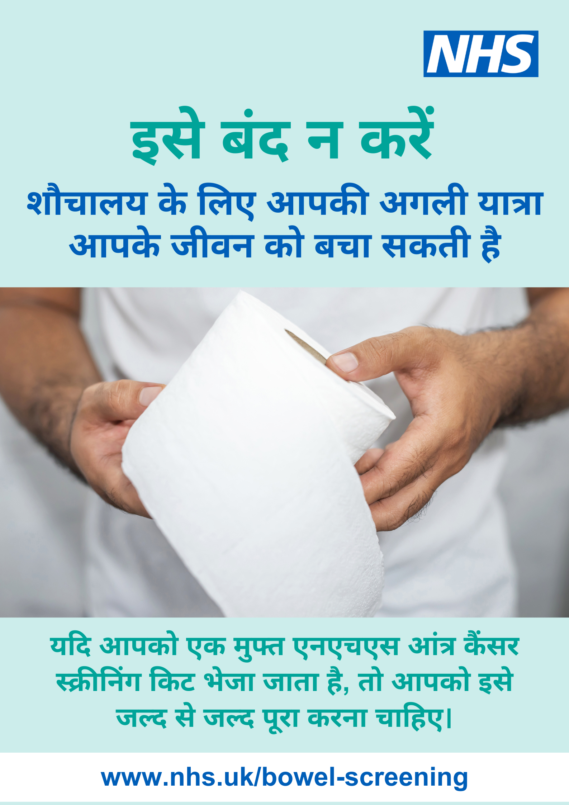

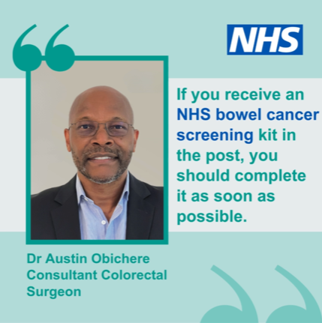
Translated bowel cancer screening materials
Available in 12 languages to encourage uptake in underserved communities
Social media post in English, Arabic, Bengali, Farsi, Gujarati, Hindi, Polish, Punjabi, Romanian, Somali, Turkish,
and Urdu.
Posters in English, Arabic, Punjabi, Bengali, Farsi, Gujarati, Hindi, Polish, Romanian, Somali, Turkish and Urdu.
Download these materials on CommsLink

Slide 21
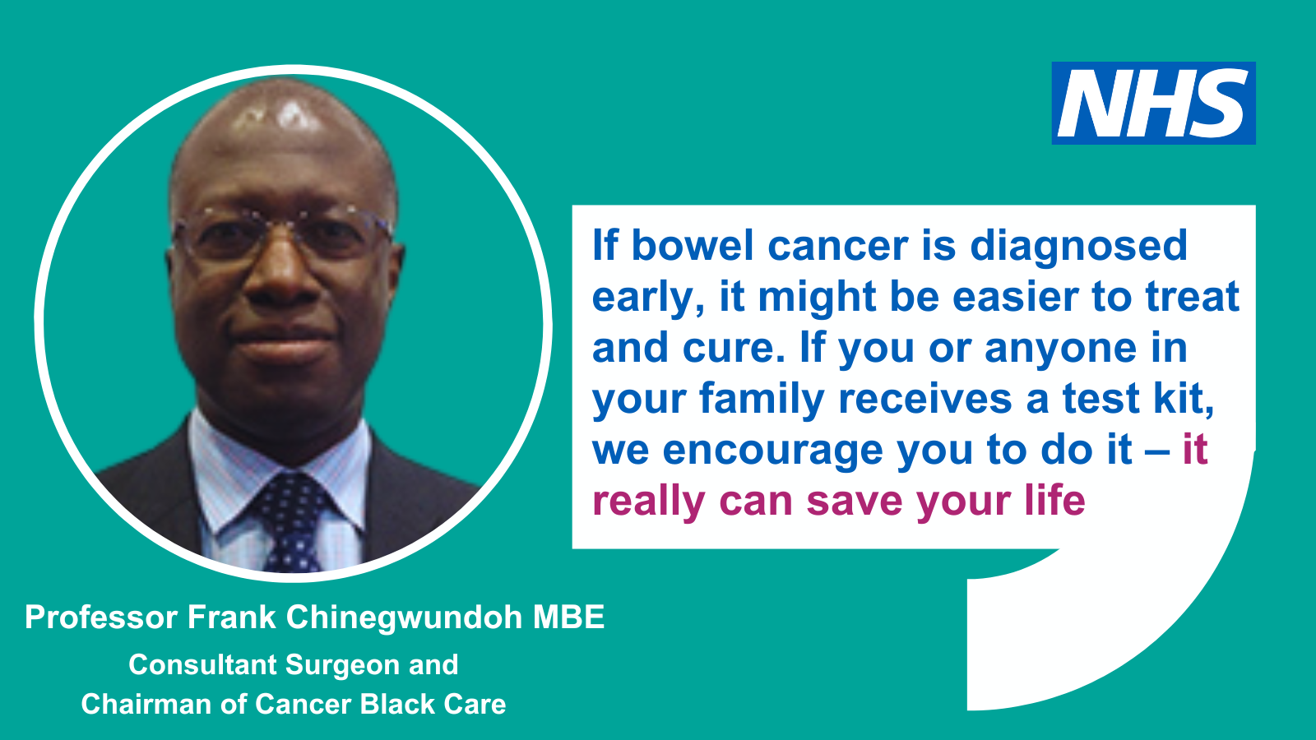
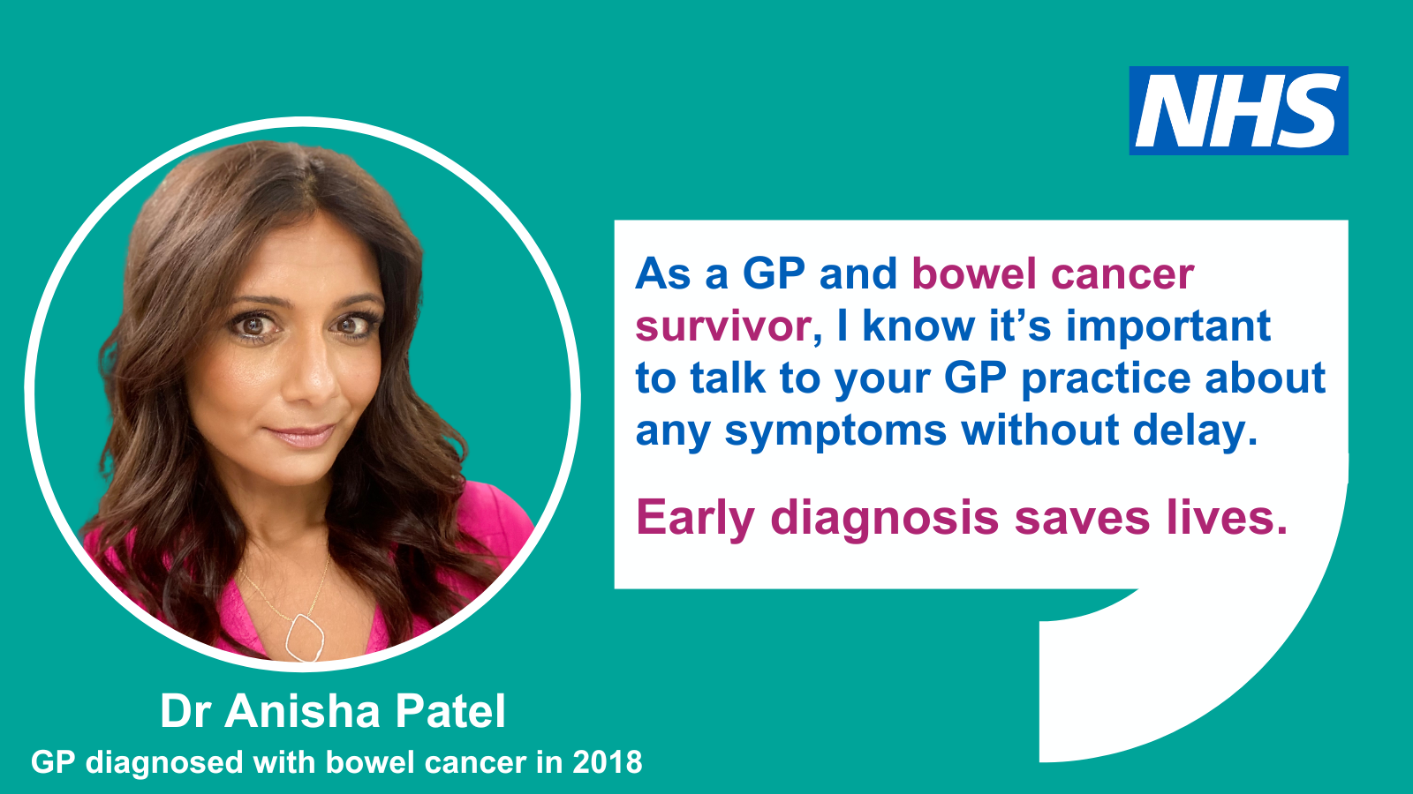
Social media quote cards
These quote cards can be downloaded from CommsLink and shared to reinforce wider messages about bowel cancer and the importance of screening.

Slide 22







Articles on bowel cancer and screening
These articles have been published in the publications listed below to encourage screening uptake across several communities.
Weekly Desh (Bengali)
Potrika (Bengali)
Daily Jang (Urdu)
Asian Express (English)
Asian Standard (English)
Asian Leader (English)
The Voice (English)
Le Petit Journal (French)

Slide 23
Useful links
Bowel screening information – nhs.uk/bowel
Bowel cancer symptoms – nhs.uk
Bowel cancer screening leaflet – gov.uk
Lynch-syndrome leaflet – gov.uk
Future NHS bowel cancer screening folder
CommsLink bowel screening folder
GP interview on bowel cancer for black and Asian radio stations on CommsLink
Talking about bowel movements isn’t embarrassing – it can save our lives, blog post by Dr Anisha Patel
Bowel Cancer UK Bowel Cancer Awareness Month toolkit
Cancer Research UK bowel cancer pages
Macmillan Cancer Support Bowel Cancer Awareness Month page
The bowel cancer screening social media cards, posters, digital screen assets and email signatures in the previous slides are available on CommsLink, Future NHS, and the Campaign Resources Centre.

