Slide 1


Review of Service Improvement Investment & Future Recommendations

Slide 2

Report to the Wessex Cancer Alliance Board
Title: | Review of Service Improvement Investment & Future Recommendations
Sponsor | Sally Rickard
Author | Kelly Spiller – Head of Faster Diagnosis
Date: | 13th September 2023
Purpose | Assurance or reassurance | Approval X | Ratification | Information
Summary of paper: | The current, temporary, staffing resource to support improvement work under the Faster Diagnosis Programme across Dorset and Hampshire & IOW was agreed in June 21 with staff starting in post from March 22. The agreement was for a two-year pilot from March 22 through to March 24 and therefore now is in the final 6 months. (To note some posts run past this date due to recruitment timescales.) There is a need to determine what the on-going, permanent resource in place of this temporary configuration will be for Faster Diagnosis. This paper provides a review of impact and outcomes from current, fixed term, service improvement provision and recommends a future permanent configuration of support for discussion and approval. Board is asked to decide on future resourcing for the Faster Diagnosis Programme so that recruitment can be undertaken to ensure sustainability of delivery within the programme as fixed term arrangements start coming to an end.
Implications: (Clinical, Organisational, Governance, Legal?) | Organisational
Key risks and mitigations: | There is a risk to delivery in the Faster Diagnosis Programme against key performance metrics, the Faster Diagnosis Framework and national, regional and local planning requirements and objectives without adequate capacity retained in the programme to undertake required improvement associated work.
Summary: Conclusion and/or recommendation | It is recommended that the Board agree: To put in place a permanent service improvement resource to enable the work required within the Faster Diagnosis Programme. To endorse the approach outlined in the paper.

Slide 3
Context
In June 2021 Board approved a proposal to put in place a temporary pathway improvement resource to support work across both Dorset and Hampshire and Isle of Wight.
This was to enable to Wessex Cancer Alliance to:
  Support initiative to improve performance
  Support work to improve services
  To deliver against mandated national requirements e.g. implementation of NSS pathways and best practice timed pathways
  Ensuring pathway work supports improved patient experience and outcomes and reduced inequity
  Introduce, implement and follow consistent methodology and approach to improvement work.
  Foster collaborative working and share best practice and lessons learned across the Wessex geography

Slide 4
Approach Adopted 2022 - 2023
Following approval of the paper recruitment was undertaken with staff coming into post from March 2022 onwards.
The following posts were recruited to and all funded via the Faster Diagnosis budget (which includes the NSS budget):
  Post spanning Dorset and Hampshire & IOW
    Programme Lead 8a
    Project managers x 3 B7
    Project Supports x 2 B6
  Dorset specific posts:
    Programme Manager 8a
    Project Officer B5

Slide 5
Benefits, Outcomes & Impact Summary
Consistent documentation and methodology developed and embedded drawing on those used nationally, regionally and locally to develop a local best practice approach.
Approach includes a focus and commitment to ensuring inequity identified and addressed as part of each piece of work and commitment to undertaking appropriate patient and public engagement.
Specific pieces of pathway work undertaken (some still in progress) for Gynaecology; Breast self-referral; Radiotherapy; Non-Specific Symptoms; Lumps and Bumps; Head and Neck; Sarcoma; Brain & CNS; HPB; Testicular self-referral; Prostate; Breast Reconstruction; and dermatology.
*Details available on scope, status and outcomes
Approaches to collaborative working modelled with best practice and lessons learned collated and shared. For example compendium developed of learning points from breadth of gynaecology pathway work and shared across Trusts.

Slide 6
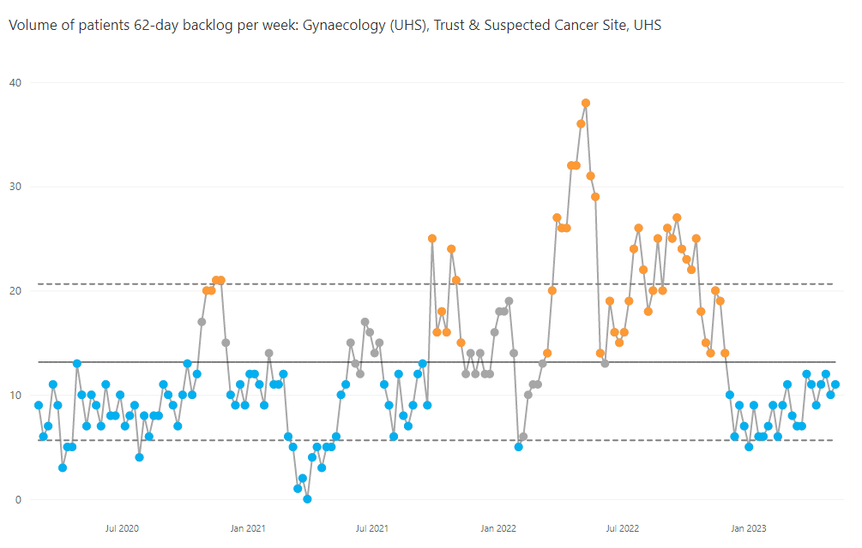
Examples of Impact & Outcomes
UHS Gynae Pathway Triage Project
A piece of work was initiated in response to growing performance challenge against first seen, 28 day and 62 day standards.
An approach to triage was designed piloted and then implemented along with the introduction of a patient navigator and tailored patient information led by an improvement team project manager.
The graph below shows the increasing backlog for gynae leading up to the implementation of triage and then the resulting and sustained reduction following

Slide 7
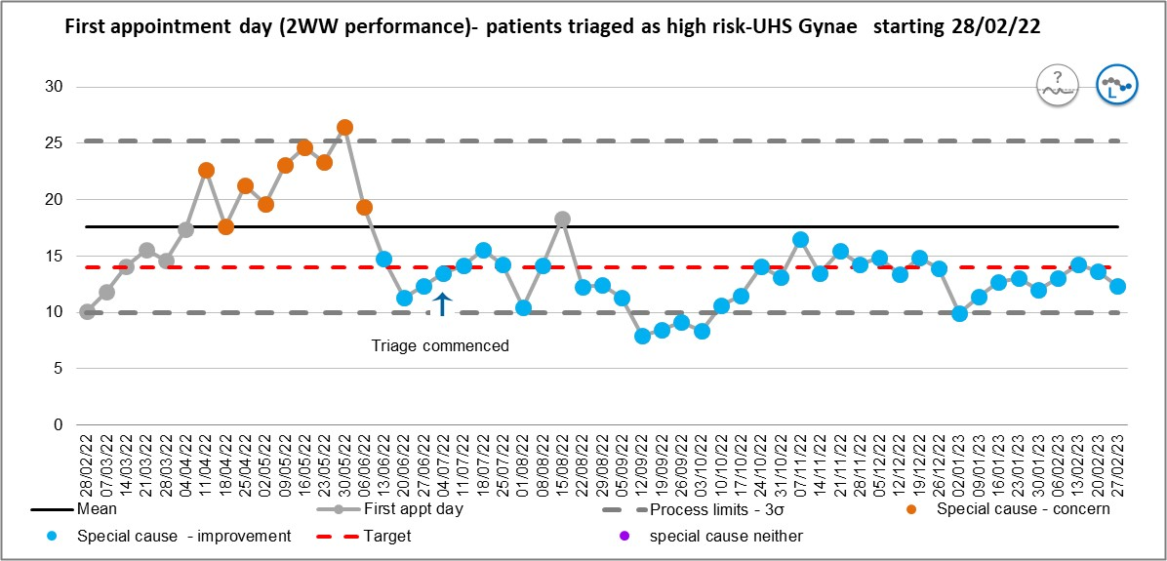
Examples of Impact & Outcomes
The graph below shows the increasing wait for first seen for gynae leading up to the implementation of triage and then the resulting and sustained reduction following
From starting in post 9 months ago they have allocated approximately 0.6WTE of their time to looking at gynaecology pathways.
The cost value of this circa £24,764 inclusive of on costs.

Slide 8
Examples of Impact & Outcomes
Gynaecology Pathways
Focused pathway work has been led by an improvement team project manager at three of the 6 Wessex Trusts including University Hospital Southampton NHSFT, Portsmouth Hospitals University NHSFT and University Hospitals Dorset NHSFT.
A document has been developed from this work collating areas of focus, common challenge and themes and examples of best practice implemented which has been shared with other Trusts.
In addition some of the common themes have been drawn together and have resulted in some further pan Wessex focussed work on gynae pathways, currently being discussed by the Clinical Reference Group and Site Specific Groups, which are looking at:
  A new management pathway for people presenting with post menopausal bleeding on HRT linking with the direct access for GPs agenda and Community Diagnostic Centres.
  This work aims to reduce suspected cancer referrals, to provide GPs with clear advice on management for this cohort of people and increase access to imaging to provide early, appropriate reassurance.
  A new management pathway for people with a raised Ca125 and negative USS linking with the non-specific symptoms pathway.
  This work aims to provide a clear management route for a cohort of patients who currently don’t neatly fit with existing criteria and management routes and therefore to speed up diagnosis.

Slide 9
Gynaecology: A Worked Example
Next Steps
Following discussions as appropriate via the Clinical Reference Group and Site Specific Group meetings pan Wessex pathways will be agreed for both people presenting with post menopausal bleeding on HRT and for people with a raised Ca125 and negative USS.
Engagement will then be undertaken as appropriate with each Trust and service to see what can adopted locally to support and enhance existing service offers based on these commonly agreed approaches.
Finally all learning and best practice will be collated and shared and of new pathways and pathway changes to identify any modifications or further evaluation required.
Trust Specific Work:
PHU: existing pathway reviewed and new pathway designed and implemented in August 2023 including triage and straight to test.
UHD: existing pathway reviewed and new pathway designed with planned implementation in October 2023 following governance approvals. This includes a new approach for people on HRT with post menopausal bleeding, GP direct access to imaging and collaboration with Community Diagnostic Centre partners.
UHS: existing pathway reviewed and new approach to triage designed, implemented and evaluated, now forming part of business as usual service delivery for the speciality.

Slide 10
Examples of Impact & Outcomes
Sarcoma Pathway Review
This work is ongoing and plans to review the pathway end to end across the Wessex geography working towards equity in access and experience for patients and transparent processes to support the flows to tertiary centres.
The improvement team have undertaken a review with each Trust on current provision and are also working with commissioning colleagues to unpick the current commissioning arrangements as part of being able to re-design this pathway.
To date the work has explored the front end of the pathway and as a result training is being undertaken on the Isle of Wight to enable USS scans to be available on the Island for patients which was previously an unmet need.
This will mean access is available to people locally to have scans and will reduce the numbers of people declining investigations of having them late due to the need to travel.
This will also mean that the diagnostic pathway is faster.
This will also provide a clear access route for primary care.

Slide 11
Approaches Elsewhere
The national guidance continues to increasingly support the approach of having resource through Alliances to support and deliver improvement work and asks Alliances to develop resources for this.
The National Cancer Programme Planning Pack for 23/24 states:
‘Alliances should also have the relevant expertise to directly support systems/providers in understanding the drivers affecting performance and be able to offer hands on management support. This should include practical support and advice to trusts on the management of Cancer PTLs, including sharing of best practice and facilitating peer review of services to identify improvements. Where this capability does not already exist, Cancer Alliances should develop it over the course of 2023/24.’ ​ ​ ​
​
Regionally and nationally Alliances in response are moving towards developing roles and teams to provide service improvement input and support across their systems and providers.

Slide 12
Provider Feedback
‘Excellent project support. Made a tangible difference to what we were able to deliver. A great resource’
‘There are teams within partner organisations that are often better placed to manage projects than we are ourselves. They hold all the skills and may have a time resource when we are challenged. Allowing and encouraging this shared working can be beneficial to the project and patients.’
‘Support has been provided to, chair the meetings, ensure momentum and offer further support to the QI bundle. This has been additionally beneficial as it has moderated behaviours within the group to enable discussion to remain on-topic and a more positive outcome. …. Has prepared for all the meetings, followed up on actions, and ensured the project had clear objectives maintained throughout. I am very grateful for this.’
‘Gynae work has been positive and helpful. Good project management support, just sometimes challenging when all of the actions for delivery still come back to the operational teams.’

Slide 13
Proposal
A pan Wessex Service Improvement Team to be recruited on a permanent basis to support Trusts across Dorset and Hampshire & IOW.
To reconfigure current temporary roles and recruit to a permanent team comprised of:
  2 x B8a Programme Managers (£128,618)
  3 x B7 Project Managers (£173,796)
  1 x B6 Project Support (£46,806)
  Total investment required annually*: £349,220
This will provide one central improvement team allowing further adoption of consistent methodologies, approaches and reporting, as well as greater opportunities for collaboration and sharing of best practice.
This proposal would allow scope to offer support into all 6 acute provider pathways and to cover multiple tumour sites throughout a years planning.
Resourcing is reflective of locally identified need to support planning and implementation alongside providers and also in response to national planning ask that Alliances configure themselves to be able to provide this.
*Costs based on 23/24 pay scales at mid-point including on costs

Slide 14
Recommendation
Total funding ask £349,220, recurrent
This would be drawn from the Faster Diagnosis Programme budget allocation
It is recommended that the Board agree:
To put in place a permanent service improvement resource to enable the work required within the Faster Diagnosis Programme.
To endorse the approach outlined in the paper.

