Slide 1


MSc prehabilitation and rehabilitation for people living with cancer module
Jo McNamara
Senior Lecturer and Module Leader

Slide 2
Module Aim
The aim of this module is to develop specialist knowledge and skills to implement prehabilitation and rehabilitation interventions across the pathway to help patients living with cancer manage side effects from cancer treatments.

Slide 3
By the end of this module students will be able to;
Critically appraise the evidence base for a range of prehabilitation and rehabilitation interventions for managing side effects from a variety of cancer treatments.
Analyse and evaluate the factors and processes that facilitate effective collaboration within a multidisciplinary team, which encourages the creation, implementation and maintenance of prehabilitation and rehabilitation services.
Critically appraise the service and the service environment through engaging with practice-based situations, identifying the relevance of contemporary policy drivers for the safe implementation of integrated service delivery of prehabilitation and rehabilitation interventions to manage treatment side effects.
Use a variety of models, reflect upon your learning during this module and self-assess your knowledge, skills and attitudes, around implementing effective pathways for patients living with cancer accessing prehabilitation and rehabilitation services to minimise treatment side effects.

Slide 4
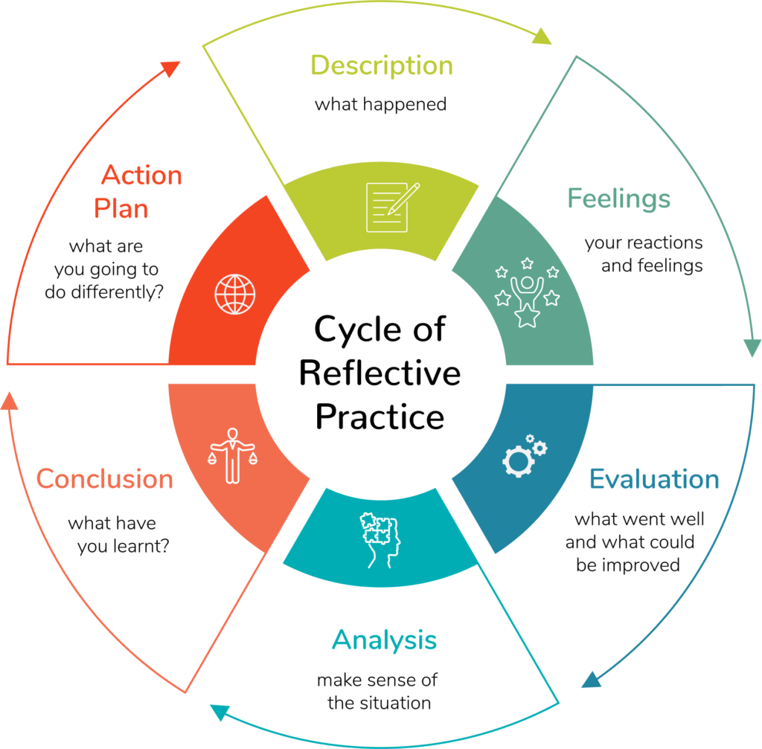
Assessment
Task 1: Students are required to submit a 2,000 word reflective report outlining your workplace project.
Task 2: Produce a 15 minute presentation to be presented to key stakeholders and with permission made available on e-learning for health.

Slide 5

Module Delivery
4 face to face days at the Advanced Wellbeing Research Centre in Sheffield (this has its challenges)
A series of webinars delivered across the module from experts in the field; Research methodologies, late effect clinics, motivational interviewing etc.
E-learning PRosPer modules
Macmillan Toolkit
Action Learning Sets

Slide 6
So far.....
34 students are on the module
15 Macmillan funded students
8 self-funded
11 funded through their trust/organisation

Slide 7
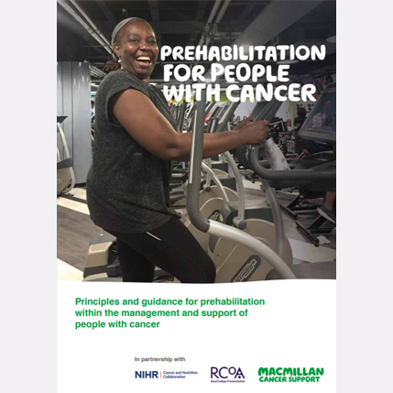
How is it going?
Highly motivated and passionate students
All experts in their field
Sharing and disseminating information and knowledge within ALS
Service design and implementation is featuring far more heavily than anticipated
The students hope to present at the end their final service design proposals

Slide 8

Mid Module Review
Informal mid module review
Via the discussion board and also a Google form
Permission gained to share
So far 10 people have responded

Slide 9
What has been the best aspect of the module so far?
‘Access to learning resources which are focused and directed to ensure you are getting what you need from them. How interactive the course is despite being distance learning.’
‘Meeting so many people in the throes of setting up prehab/rehab clinics and support. Tapping into Jo’s knowledge is priceless. Supporting each other and using others knowledge of how to do things and avoid pitfalls is so useful.’
‘The interdisciplinary working and learning.’
‘The quality of the teaching is great, very interactive and thought provoking. There are a lot of additional resources provided which are all amazing!’
‘The learning resources are excellent. Also being grouped into ALS is a fantastic way to support each other when distance learning. Unfortunately I was unable to attend the race to face days but have read the presentations which were really helpful.’

Slide 10
How could the module be improved?
‘More face to face, often having too watch webinars at different times but really helpful they're recorded which allows us to do that.’
‘I do feel that there is an awful lot of content within this module considering the short time frame. This could be addressed by making it slightly longer, if the content cannot be reduced.’
‘Perhaps a little more guidance on the work we are meant to be doing for our final project.’
‘Time frames feel short and feels an incredible amount of work for the number of credits. (I don't mind as I am loving the work and just want to use the module to be better at my job, but if you have budgeted headspace, you need more..!)’
‘Could have more clinical elements such as exercise physiologist session on exercise prescription from real life scenarios.’

Slide 11
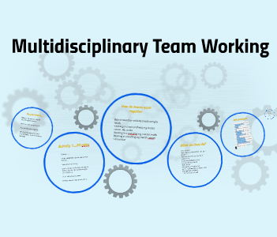
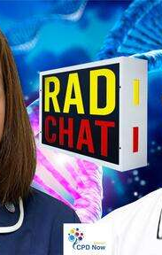

Unexpected Consequences of delivering the module
Networking
Creation of resources from the students themselves!
Wider dissemination of patient prehabilitation and rehabilitation
Increasing knowledge of other professionals and services available
Increase in confidence
Publications
Engagement with Macmillan
My own professional development, which then feeds into pre-registration teaching

