Slide 1



PRosPer
Performance stats
27.05.22
Evaluation survey feedback and performance stats
@NHS_HealthEdEng @HEE_TEL #HEETEL

Slide 2
Tableau Reporting statistics

Slide 3
Introduction to prehabilitation, rehabilitation and personalised
care
Launches 1111
Unique users 539
Completed 308
Prehabilitation in Cancer Care
Launches 542
Unique users 298
Completed 234
Rehabilitation across the cancer pathway
Launches 388
Unique users 207
Completed 158
Components of personalised care and planning support
Launches 193
Unique users 102
Completed 45
Approaches to prehabilitation screening, assessment and interventions
Launches 105
Unique users 61
Completions 43
Cancer rehabilitation and
symptom management Cluster 1
Launches 87
Unique users 53
Completed 44
Cancer rehabilitation and
symptom management Cluster 2
Launches 88
Unique users 45
Completed 46
Cancer rehabilitation and
symptom management Cluster 3
Launches 82
Unique users 60
Completed 42
Notes:
Intro – 57% Pass rate
Prehab in cancer care – 79% Pass rate
Rehab across the cancer pathway – 76% Pass rate
Comp of personalised care - 44% pass rate
Approaches to prehabilitation screening, assessment and interventions – 70%
Cancer Rehab cluster 1 – 83% pass rate
Cancer Rehab cluster 2 – 98% pass rate
Cancer Rehab cluster 3 – 70% pass rate
Evaluation stats
Launches 151
Users 123
Completions 96
Completion percentage 78%
Evaluation Survey – 72% Completion rate

Slide 4
Roles accessing the sessions

Slide 5
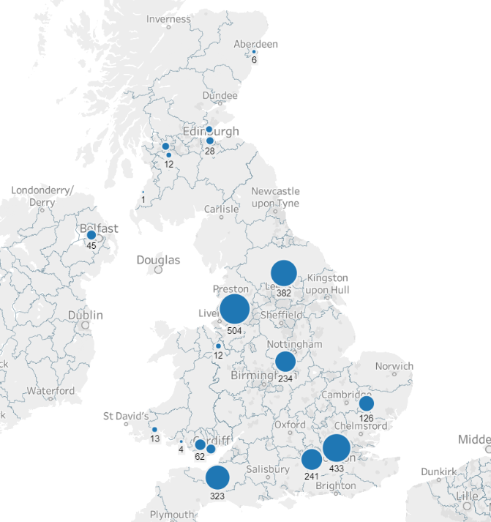
Launches by location
England 2243 82%
Scotland 96 3%
Unknown 229 8%
Wales 135 5%
Northern Ireland 45 2%
Total 2748**
*Highest launches made from a single
Area – 504 (265 hours)
** Does include evaluation launches

Slide 6
Tableau statistics

Slide 7
Intro to prehab,
re-hab and
personalised care
Content 4.8
Interactivity 4.8
Presentation 4.7
Self assess 4.8
Overall rating 4.8
Prehab in cancer care
Content 4.9
Interactivity 4.6
Presentation 4.8
Self assess 4.8
Overall rating 4.8
Rehabilitation
across the cancer pathway
Content 4.9
Interactivity 4.9
Presentation 5.0
Self assess 4.6
Overall rating 4.9
Components of personalised care and support
planning
Content 4.7
Interactivity 4.9
Presentation 5.0
Self assess 4.9
Overall rating 4.9
Approaches to prehabilitation screening, assessment and interventions
Content 5.0
Interactivity 4.4
Presentation 4.8
Self assess 4.8
Overall rating 4.8
Notes:
The feedback scores are collected after a user completes the session in the portal.
They have then the option to give some real time feedback.
Scoring is from 1-5 with 5 being outstanding/excellent.
Average scores are currently 4.5-4.7

Slide 8
Cancer rehabilitation and symptom management cluster 1
Content 5.0
Interactivity 4.8
Presentation 5.0
Self assess 3.7
Overall rating 4.6
Cancer
rehabilitation and symptom management
cluster 2
Content 4.8
Interactivity 4.6
Presentation 4.9
Self assess 4.3
Overall rating 4.7
Cancer
rehabilitation and symptom management
cluster 3
Content 5.0
Interactivity 5.0
Presentation 5.0
Self assess 5.0
Overall rating 5.0
Notes:
The feedback scores are collected after a user completes the session in the portal.
They have then the option to give some real time feedback.
Scoring is from 1-5 with 5 being outstanding/excellent.
Average scores are currently 4.5-4.7

Slide 9
How likely are you to recommend the programme

Slide 10
Notes:
How likely are you to recommend the session to a colleague, on a scale of 0 to 10, where 0 = not at all likely and 10 = extremely likely

