Slide 1
Maintaining Weight Throughout Cancer Treatment
Jennifer Van Zant MCN RD
Senior Dietitian in Oncology
Isle of Wight NHS Trust

Slide 2
Objectives
Managing weight throughout treatment
Cancer cachexia​
Food fortification
General advice

Slide 3
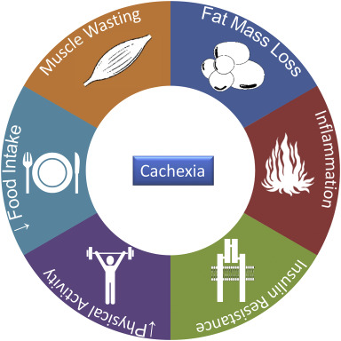
Cancer Cachexia
What is it?
How can you identify it?
Notes:
Furthermore, cancer cachexia is associated with psychosocial effects impacting on both patients and their families/carers, including loss of independence, conflict with family members/carers over food, social isolation, and a range of negative feelings including failure, helplessness, anxiety, distress and a loss of a sense of self

Slide 4
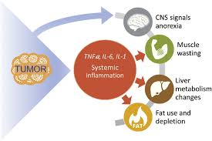
Cancer-associated cachexia
What is it?
What contributes to it?
Many factors, including inflammation, poor appetite and tumour effects, contribute to muscle loss, and often fat loss. Which leads to decreased functionality and quality of life.
Break down effects of tumour and inflammation
Changes in the way the body uses protein, carbs, and fat
Inadequate intakes due poor appetite
Reduced intakes due to side effects of treatment
Pain, anxiety, depression
Notes:
Unintended weight loss. They lose weight because they eat less due to a variety of reasons. At the same time, their metabolism changes, which causes their body to break down too much muscle. Both inflammation and substances created by tumors can affect appetite and cause the body to burn calories more quickly than usual.

Slide 6
Consequences of Malnutrition
Decreased
Increased
Response to chemo
Survival
Performance status & muscle function
Quality of Life
Immune function
Complications
Hospital stay or length of hospital stay
Morbidity and Mortality
Healthcare Costs

Slide 7
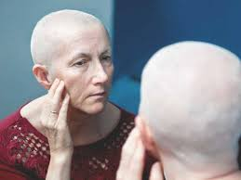
Malnutrition: How can you help identify it?
Ask. . .
Have you unintentionally lost weight?
Have you been eating less than usual?
Are your clothes/jewellery fitting more loosely?
Look . . .
Can you see obvious fat loss or muscle wasting (thinning)
This Photo by Unknown Author is licensed under CC BY

Slide 8
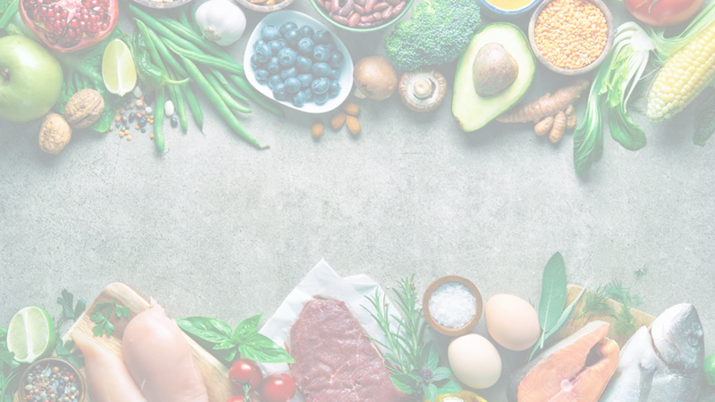
Maintaining Weight: A Food-based approach
3 meals per day, even if smaller portions ​
1-2 snacks​
1 nourishing drink

Slide 9
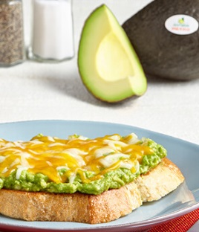
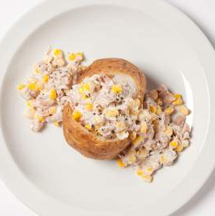
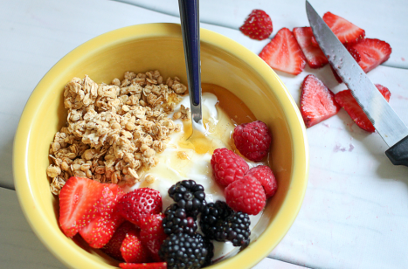
Food Fortification: Three meals per day
Choose foods high in energy and protein
Add food boosters to increase the energy & protein content without increasing volume.
If larger portions are overwhelming, aim to have 3 smaller meals a day.

Slide 10
Food Fortification: Food Boosters
Food Booster | Portion Size | Calories | Add to..
Double cream | Two tablespoons (30ml) | 140 | Mashed potato, puddings, sauces, soups, fruit salad, milky drinks
Cheese | Matchbox size (30g) | 120 | Mashed potato, vegetables, crackers, crumpets, sandwiches, toast
Butter | One teaspoon (10g) | 75
Oil | One tablespoon (15ml) | 120 | Pasta, salad dressing, mashed potato, use for frying
Peanut butter | One tablespoon (15g) | 100 | Crumpets, toast, sandwiches, banana, rice cakes
Jam/Honey | One tablespoon (15g) | 45 | Crumpets, toast, porridge, rice pudding
Full fat mayonnaise | One tablespoon (15g) | 100 | Sandwiches, salad, vegetables, potatoes
Milk powder | One tablespoon (10g) | 35 | Mix into yoghurt, custard, milk, milky puddings

Slide 11
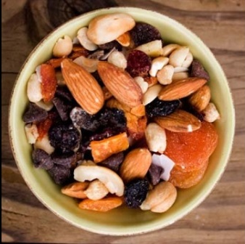
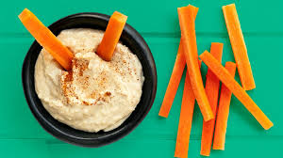
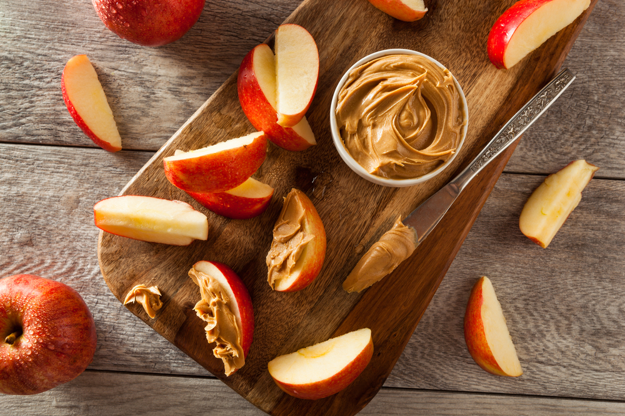
Food Fortification: One to Two Snacks
Have 1-2 nourishing snacks each day between meals or before bed.
Small, frequent meals and snacks can help prevent weight loss and promote weight gain.
About 100-150 calories | About 200 calories | About 300 calories
1 Small packet of crisps (25g) | 30g Cheese with 3 crackers | Pitta bread with 50g houmous*
3 Mini sausage rolls | ¼ Quiche (100g | 1 Small bag (50g) peanuts**
2 Scoops (90g) dairy ice-cream | ½ Avocado on 1 slice of toast | 40g Pâté on 2 slices toast
1 Boiled egg with 1 tbsp. mayo* | 1 Slice of cake | Sandwich (2 slices bread, butter, meat / cheese / egg)
2 Digestive biscuits | 1 Crumpet with butter & jam | 2 Slices smoked salmon + 60g cream cheese
150g Pot of rice pudding* | 150g Full fat yoghurt | 1 Scotch egg (113g)
5 Cocktail sausages* | 145g Pot of trifle | 1 Scone with butter & jam

Slide 12
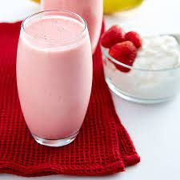
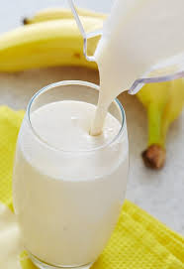
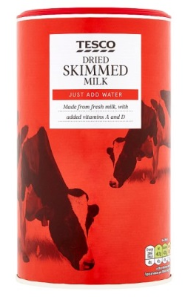
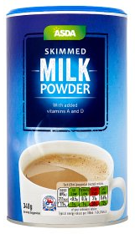
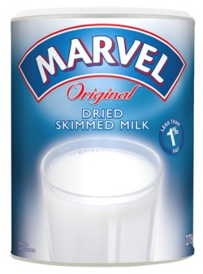
Homemade Nourishing Drinks
Fortified Milk Recipe
This can be used as normal milk.
1 pint of full fat milk + 4 tablespoons of dried skimmed milk powder
Can provide energy and protein, even as much as prescribed nutrition supplements
Hot chocolate, milky coffee, Horlicks, Ovaltine made with full fat milk

Slide 13
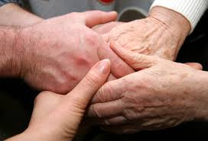
Advice
If your appetite is better at certain times of the day, try and eat more at these times.
Keep snacks that are ready to eat close to your chair, bed or in your pocket.
Serve smaller portions of your meal on a smaller plate to prevent feeling overwhelmed – you can always have more.
Try ready-made meals: they can be cooked quickly and do not take a lot of preparation.
Cook extra portions of meals in advance and freeze them for use another day.
Keep a stock of ready made or tinned foods in case you cannot get to the shops.
Have at least two nourishing drinks per day, e.g. milk, milky coffee, hot chocolate or malted drinks.
If you are able to get outside, gentle exercise and fresh air can help stimulate your appetite.

Slide 14
Be Proactive
Tell your medical team if you lose weight or don’t feel like eating.
See a registered dietitian who can help you establish a healthy diet and offer tips for what to do if your appetite flags.
Stay active—it can help improve your sleep, mood and fatigue, and it may help keep cachexia from advancing.
Be patient with loved ones who urge you to eat more. Cachexia is hard to watch from the sidelines.
Notes:
Key message for everyone

Slide 15
Thank you!

