Slide 1
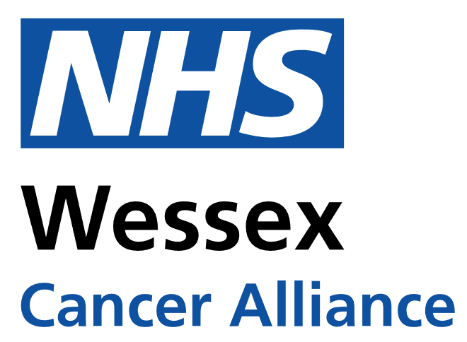
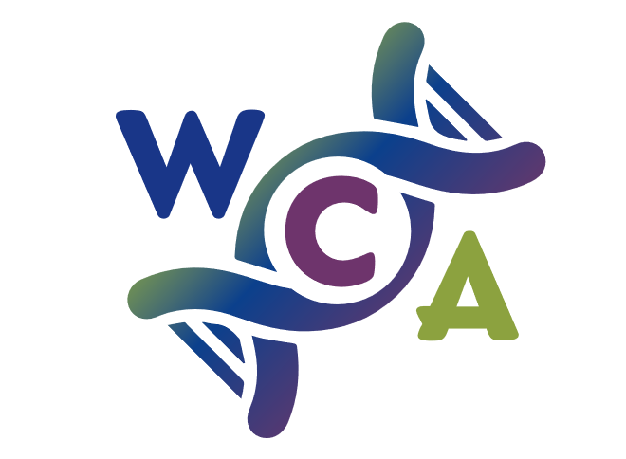
Advising and supporting patients with Cancer and Nutrition Kate Thomas- Specialist Gynae-Oncology Dietitian University Hospital Southampton
Notes:
I am going to cover some misconceptions of diets used for cancer that are present in the media, talk about the use of nutritional supplements, and how we use oral nutritional supplement in practice.

Slide 2
Misconceptions from the media- myth busting
The news of a cancer diagnosis is an extremely difficult time for both patients and their families. It can bring about many psychological, emotional, spiritual and physical challenges for those being treated for and living with and beyond their cancer.
It is understandable therefore that many will try to help fight cancer or alleviate treatment side effects through changing their diet.
Some diets may result in interactions with cancer treatments, nutritional deficiencies, weight loss and muscle loss.
Notes:
I will cover some common dietary myths that are currently in the media and the evidence behind why these are not justified.
Often aspects looked at in isolation.
Based on single study/ lab studies.
It is useful for you to know what these myths are so you can help dispel them and hopefully stop people following what are restrictive and unhelpful diets!

Slide 3
Myth busting- soya
Myth:
Isoflavones, found in soy products have a similar chemical structure to the hormone oestrogen. Oestrogen can stimulate some cancers, therefore it was thought foods containing isoflavones might have the same effect.
Facts:
Current evidence suggests that a diet containing naturally occurring Isoflavones is safe.
Soya foods can be used as part of a healthy balanced diet as a non-meat source of protein and provide fibre.
In fact, there is growing evidence that eating traditional soy foods such as tofu, tempeh, edamame, miso, and soymilk may lower the risk of breast cancer, especially among Asian women.
Notes:
This is because risk of breast cancer is increased by lifetime exposure to oestrogen, and long term consumption of soy can block these oestrogen receptors.

Slide 4
Myth busting- sugar
Myth:
Sugar feeds cancer cells.
Facts:
Cutting out sugar in diet does not restrict glucose (sugar) to cancer cells.
Sugars are found in a number of healthy foods including complex carbohydrates, fruits and vegetables. These are high in fibre, vitamins and minerals and have been linked with a lower risk of cancer.
It is recommended to reduce excessive sugar in the diet, particularly in the form of ‘free sugars’ or ‘simple’ sugars (for example those found in sugary drinks) as these are linked with being overweight.
Notes:
Reduced sugar intake results in gluconeogenesis- generation of glucose from other sources (fats and protein)
Being overweight results in higher risk of developing cancers.

Slide 5
Myth busting- alkaline diet
Myth:
An acidic environment promotes ill health whereas an alkaline environment is beneficial and promotes good health. It is claimed that the food you eat can affect the body’s pH and that as our blood is naturally alkaline (~pH 7.4) eating acid foods upsets the balance.
Facts:
No consensus on grouping foods as acid or alkaline with many misclassified.
Blood pH (7.4) is tightly regulated by the kidneys and respiratory system. Any excess acid is excreted in the urine. Blood pH is not altered by dietary intake.
The alkaline diet suggests that eating an alkaline diet can create a hostile alkaline environment and therefore kill cancer. However neither cancer cells nor healthy cells can survive in an alkaline environment.
There is no scientific literature establishing the benefit of an alkaline diet for curing cancer.
The only situation in which blood pH is altered is during metabolic acidosis, when an individual is critically ill.

Slide 6
Myth busting- dairy
Myth:
Hormones used in the production of milk promote hormone related cancerous tumour growth.
Facts:
There is no link between dairy containing diets and risk of cancer or promoting cancer growth as a result of hormones.
There is evidence suggesting a protective role of dairy in the development of breast cancer through increased intake of calcium, vitamin D, butyrate, conjugated linoleic acid and lactoferrin.
Evidence to suggest that dairy consumption can reduce the risk of bowel cancer.

Slide 7
Myth busting- ketogenic diet
Myth:
The ketogenic diet decreases tumour size and spread.
Facts:
The ketogenic diet is a low-carbohydrate diet. There are variations, with specific proportions of macronutrients depending on the type of ketogenic diet followed.
The existing research is on animals and in brain tumours.
Human data is based on single cases and demonstrated weight loss, which may be a concern.
A high protein intake may counteract the ketogenic diet by providing glucogenic amino acids for production of glucose when the level of protein consumed exceeds the normal non starvation protein turnover.
A ketogenic diet can cause symptoms of constipation, diarrhoea and fatigue.
Adherence may be low due to palatability, and prolonged dietary restrictions.

Slide 8
Myth busting- turmeric
Myth:
Turmeric can kill cancer cells and promote more from growing
Facts:
The active ingredient in turmeric is a substance called curcumin.
Research has shown lower rates of certain cancers in countries where people eat more curcumin. This is at curcumin levels of about 100mg to 200mg a day over long periods of time.
A few laboratory studies on cancer cells have shown that curcumin has anti cancer effects. It seems to be able to kill cancer cells and prevent more from growing.
It has the best effects on breast cancer, bowel cancer, stomach cancer and skin cancer cells.
We need more clinical trials in humans before we know how well it works as a treatment for cancer.
Potential issues
Safety
Side effects- stomach pain
Poor absorption

Slide 9
Supplements
Myth:
Complementary alternative medicines can increase survival and reduce recurrence, optimise treatment, alleviate side effects and boost immune system.
Facts:
Some vitamins and minerals could interfere with how well cancer drugs work. High dose antioxidants (coenzyme Q10, selenium, vitamins A, C, E) may help prevent cell damage but may stop chemotherapy from working as efficiently.
Check with your oncology team before taking any supplements

Slide 10
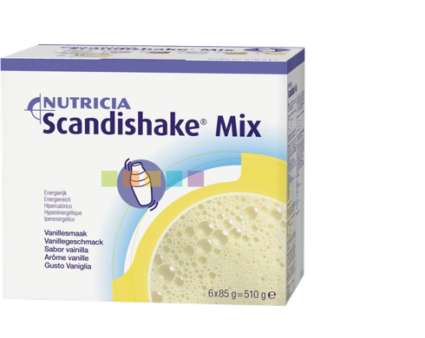
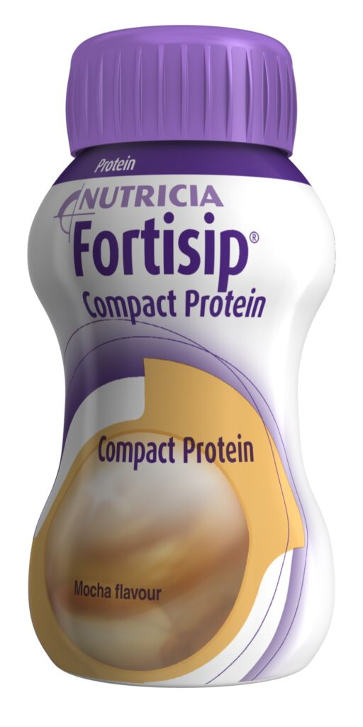
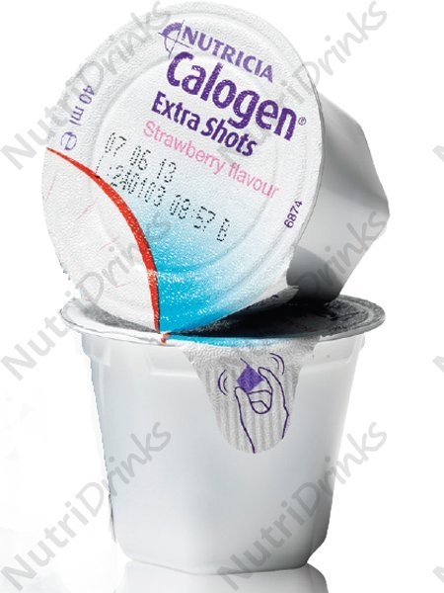
Oral nutritional supplements
Used to treat and prevent disease related malnutrition.
Different types to accommodate varying nutritional needs, taste preferences and dietary requirements

Slide 11
References
Challenging cancer diets myths | British Dietetic Association (BDA)
Turmeric | Complementary and alternative therapy | Cancer Research UK

