Slide 1
The importance of emotional support in cancer care
Lisa Young
Gynae CNS UHS

Slide 2
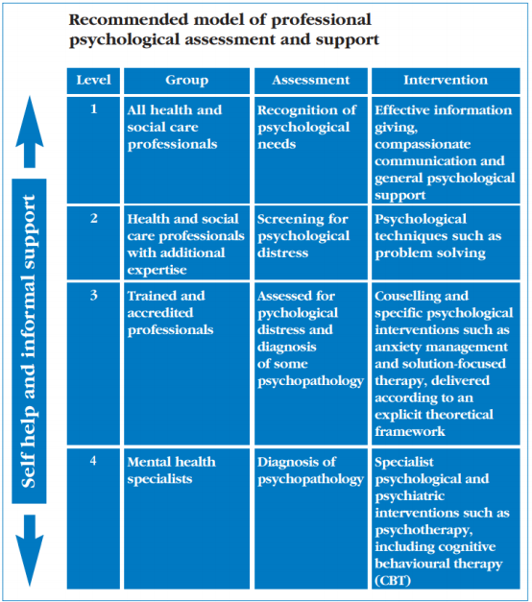
How should we integrate /emotional/psych support?
Psychological support services in cancer are sparse
To optimize patient care we need to be creative with our workforce and look for opportunities to upskill to deliver Level 1-2 of the NICE model
4 Levels of psychological assessment and support (NICE 2014)

Slide 4
1. Develop a programme of physical activity sessions
2. Support for optimised nutrition
3. Psychological support with access to resources and Apps

Slide 5
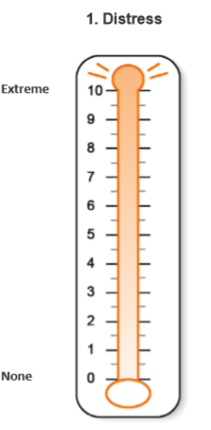
Additional training – psychological support
A clinical psychologist developed a 45 minute webinar – Level 1/2 of NICE guidelines
Written information includes key elements of the training and links to additional resources
Focus on:
Recognising and eliciting emotion
Active listening
Questioning
Sitting with emotion
Using distress thermometer
Clear escalation plan re concerns for mental wellbeing/self-harm

Slide 6
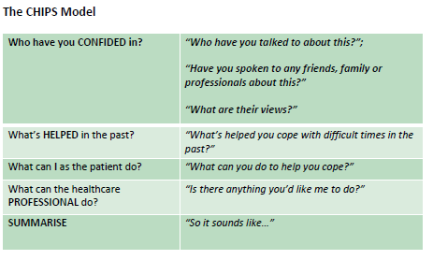
Additional training – psychological support
Trainers can signpost to additional resources/clinical teams as necessary
Focus is supporting self-management – HCS training
Supervision/group session for trainers to discuss issues & encouraged to share concerns with trial team

Slide 7
Implementation: Lessons learnt so far
Personal trainers feeling the need to ‘fix’ problems
Managing their own emotional wellbeing– particularly when there are shared experiences
Providing specific forms of words to support difficult conversations
Using physical analogues to support discussions around accessing additional services

