Slide 1
Advising and supporting patients with Cancer and Nutrition

Slide 2
The Role of a Dietitian in Oncology services
Dietitians work across cancer sites and across treatment types.
Work with patients undergoing chemotherapy, radiotherapy and surgical treatment.
Work to combat side effects of cancer and side effects of treatment.
Recognise, diagnose and treat malnutrition.
Provide dietary advice through treatment and beyond.
Work with after effects of cancer treatment and help with cancer survivorship.
Dietitians also have a role in cancer prevention!

Slide 3
Malnutrition in Oncology Patients
High risk of malnutrition both due to their illness and as a result of treatment.
Up to 50% of patients present with weight loss at diagnosis, this can continue throughout treatment.
At any one time, it is thought that up to 80% of cancer patients are malnourished at any one time.
Malnutrition is caused by a imbalance of protein and energy (calories) intake.
Protein requirements for cancer patients can be up to double the recommended level for the general population.
The reasons for poor oral intake can be complex and multifactorial.

Slide 4
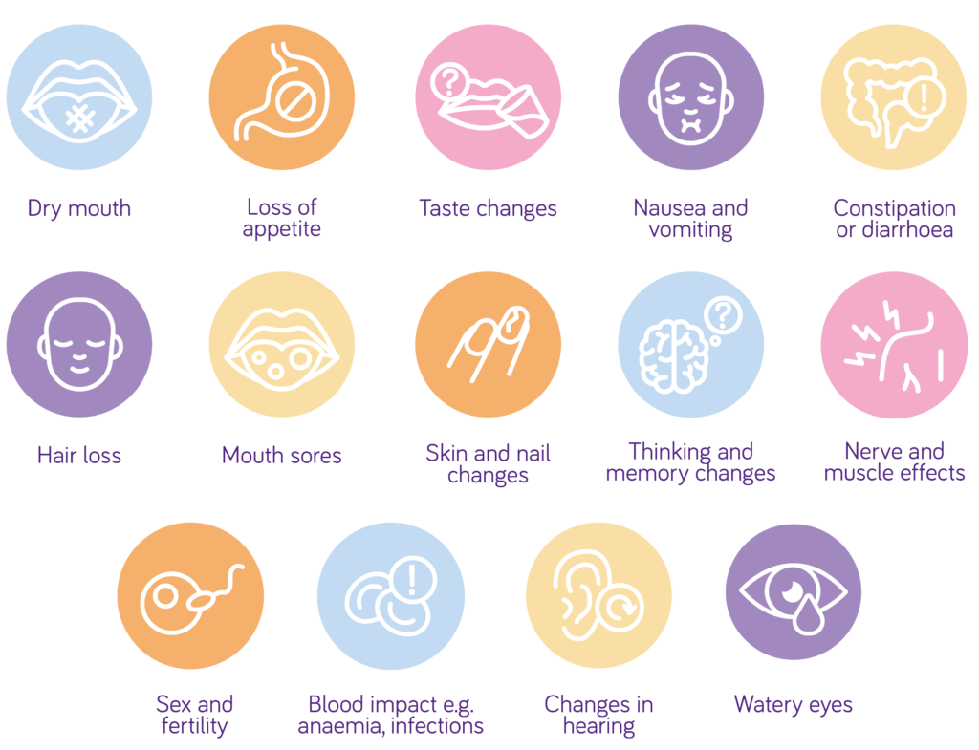
Cancer and Treatment Side Effects
Dietitians can have a direct impact on these side effects!
*
*
*
*
*
*
*

Slide 5
How do we combat these?
Helping patients to achieve a higher energy and protein intake through:
Food fortification
Oral nutritional supplements
Enteral / artificial feeding (if appropriate)
Limiting ‘fad’ and potentially ‘dangerous’ diets
Combating nutritional issues before they happen
E.g. placing feeding tubes before treatment
Preventing inpatient stays if possible, but also promoting inpatient admission as needed
The role outside of the dietitian – being an extra person to support!

Slide 6
Where to find us?
Referral through the patients Oncology or Haematology consultant.
Referral through a Clinical Nurse Specialist.
Contacting the patient’s GP regarding the patient and asking for a referral to an Oncology Dietitian.

Slide 7
Further information and resources
Cancer Research UK
Macmillan
World Cancer Research Fund
British Dietetic Association (BDA) Oncology Specialist Group
Bloodwise (for haematological cancers)
Trekstok (for teenagers and young adults)

