Slide 1
Preparing for treatment and life afterwards
Hermanus Louw
22 February 2022

Slide 2
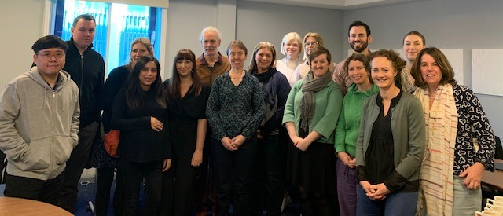
Who we are
Patient Information Web Team - nurses, a radiographer and digital and administration professionals
Our experience spans a number of years across children’s cancers, various adult cancers and specialities such as lymphoedema, clinical trials, intensive care and palliative care

Slide 3


How we work
All our information is written in plain English - Plain English Campaign Crystal Mark
Reliable - rigorous writing and review process (every 18 months to 3 years) – internal and external reviews - Trusted Information Creator Kitemark (TICK)
Lay reviewers review our information and make suggestions
Trial write ups approved by trial teams and regularly updated
Work across teams at CRUK such as Patient Involvement Team/Cancer Stats/Early diagnosis

Slide 4
Prehab information

Slide 5
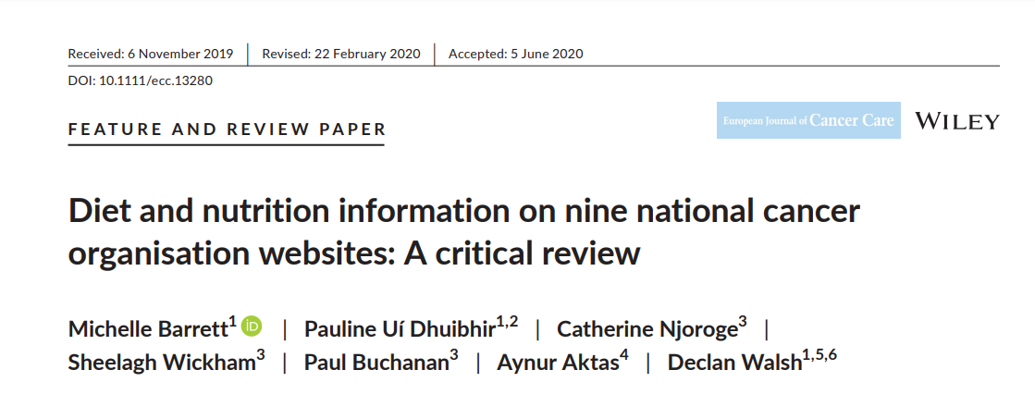
Background

Slide 6
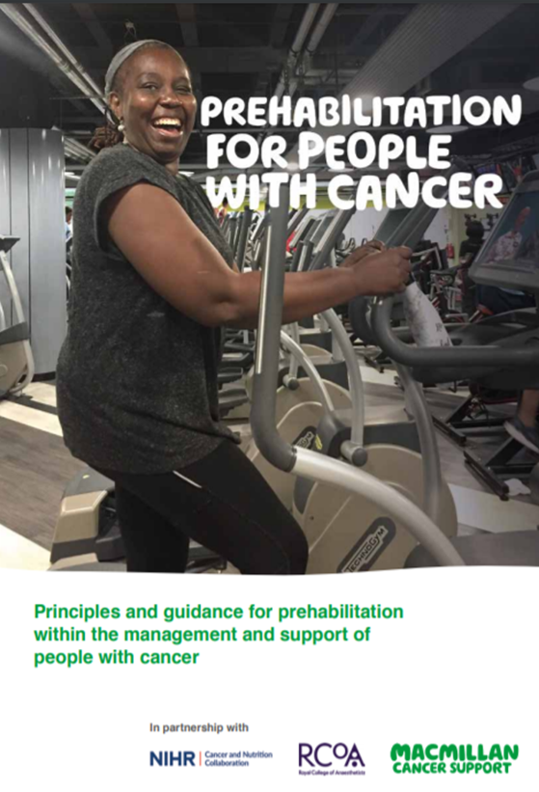
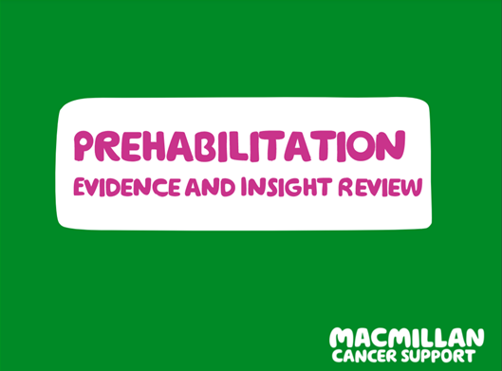
Development

Slide 7
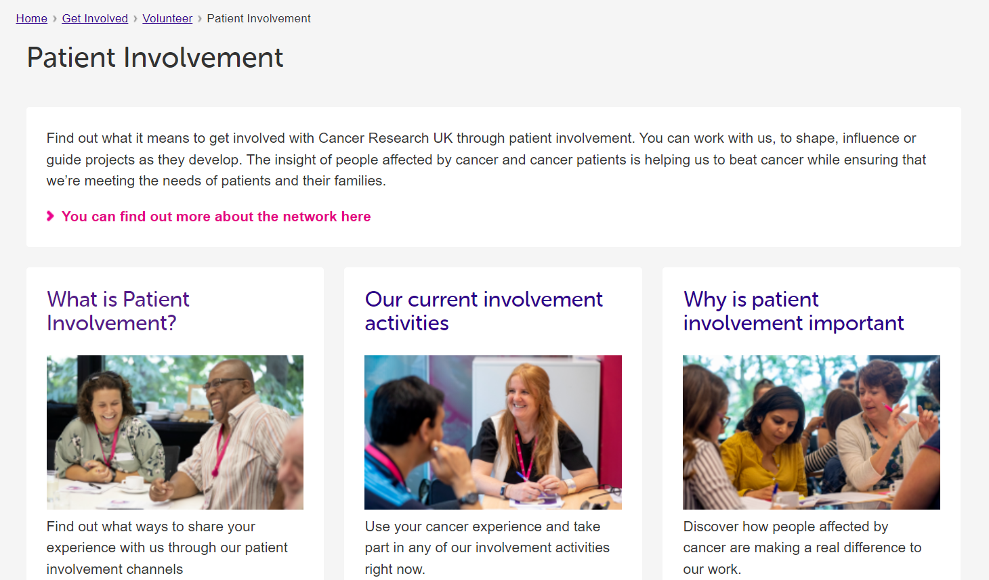
Development

Slide 8
Universal interventions

Slide 9
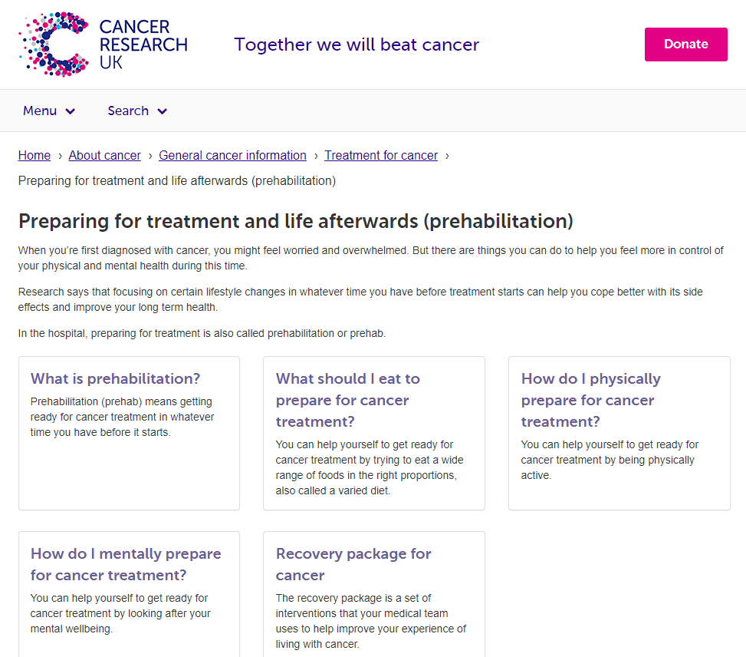
Information

Slide 10

Performance
Preparing for treatment and life afterwards (prehabilitation) – published July 2021
    Unique page views: 23,766
    Average time on universal intervention pages: 2:37 (mental wellbeing longest – 2:54)

Slide 11
Videos
Preparing for treatment and life afterwards (Prehabilitation) - 6.31s long
What should I eat to prepare for cancer treatment? – 1.39s
How do I physically prepare for cancer treatment? – 1.45s
How do I mentally prepare for cancer treatment? – 1.23s

Slide 12

Performance
Videos on YouTube – published December 2021
    Preparing for treatment and life afterwards (prehabilitation) – 848views
    What should I eat to prepare for cancer treatment? – 389 views
    How do I physically prepare for cancer treatment? – 402 views
    How do I mentally prepare for cancer treatment? – 358 views

Slide 13

Performance
Twitter – 3 tweets by CRUK social media team – short versions of video (December 2021)
    What should I eat to prepare for cancer treatment? – 5,998 impressions
    How do I physically prepare for cancer treatment? - 5,537 impressions
    How do I mentally prepare for cancer treatment? - 24,726 impressions 40 interactions in total, 28 likes, 2 replies and 10 retweets
    2.6k media views

Slide 14
Next steps
Instagram TV (IGTV) video - currently in production by social media – focus on the feeling of being overwhelmed at the time of diagnosis and what people can do to help them regain control.
Publish IGTV video
Supplement with patient stories
Project in collaboration with MIND on mental health and cancer

Slide 15
Thank you
Please visit cruk.org/prehab
Email: hermanus.louw2@cancer.org.uk
Notes:
.

