Slide 1

Prevention and Earlier Diagnosis Local Improvement Scheme
Introductory Webinar
27th January 2022
Wessex Cancer Alliance

Slide 2


This session
  Early Diagnosis in Primary care & Long Term Plan
  Alliance/DCP organisations and teams
  Role of clinical and non-clinical cancer leads
  Use of Faecal Immunochemical Test (FIT)
  Clinical Decision Support tools (CDS)
  Primary Care Toolkit
  Reporting

Slide 3
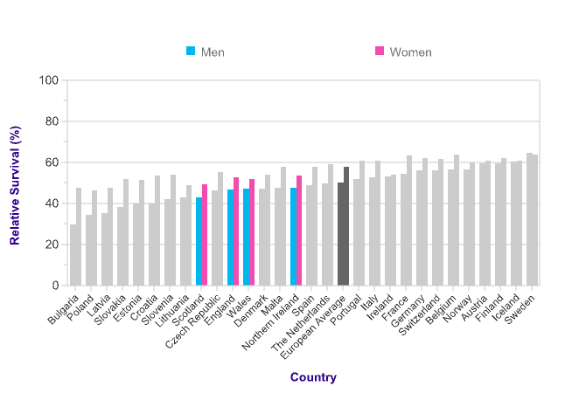
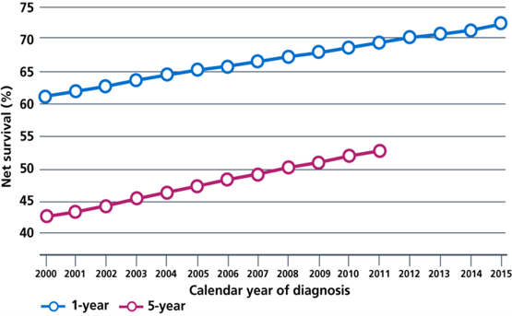
Early Diagnosis of cancer
Early Diagnosis is strongly linked to survival
Survival has doubled in 40 years
Lagging behind other comparable nations
https://www.cancerresearchuk.org/health-professional/cancer-statistics/survival/
Notes:
Cancer survival rates in UK (doubled in the last 40 years) are improving but lagging behind comparable nations.
In 1970s, approx. 50% survived cancer beyond one year, in 2010 approx. 75%.
progress in UK cancer survival might go backwards, for the first time
in decades.

Slide 4

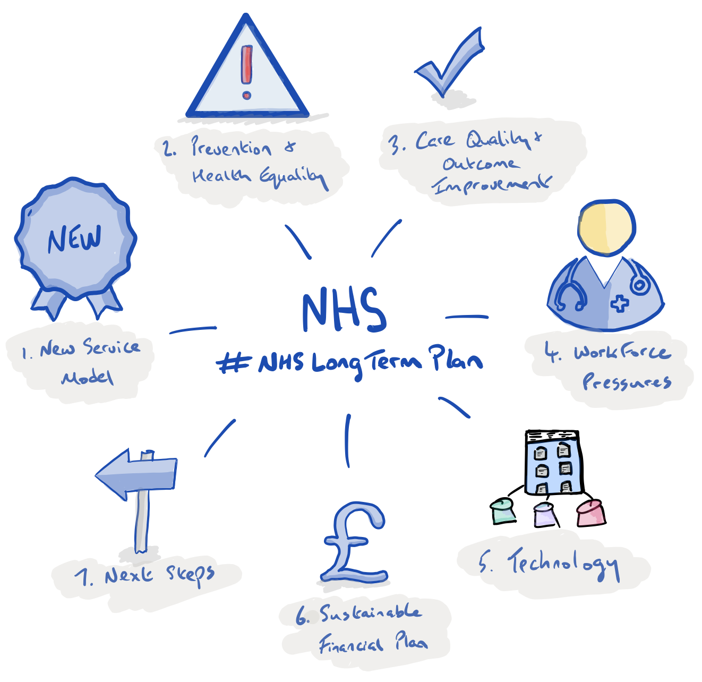
NHS Long Term Plan 2019
LTP Target
Increase rates of diagnosis at stage 1 and 2 to 75% by 2028
  2016 52.6% England
  2016 55.6% Dorset
Increase number of people surviving their cancer >5 years by 55,000
Notes:
Early Diagnosis fo Cancer is a MAJOR NHS priority

Slide 5

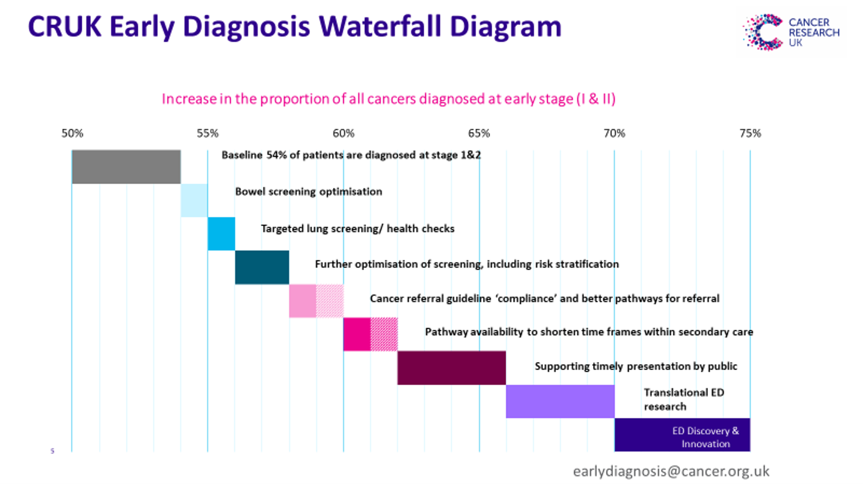
How are we going to achieve this?
Working in Partnership
  Primary and Secondary Care
DES/QOF
Referral Practice
Focus of potential activity within primary care.
Also source of potential funding in Primary Care Network DES and QOF requirements
Notes:
Just to note where the primary care opportunities sit within the wider scheme of interventions to improve early diagnosis of cancer.
The Targeted Lung Health Checks (TLHC) programme targets those most at risk of lung cancer and will initially work with CCGs who have some of the highest rates of mortality from lung cancer. The programme will work with ten projects covering fourteen CCGs over the next four years to deliver the programme to approximately 600,000 eligible participants.​
People aged over 55 years old but less than 75 years old that have ever smoked will be invited to a free lung check.​
Following the lung health check those assessed as high risk will be offered a low dose CT scan. ​
​
Southampton, Portsmouth and soon Dorset ​
​
Optimisation of screening includes targeting patient cohorts with low uptake (e.g. people with learning disabilities, first time entrants to the screening programme, people from ethnic minority groups). ​
​

Slide 6
Early Detection of Cancer in Primary Care contracts
Early cancer diagnosis: QOF indicators (payment protected this year)
QI005: The contractor can demonstrate continuous quality improvement activity focussed upon early cancer diagnosis as specified in the QOF guidance (27 points)
QI006: The contractor has participated in network activity to regularly share activity as specified in the QOF guidance. This would usually include participating in a minimum of two peer review meetings (10 points)
PCN DES
Improve referral practice for suspected cancer using NICE NG12, clinical decision support tools, exploring practice data, utilising the Rapid Investigation Service (RDC), safety netting using a required code
Improve local uptake of national cancer screening programmes
Establish communities of practice

Slide 7
Wessex Cancer Alliance, Dorset Cancer
Partnership
WCA – Hampshire, Dorset and IoW.
Cancer alliances bring together clinical and managerial leads from acute trusts, health and social care and primary care to transform the diagnosis, treatment and care of cancer patients in their local area.
Dorset Cancer Partnership – CCG, Acute and community hospital trusts, primary care and third sector organisations to look at cancer standards, pathways and care in Dorset.
Team of 10 Cancer Alliance GPs, led by Jane McLeod for Hants IoW and Sarnia Ward for Dorset.
2 CRUK facilitators – Vicki Wright (Dorset) and Lucy Pickup (Hants IoW)
For support in Hants IoW – england.wessexcanceralliance@nhs.net
For support in Dorset – dcp@dorsetccg.nhs.uk

Slide 8
2022 Cancer Early Detection LIS
(LES)
Requirements
Identify a clinical and non clinical cancer lead and complete initial reporting
Join this introductory webinar and mid point one
Non clinical lead to act as conduit for sharing the Wessex Cancer Alliance Primary Care newsletter and other important cancer information or educational opportunities within their PCN
Non clinical lead to work with clinical lead to share targeted messaging with their PCN population about cancer prevention and cancer signs and symptoms
Clinical lead to join FIT webinar and review use of FIT within the PCN, identify any areas for improvement and share this learning and plan
Clinical lead to join webinar on use of CDST. Trial use of these in the PCN and share reflections of this.

Slide 9
Cancer champions

Slide 10
Clinical and non-clinical cancer champions
Non clinical cancer champion
The main conduit for our newsletter and other communications
Work with your clinical champion to use a variety of methods appropriate to your PCN population to :
  provide messaging to encourage patients to spot the signs and symptoms of cancers and to present to the GP earlier;
  provide cancer prevention messaging to stop smoking, reduce alcohol intake, improve diet and increase exercise

Slide 11
Clinical and non-clinical cancer champions
Consider the needs of your PCN, this messaging could be targeted to selected group(s) of harder to reach or difficult to engage patients
  e.g those with other long term conditions, deprived communities, those that rarely/never consult primary care and those with risk factors (raised BMI, smokers)
Look at different ways to provide messaging to them
  e.g. text messaging, social media, work with local groups, campaign in surgery etc

Slide 12
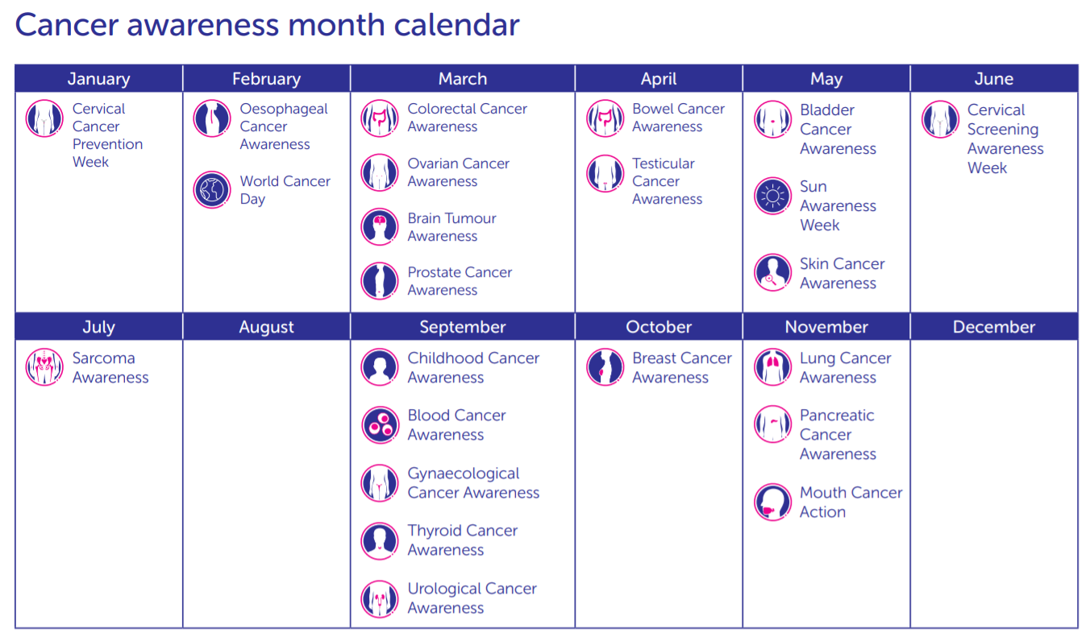
Notes:
?put this in as example to guide ideas on which tumour sites they could focus on

Slide 13

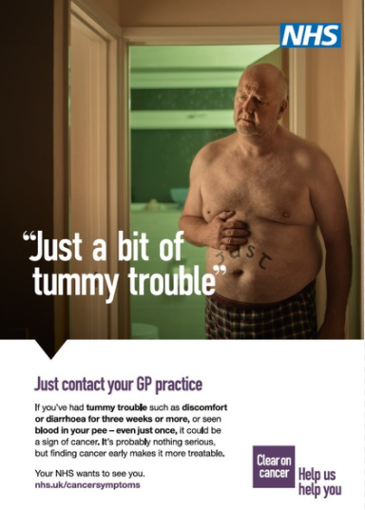

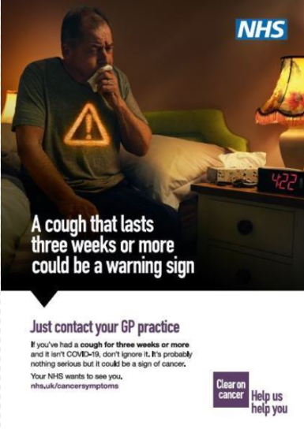

National Campaign’s
Notes:
Examples of campaigns that we can share

Slide 14
Upcoming National
Cancer Campaigns
Cervical cancer screening campaign
Launching on 14th February 2022 and running until 14th March 2022 this campaign aims to improve knowledge of cervical cancer symptoms and debunk myths around HPV
‘Overcoming Fear’ campaign
Launching on 2nd March 2022 and running into April 2022 this campaign aims to reduce barriers to presentation by encouraging people to overcome their fear and to go to their GP with even the smallest of healthcare concerns
If this campaign proves to be successful, then it will underpin future cancer campaigns
National Prostate Cancer Campaign, (Co-led by Prostate Cancer UK)
Launching on 17th Feb 2022 the aim of the campaign is to raise awareness of prostate cancer among high risk men (particularly Black men over 45 years old), encourage them to use the prostate cancer risk checker which has been developed by PCUK and to have PSA tests.
The campaign will run on social media, tv and radio

Slide 15
Non clinical cancer champion support network
Cancer Research UK facilitators available as point of contact for support and resources
  Teams group for questions, resources and sharing of information across the participating PCNs
  Email updates with resources and campaign info that may be helpful with your project
Contacts:
Lucy.Pickup@Cancer.org.uk (HIOW)
Victoria.Wright@Cancer.org.uk (Dorset)

Slide 16
Clinical cancer champion
Review the use of FIT in your PCN
  Join or access the 1 hour webinar (March) about colorectal cancer and the use of FIT in the pathway or complete the Gateway C e-learning module
  Identify areas for improvement across the PCN
Increase the use of clinical decision support tools
  Join or access the 1 hour webinar (May) showcasing clinical decision support tools
  Chose a CDS tool for use in your PCN
  Submit reflections of what has changed at end of agreement

Slide 17
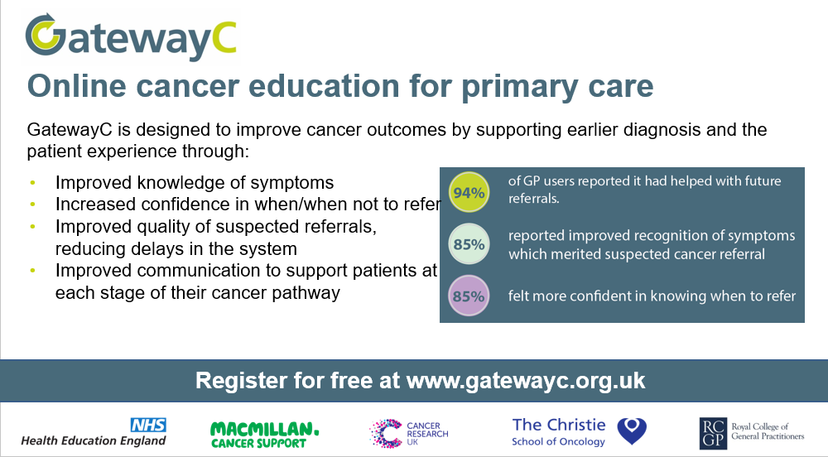
Gateway C

Slide 18
FIT

Slide 19
FIT Testing (the 3 uses)
FIT is used in the National bowel screening programme which invites patients aged 56 to 74 years.
FIT is requested by a GP in patients:
<60yrs with changes in bowel habit or iron deficiency anaemia
< 50 yrs with unexplained abdominal pain or weight loss
FIT is requested by a GP either as part of the mandatory filter tests prior to referral to the Rapid investigation service or at the same time as a fast track colorectal referral is made even if there has been rectal bleeding

Slide 20
What is a positive FIT test?
In bowel screening a FIT test is positive if > 120ug/ml
When a GP orders a FIT test is positive if >10ug/ml in most areas ( in some areas the result is positive if > 3ug/ml)

Slide 21
How can FIT testing help?
Broadly the higher the FIT test result, the greater the risk of bowel cancer including in those patients with rectal bleeding
Depending on the threshold, FIT test has both high sensitivity and specificity for bowel cancer
It can be used to assess risk of bowel cancer in patients with non-specific symptoms speeding up investigation
Importantly it enables secondary care to risk stratify our fast track colorectal patients to ensure the highest risk patients are investigated most rapidly which is vitally important at this time of pandemic backlogs. It really is important for us as GPs to request FIT tests with every fast track referral stressing the importance of timely completion to the patient

Slide 22
What is the LIS asking you to do re FIT?
We are asking you to review the use of FIT testing in your PCN
Identify areas for improvement
There will be a webinar in March looking at FIT. There is also an e-learning module on Gateway C
Do contact the Alliance if you need help

Slide 23
Clinical decision support tools

Slide 24
Clinical decision support tools
Cancer Decision Support (CDS) tools are designed to support health professionals to recognise potential cancer signs and symptoms and manage patients appropriately.
CDS tools do not replace clinical judgement. Instead, they provide further guidance to inform patient management decisions. This may be to refer, to safety net, or it may support the decision on which pathway is most appropriate.
Use of CDS tools to improve referral practices is highlighted in the PCN DES on early diagnosis of cancer

Slide 25
Clinical decision support tools
Current local use
According to a recent survey* only a quarter of clinicians in Wessex use clinical decision support tools
The reason for staff not using CDS tools was identified in the majority of responses (49%) to be related to them not being aware of the tools
Other reasons for CDS tools not being used included, lack of training, forgetting to use the tool and preference to use own clinical judgement
*Wessex Cancer Alliance, unpublished
Notes:
Highlighting the importance of raising awareness of the tool locally.

Slide 26


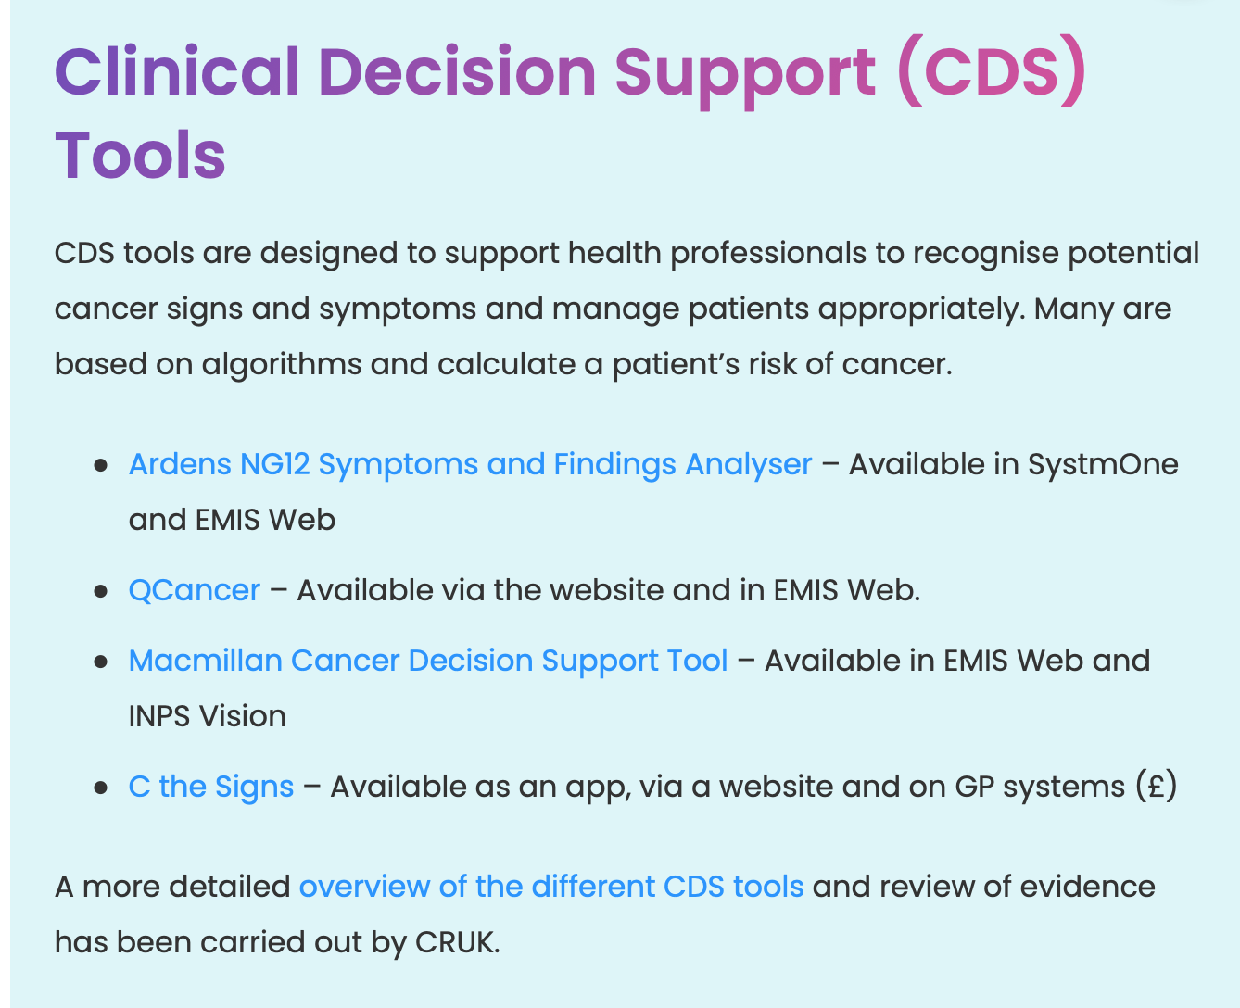
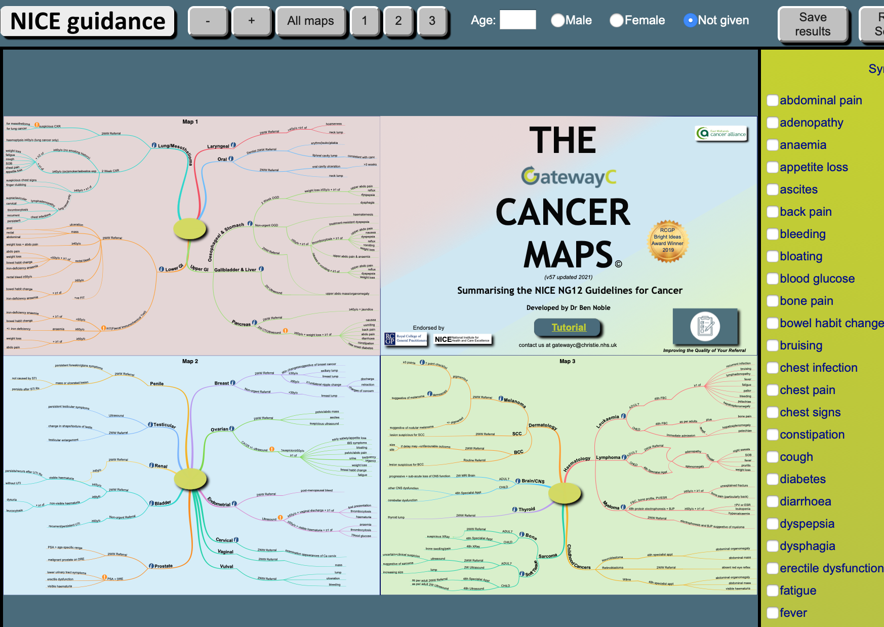
Notes:
ERICA trial

Slide 27
Primary care toolkit

Slide 28

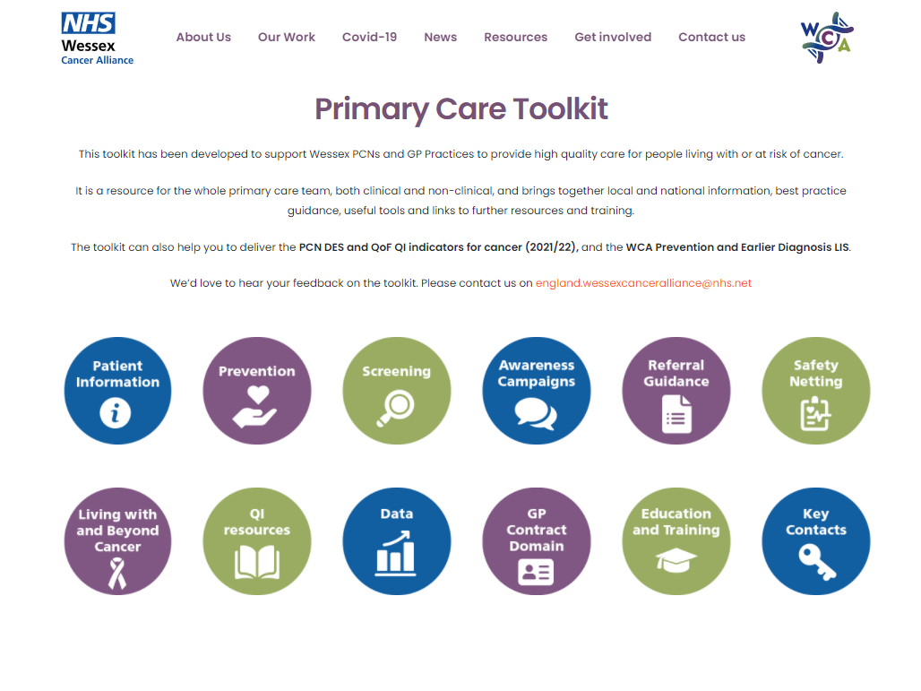
Primary Care Toolkit
*NEW* Cancer Care Toolkit for Primary Care Teams
Wessex Cancer Alliance have developed a toolkit of resources to support Wessex PCNs and GP Practices to provide high quality care for people living with or at risk of cancer.
The toolkit brings together local and national information, best practice guidance, and helpful tools and links to further resources and training, in areas including:
Prevention and symptom awareness
Increasing screening uptake
GP Contract requirements
Referral guidance and safety netting
Cancer care reviews and supporting people after a cancer diagnosis
https://wessexcanceralliance.nhs.uk/primarycaretoolkit

Slide 29
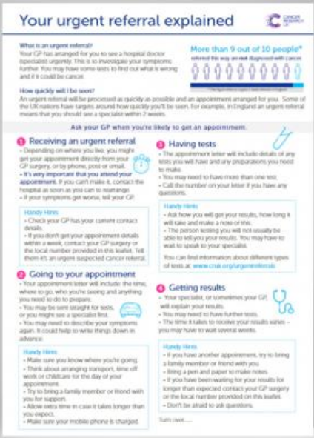

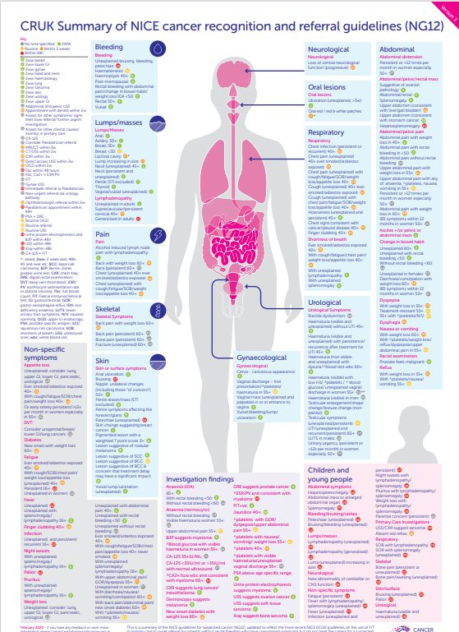




Primary Care Toolkit
We hope that the toolkit will be a useful resource for the whole primary care team, both clinical and non-clinical.

Slide 30
Reporting

Slide 31



Reporting
Initial reporting
Contact details for Cancer Champions
PCN name
Name of Non Clinical Cancer Champion
Role
Email address
Name of Clinical Cancer Champion
Role
Email address
Which ARRS roles does your PCN employ/intend to employ?
Reporting requirements at end of LIS
Element | Reporting Required
Non Clinical cancer champion
Work with your clinical champion to use a variety of methods appropriate to your PCN population to provide messaging | Share how you communicated your messaging and any thoughts on results
Element |  | Reporting Required
Clinical cancer champion
Review the use of symptomatic Faecal Immunochemical Test (FIT) in the PCN. | Share learning and plans for improvement
Increase the use of clinical decision support tools for the diagnosis of cancer and safety netting. | Submit your reflections on what has changed at the end of the agreement

Slide 32
Thank you
Any Questions?

