Slide 1
Advising and supporting people with cancer with physical activity and exercise
Case Studies
Dr Lisa Loughney (PhD), Clinical Exercise Physiologist
Cancer Survivorship Programme & Evaluation Specialist, Irish Cancer Society

Slide 2
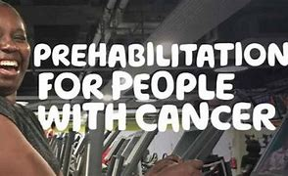
Ability to walk 150 min/week and undertake resistance/strength exercise 2/week
Needs support based on disease/TX/side effects/co-morbidities
Inactive/sedentary/co-morbidities/ contemplative/low self-efficacy or TX related indication (i.e. Major surgery)
Universal
Exercise booklets
Exercise webinars
Healthy lifestyle websites
Self-management webinars
Targeted
Group/1-to-1 support in community aiming to increase frequency, intensity and duration to get as near to 150 min/week by surgery/TX.
Some supervision + structured exercise for those sufficiently active: 30-150 min/wk or low self-efficacy
Specialised
Fully supervised exercise intervention delivered by a qualified cancer exercise professional

Slide 3
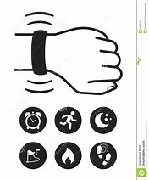
UNIVERSAL PROGRAMME: Case study 1
Gender: Female
Age: 63
Cancer: Oesophageal
Treatment: Neoadjuvant chemoradiotherapy and surgery
Comments: Clinical nurse specialist who continued to work during treatment.
Enjoys running and cycling

Slide 4
Exercise plan to follow at home
FITT | During Neoadjuvant Treatment | Time Window between treatment and surgery | Post-Surgery
Frequency | 2/week | 3/week | 2-3/week
Intensity | Moderate-High | Moderate-High | Moderate (as far as week 8 post-surgery)
Time | Aerobic: 40 min Resistance: 20 min | Aerobic: 40 min Resistance: 20 min | Aerobic: start at 20 min and increase each week by 5 min (if possible) aiming to achieve same as pre-operatively
Type | Home based | Home based | Home based
Neoadjuvant Treatment
(5 weeks)
8 Week wait for surgery
Surgery
Post-Operative Recovery
SELF-ASSESSMENTS

Slide 5
Results

Slide 6
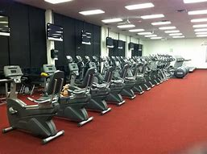
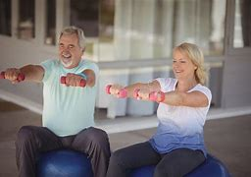
TARGETED PROGRAMME: Case study 2
Gender: Male
Age: 52
Cancer: Gastric
Treatment: Neoadjuvant chemotherapy and surgery
Comments: Hypertension, sedentary lifestyle, current smoker
Community Referral

Slide 7
Supervised exercise plan to follow in the community gym
FITT | During Neoadjuvant Treatment | Time Window between treatment and surgery | Post-Surgery
Frequency | 2/week | 3/week | 2-3/week
Intensity | Moderate-High | Moderate-High | Moderate (until week 8 post-surgery)
Time | Aerobic: 40 min Resistance: 20 min | Aerobic: 40 min Resistance: 20 min | Aerobic: start at 20 min and increase each week by 5 min (if possible) aiming to achieve same as pre-operatively
Type | Gym based | Gym based | Gym based
Neoadjuvant Treatment
(8 weeks)
4 Week wait for surgery
Surgery
Adjuvant Treatment
(8 weeks)
12 Week Training Plan
8 Week Training Plan
EXERCISE PROGRAMME
PAUSES
EXERCISE PROGRAMME RESUMES
START OF EXERCISE PROGRAMME
END OF EXERCISE PROGRAMME

Slide 8
Results:
“Following my diagnosis, I joined a programme for about 10 weeks starting before my cancer treatment and ran right up to my surgery. The help and support I got was exceptional.
The physical and emotional benefits that I got from the programme were immese. It clearly set me up to be in the best condition possible for my op and beyond. Four weeks after my surgery, I have now started the post-op exercise programme..I am now fit and don’t smoke.”

Slide 9
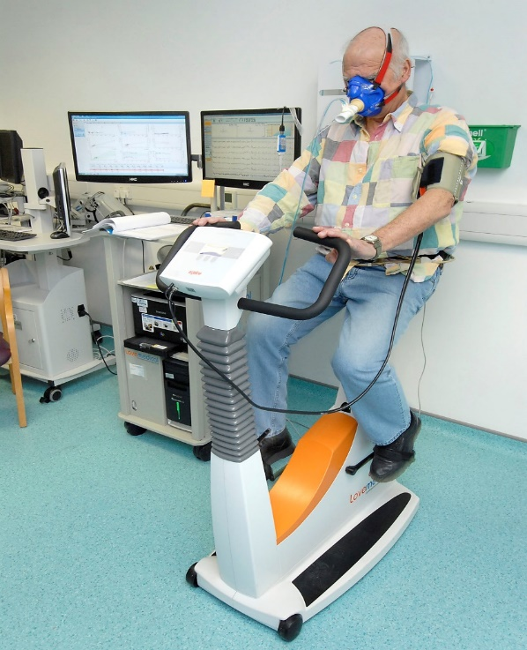
SPECIALISED PROGRAMME: Case study 3
Gender: Male
Age: 71
Cancer: Rectal
Treatment: Completed neoadjuvant and awaiting surgery
Comments: Experiencing negative side effects from treatment which are impacting day-to-day tasks.
T2D, Hypertension, ex-smoker, sedentary lifestyle (spends the waking day watching TV), lacks confidence since diagnosis
Hospital Referral

Slide 10
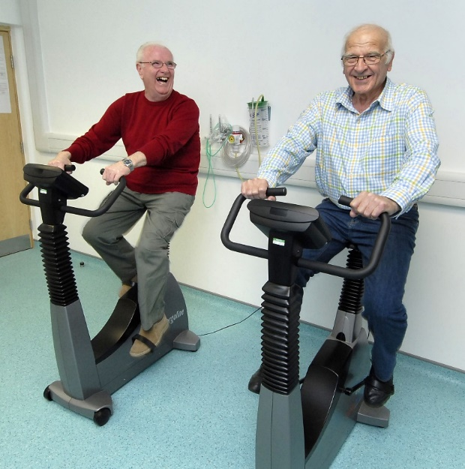
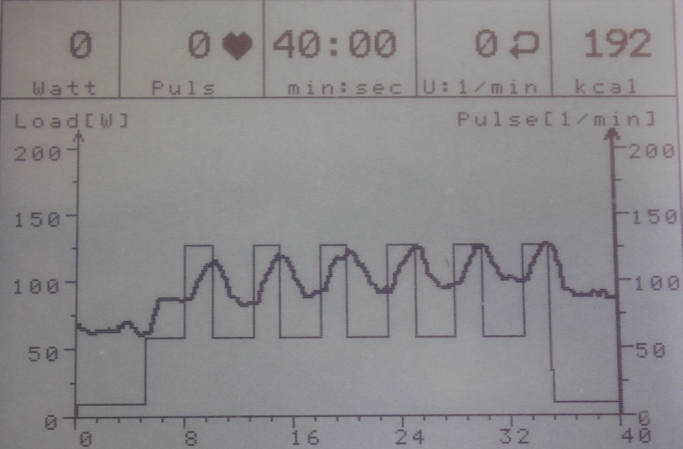
EXERCISE PRESCRIPTION
Frequency: 3 sessions/week
x 9 weeks
Intensity: Moderate/severe Time: 40 min
Type: Aerobic
Neoadjuvant Treatment
9 Week wait for surgery
Surgery
9 Week Training Plan
START OF EXERCISE PROGRAMME
END OF EXERCISE PROGRAMME

Slide 11
Results
“Exercise training strengthened my body for what's coming next - some man using a sharp implement on me... I would probably be more nervous about tomorrow than I am now. I think doing exercise training, I'm more confident going into tomorrow than I would have been if I hadn't done it. The exercise and preparation that I've been put through has got me all ready for it.”
↑+3.3 (2.8) ml/kg/min

Slide 12
Contact Lisa
Email: lloughney@irishcancer.ie
Telephone: +353 86 1373 315

