Slide 1
What is the difference between exercise and physical activity and what does the evidence tell us?
Sandy Jack
Professor of Prehabilitation Medicine, Clinical Experimental Sciences, Faculty of Medicine, University of Southampton

Slide 2
Physiological Reserve
PHYSICAL FITNESS
ACTIVITY
EXERCISE
Notes:
Physical activity is movement that is carried out by the skeletal muscles that requires energy. In other words, any movement one does is actually physical activity.
Exercise, however, is planned, structured, repetitive and intentional movement intended to improve or maintain physical fitness. Exercise is a subcategory of physical activity.
Exercise assists improvement of physical fitness, which consists of five specific components:
-Cardiorespiratory fitness
-Muscular strength fitness
-Muscular endurance fitness
-Flexibility fitness
-Body composition

Slide 3
Physiological Reserve
Physical activity = movement that is carried out by the skeletal muscles that requires energy.
Exercise = planned, structured, repetitive and intentional movement intended to improve or maintain physical fitness.
PHYSICAL FITNESS
ACTIVITY
EXERCISE
Notes:
Physical activity is movement that is carried out by the skeletal muscles that requires energy. In other words, any movement one does is actually physical activity.
Exercise, however, is planned, structured, repetitive and intentional movement intended to improve or maintain physical fitness. Exercise is a subcategory of physical activity.
Exercise assists improvement of physical fitness, which consists of five specific components:
-Cardiorespiratory fitness
-Muscular strength fitness
-Muscular endurance fitness
-Flexibility fitness
-Body composition

Slide 4
Physiological Reserve
Frailty = a distinctive health state (related to the ageing process) in which multiple body systems gradually lose their in-built reserves.
FRAILTY
PHYSICAL FITNESS
Notes:
Frailty = impairment in multiple systems leading to decline in homeostatic reserve and resiliency

Slide 5
Physiological Reserve
Sarcopenia = degenerative loss of muscle mass, quality and strength
SARCOPENIA
FRAILTY
PHYSICAL FITNESS
Notes:
Sarcopenia is the degenerative loss of skeletal muscle mass (0.5–1% loss per year after the age of 50), quality, and strength associated with aging.
Sarcopenia is part of frailty AND cachexia

Slide 6
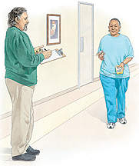
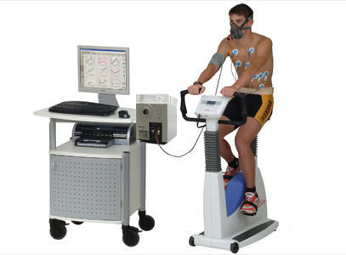
Physiological Reserve
SARCOPENIA
FRAILTY
ACTIVITY
EXERCISE

Slide 7
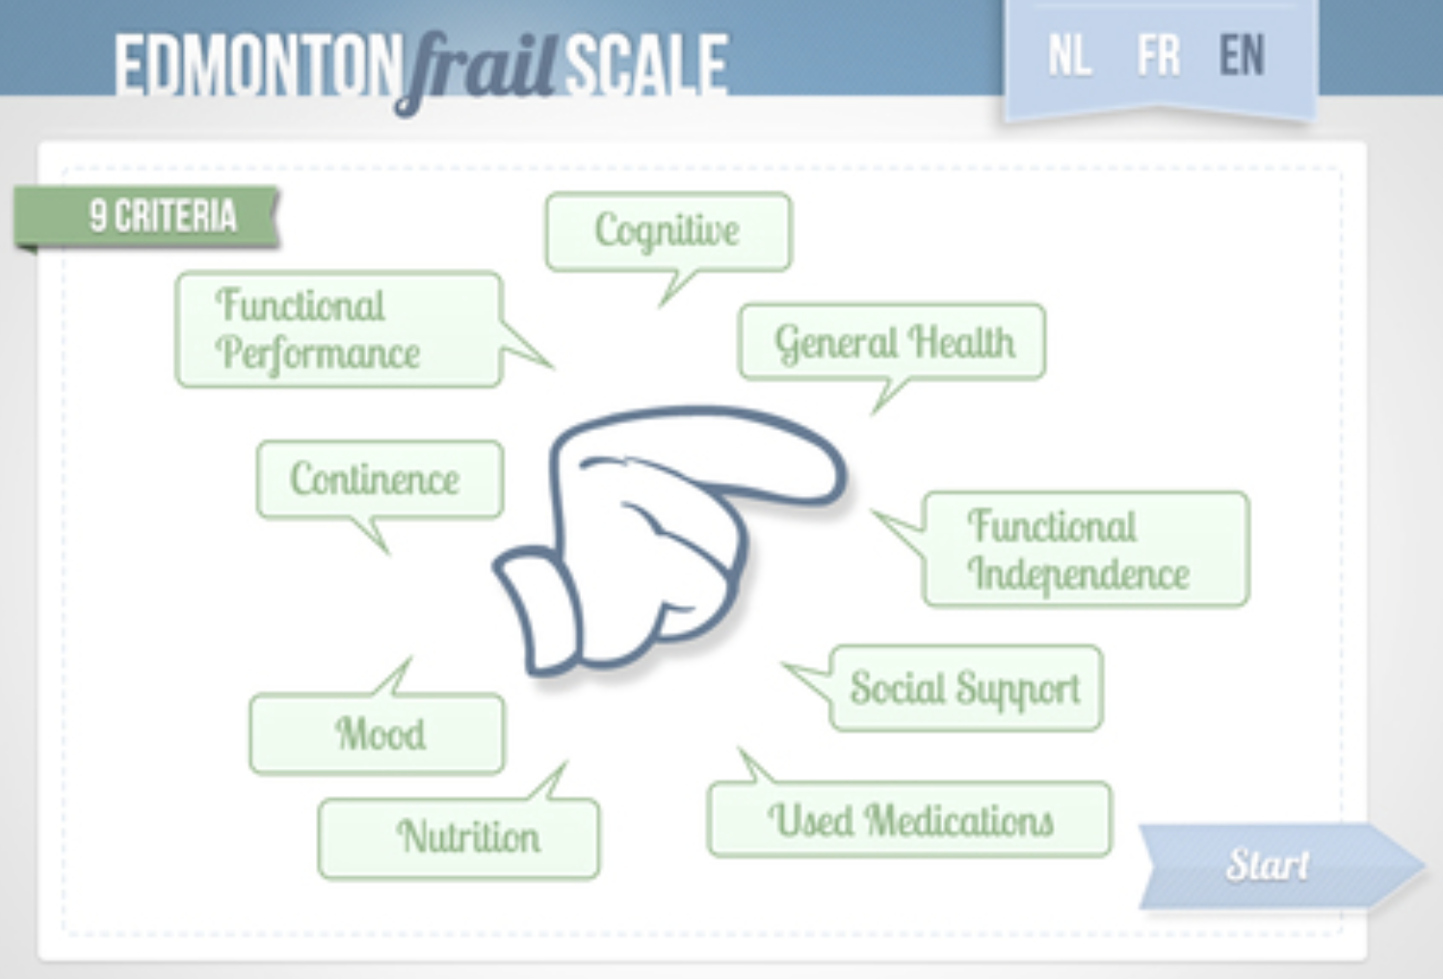
Physiological Reserve
SARCOPENIA
FRAILTY
ACTIVITY
EXERCISE
Notes:
Frailty – lack of functional reserve in all organ systems

Slide 8
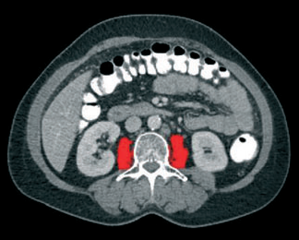
Physiological Reserve
SARCOPENIA
FRAILTY
ACTIVITY
EXERCISE
Notes:
Frailty – lack of functional reserve in all organ systems

Slide 9
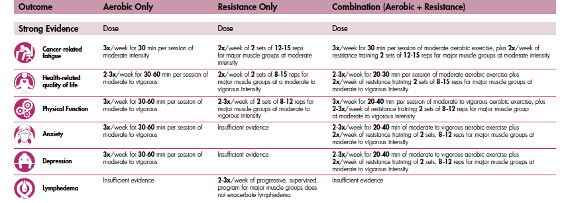

Slide 10
Macmillan/RCoA/NIHR Guidance on Exercise Interventions
Statement 1: Health and care professionals should understand and communicate the important difference between physical activity and exercise.
Strength of Recommendation = Strong, Level of Supporting Evidence = A
Statement 2: Exercise should be integral to care for all people with a cancer diagnosis, starting as early as possible.
Strength of Recommendation = Strong, Level of Supporting Evidence = A
Statement 3: All people with a cancer diagnosis should have a validated physical fitness screen as early as possible in their treatment pathway
Strength of Recommendation = Weak, Level of Supporting Evidence = B
Statement 4: People with a cancer diagnosis who are less physically fit should undergo a comprehensive evaluation to inform the prescription of a supervised exercise programme as early as possible.
Strength of Recommendation = Strong, Level of Supporting Evidence = B

Slide 11
Statement 5: Supervised exercise programmes are more effective than unsupervised programmes at improving physical fitness before surgery.
Strength of Recommendation = Strong, Level of Supporting Evidence = B
Statement 6: Exercise programmes should be prescribed by a professional qualified in exercise prescription with relevant experience in cancer care.
Strength of Recommendation = Strong, Level of Supporting Evidence = A
Statement 7: Exercise programmes for people with a cancer diagnosis should be delivered by appropriately trained individuals.
Strength of Recommendation = Strong, Level of Supporting Evidence = C
Statement 8: A validated measure of physical fitness should be used to monitor the effectiveness of an exercise prehabilitation intervention for people undergoing cancer treatment.
Strength of Recommendation = Strong, Level of Supporting Evidence = A

Slide 12
s.jack@soton.ac.uk
wesfit.org.uk @WesFit_trial
SafeFit.nhs.uk
@SafeFit_Trial

