Slide 1


Fit4Surgery Prehabilitation
Dr Andrew Packham Dr Heather MacKinnon
Clinical Lead for Prehab and CPET Prehab Project Manager
Consultant Anaesthetist Physiotherapist
November 2021

Slide 2
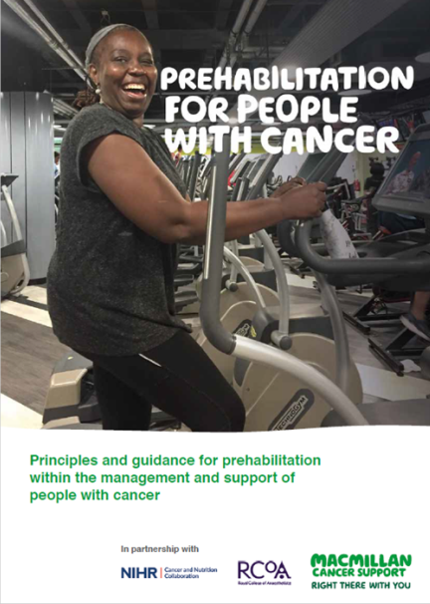
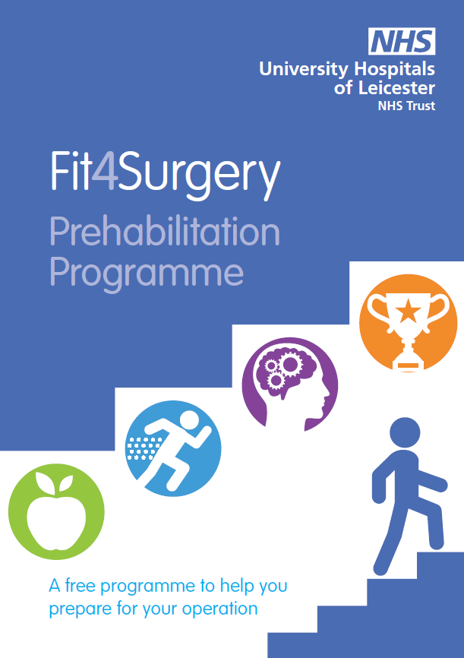
Contents
Why?
What?
What changed with COVID?
Results so far…
Future plans

Slide 3
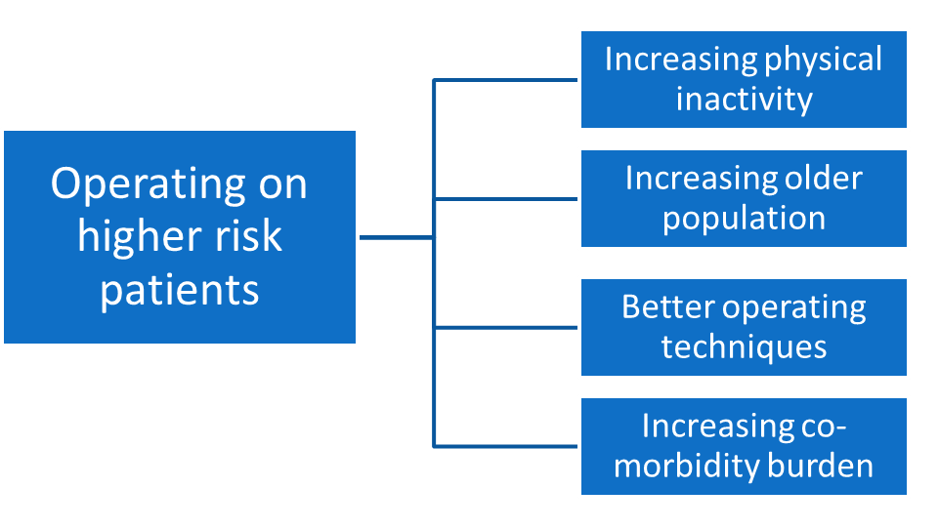
Why?
Prehabilitation
Opportunity to:
Provide Personalised care
Empower patients
Maximise physical and psychological resilience to cancer treatments
Improve long-term health

Slide 4
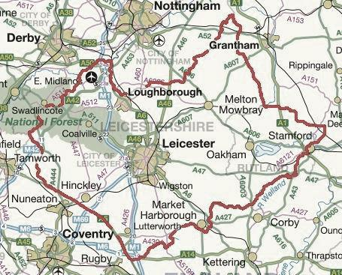

The Original Plan
Comprehensive assessment + CPET beginning and end
6 week intervention episodes
1 hour Face-to-face sessions 3x per week
HIIT + strength training
5 localities
2 Centres Physio led
3 Centres Exercise Instructor led

Slide 5
Pandemic plan
CAPABILITY
Co-developed exercise plan
Education
Self-efficacy
Home based
Motivational interviewing
COM-B model of behaviour change
Pragmatic
Moderate intensity
HIIT where possible
Using available equipment
Weekly supportive telephone calls
Engagement positive
Loss of objective data
OPPORTUNITY
Available equipment
Within participants environment & lifestyle
BEHAVIOUR
MOTIVATION
Facilitate self-monitoring
Goal setting
Supportive phonecalls

Slide 6
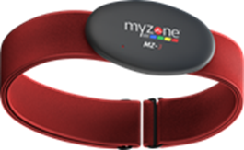
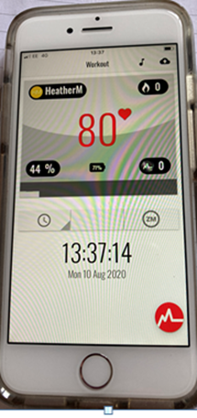
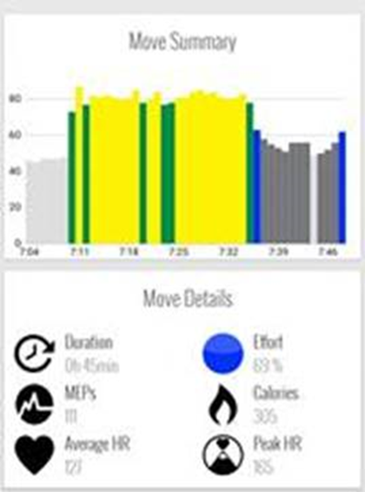
MyZone Activity Monitors
Heart rate monitor
Real-time feedback for patients
Remote monitoring by exercise professional and project team
Chat facility to promote peer support

Slide 7
Recovery plan - Blended approach
Patients flex attendance at face-to-face group sessions depending on personal circumstances
Attending group sessions:
2 sessions per week exercise at home
1 session group exercise + weekly check + time with peers
Heart rate data for all sessions
Added value with group sessions:
Better check of exercise technique and intensity
Wider range of exercise equipment available
Calibrate intensity of home exercise with heart rate measurement
Visual wellbeing check
Social support with other group members
Not attending group sessions:
3 sessions per week exercise at home
Weekly check by telephone / video call
Heart rate data for all sessions
Reasons for not attending group sessions:
Undergoing chemotherapy/radiotherapy
Shielding due to age or co-morbidities
Self-isolating after COVID contact
Shielding pre-surgery
Patient choice
Social / transport impediment

Slide 8
Pilot service – The First 150 Patients
Episode outcomes (1/3 of episodes include SACT)
Hospital Outcome (68 patients with 90 day outcomes)
Referred Feb 2020 to Mid- March 2021
Interim data compiled Mid-Sept 2021 (only 5 months FU for some)
63 % Male Median age 68years (range 38-87)
Mean duration of prehab for operated patients
14.1 weeks (range 1 to 41 weeks).
269 assessments and 1,960 weeks of prehab delivered by reporting date for these patients
Measure | Improved | Unchanged | Worsened
Sit-to-stand 60 | 53 | 2 | 18
MUST (95 started with score of 0) | 28 | 92 | 5
Rockwood Frailty score | 47 | 80 | 11
EQ-5D-5L | 44 | 42 | 41
Speciality | No. |  | Interim Status | No.
Oesophagogastric | 60 |  | Operated after Prehab | 78
Colorectal | 56 |  | Active in programme | 6
Urology | 18 |  | Change in treatment plan | 53
Gynaecology | 13 |  | Declined or withdrew | 13
HPB | 3
DAOH90 | Patients |  | DAOH90 | Patients
80-90 | 36 |  | 30-39 | 0
70-79 | 18 |  | 20-29 | 0
60-69 | 2 |  | 10-19 | 1
50-59 | 4 |  | 1-9 | 0
40-49 | 4 |  | 0 (Died) | 3

Slide 9
Patient Voice
“I have lost weight, maintained my fitness through 4 punishing Chemo treatments, from which I bounced back remarkably quickly and really feel very well indeed. […] And, as I go forward to my surgery next week, I’m very grateful for this preparation. So, this may be a pilot, but as one who has been following it, and can attest to it’s value, I would strongly urge that it needs to be rolled out to all cancer patients, as soon as possible.”
“Keeping up with your calls re my progress bolstered my efforts as in the latter period I was starting to really feel the benefits and this spurred me on to do more. […] I’m still keeping up my regime as its helped with my weight, obviously, but also my balance or at least my confidence to walk un-assisted without my frame […]please keep up your brilliant work it helped me massively and I’m sure that your caring therapeutic approach will help many in the future.”

Slide 10
Feedback comments from staff
“I have had positive feedback from patients who have been in this programme and It has enabled them to focus on their fitness and to gain control over something in their cancer journey that they can see will enable them to achieve their goals to become fitter during their treatment.” – Louise Boulter, Cancer Nurse Specialist
“Seeing patients on the other side of surgery is a real positive. …The patients that have engaged in prehab are always highly motivated to get up and go and are determined to get back to their life pre surgery…. The patients speak highly of the service provided and have nothing but praise for the staff.” – Rosie Moulds, Physiotherapist
“All the patients I have spoken to find it easy to follow and have seen good results. They are supported throughout and it gives them ownership of a part of their cancer treatment.” – Catherine Knox, Oncologist
“The Prehabilitation service in UHL is, in my opinion, the best thing to have happened to my patients in a very long time.... But it’s not just their physical fitness that improves – the effect of prehabilitation on my patients’ mood and positivity is amazing” – Kirsten Boyle, Surgeon
“Watching this small team make their vision a reality has been inspirational. Their dedication and commitment have seen this pilot go from strength to strength in its success. The benefits of prehabilitation is becoming more and more evident and has been supported widely across Leicester, Leicestershire and Rutland to improve outcomes for our patients. The concept is expanding nationally and its true holistic approach adds more that exercise alone to enhance patient wellbeing.” – Jane Pickard, MacMillan Lead Cancer Nurse

Slide 11

Phased Development Plans
3 stage development for cancer and time-critical surgery
Current Service – 150 patients per year
Phase 3 – 1500 patients per year
Expanding to support
People with a short pathway to surgery (2-4 weeks)
Bowel, Lung, Liver, Pancreas
Additional combined treatment pathways
Breast, Head & Neck, Adjuvant Bowel & Breast SACT
People having non-surgical cancer treatment
Lung RT, Upper GI RT, Myeloma, Bone Marrow Transplant
People requiring vascular surgery
AAA repair
Expansion of CPET service and merging of management systems
Development of Peri-Op Geriatric Medicine clinics (POPS)

Slide 12
Patient Pathway
Initial Assessment
CPET
Pathways to suit different cancer journeys
Short: 2-4 weeks
Medium: 6-12 weeks
Long: 3-6 months
Holistic assessment + CPET
20% repeat CPET for multistage pathways or final surgical decisions
Geriatric assessment (POPS) if needed
Personalised Exercise programme
Short pathway – 3x week in centre
Others – blend of in-centre and home exercise
Dietetic and psychological support according to need
Smoking cessation, alcohol reduction
Early initiation of medical optimisation
Short
Medium
Long
+/- POPS
Final
Final
Interim
+/- CPET
Long
Final
+/- CPET

Slide 13
Conclusions
Pilot project
Opened to recruitment in Feb 2020
Continuous delivery throughout COVID-19 pandemic
Excellent patient recruitment and retention
Positive trends for objective measures and cost savings
Business case submitted for conversion to substantive funding and expansion
Starting elective orthopaedic service this week!

Slide 14
Questions? Thanks for listening
Heather MacKinnon
Fit4Surgery Prehabilitation Project Manager
Heather.j.mackinnon@uhl-tr.nhs.uk
@Fit4Surgery_LLR

