Slide 1
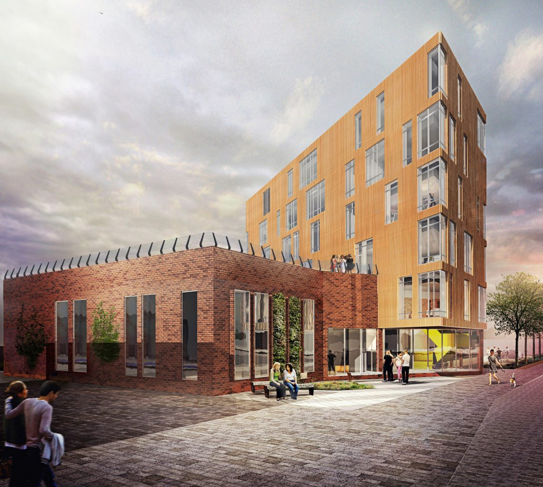
Sheffield Cancer Rehabilitation Service
Liam Humphreys
Research Fellow
Advanced Wellbeing Research Centre,
Sheffield Hallam University

Slide 2
My presentation
Vision and aims of the service
Designing of the service
The infrastructure in Sheffield for Physical Activity provision
Advanced Wellbeing Research Centre and partners in delivering the service
Planned service
Phases of implementation

Slide 3

Vision
Our vision, is to design, deliver and sustain a comprehensive rehabilitation service for people affected by cancer across Sheffield and South Yorkshire.

Slide 4
Aims
Embed physical activity within the cancer care pathway.
Create a unique, high-quality rehabilitation service for people living with cancer in Sheffield and South Yorkshire, with physical activity at its core, but with additional psychological and nutritional support.

Slide 5
Designing the service
Survive and Thrive project - funded by Weston Park Cancer Centre. (2015)
Active Everyday - funded by Macmillan. (2015-2018)
Prep Project - funded by Macmillan. (2019-2020)
Notes:
Previous research
Previous service

Slide 6
Prep Project
Stakeholder engagement.
Health professionals involved in the medical treatment and care of people affected by cancer.
Professionals involved in the provision of physical activity, nutrition and psychological support.
People affected by cancer.
Visits to prehabilitation/rehabilitation projects.
Notes:
Key findings from the discussions
Prehabilitation is part of the rehabilitation continuum. If we develop a prehabilitation pathway, it must lead to further rehabilitation following treatment.
Prehabilitation pathways should incorporate a holistic approach to health. Patients should have access to exercise, nutrition, and psychological support.
Patients should have access to an individualised prehabilitation prescription based on an initial assessment. The assessment will ensure patient safety.
Patient access needs to be as quick and straightforward as possible. Quick access will ensure that the patient receives timely support before treatment.
The prehabilitation should take place away from the hospital, preferably in an area that has public transport access and ample parking.
A multi-disciplinary team should deliver a prehabilitation service. There is currently no capacity within the workforce to provide a prehabilitation service.

Slide 7

The physical activity infrastructure in Sheffield

Slide 8
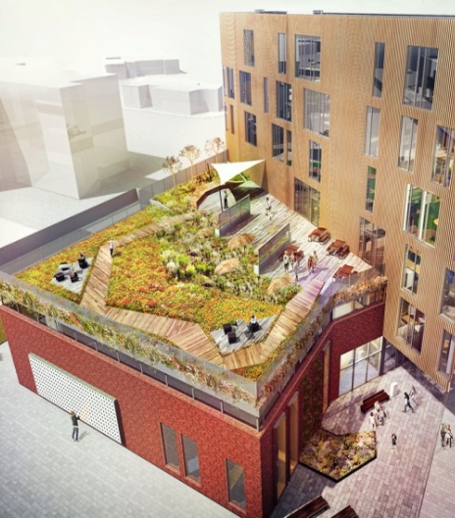
Advanced Wellbeing Research Centre

Slide 9





Slide 10
Sheffield Cancer Rehabilitation Service
Includes physical activity, nutritional and psychological support throughout their cancer journey
Referral pathways will be designed to identify people who have been newly diagnosed with cancer to ensure support is available at the start of their treatment journey.
The primary route of referral will be from a health professional.
Service will initially receive referrals from lung, colorectal, and upper GI cancers

Slide 11
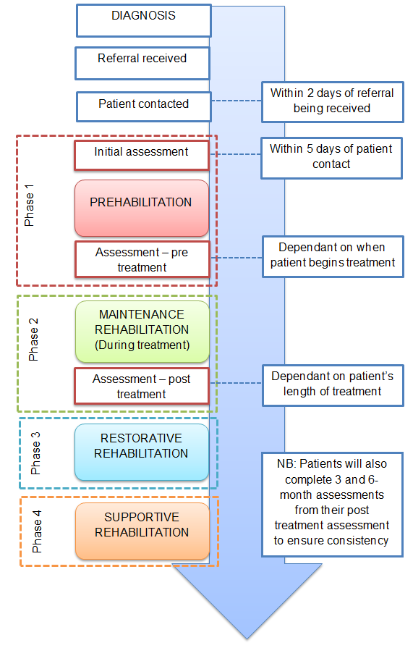
Proposed service design
Notes:
It builds on widely understood principles surrounding exercise positively contributing to the reduction of such secondary symptoms,
particularly related to mental health [43e45], with the overall aim of providing a holistic pathway to improve patient quality of life, during
and after treatment. This in turn supports people with cancer to recover faster from their treatment with motivation for resumed independence and the ability to perform their pre-morbid occupations including returning to work, self-care and other important and personally meaningful activities of daily life.

Slide 12
Risk assessment
Support | Low risk | Medium risk | High risk
Physical activity | Access to free gym based programme. | Supported by level 4 cancer exercise specialist. | Supported by specialist rehabilitation physiotherapist.
Nutrition | Written information provided by cancer teams. | Referred to generic NHS dietician support. | Specialist cancer dietician support.
Psychological support | Written information provided by cancer teams. | Referred to IAPT. | Clinical psychologist or psychiatrist where appropriate.

Slide 13
Implementation Phases
Phase | Description | Date
1 | Project set up | March 2021
2 | Beta test the referral pathways | October 2021
3 | Service launch | January 2022
4 | Service open to other cancer groups | January 2023

Slide 14
Thank you for listening.
Any questions?

