Slide 1

Supportive Oncology at BSUH
Dr Ollie Minton

Slide 2
National Picture
29% NHS spending is on patients in the last year of their life
1:3 of the adult inpatient population is in the last year of their life
1:10 is in their last admission
Supportive and palliative care intervention is evidenced to reduce cost of hospital admission by 14-24%

Slide 3
Baseline Data
Analysed July 2018 - June 2020
ICD 10 codes
Primary ‘any cancer’
Secondary ‘palliative care’
375 patients, 405 patient spells
Average length of stay 10-12 days
Upper and Lower GI most common tumour group admitted, although large cohort in ‘other’

Slide 4
Oncology groups were formed according to the table below, formed according to the methodology created by the North Mersey Macmillan project.

Slide 5
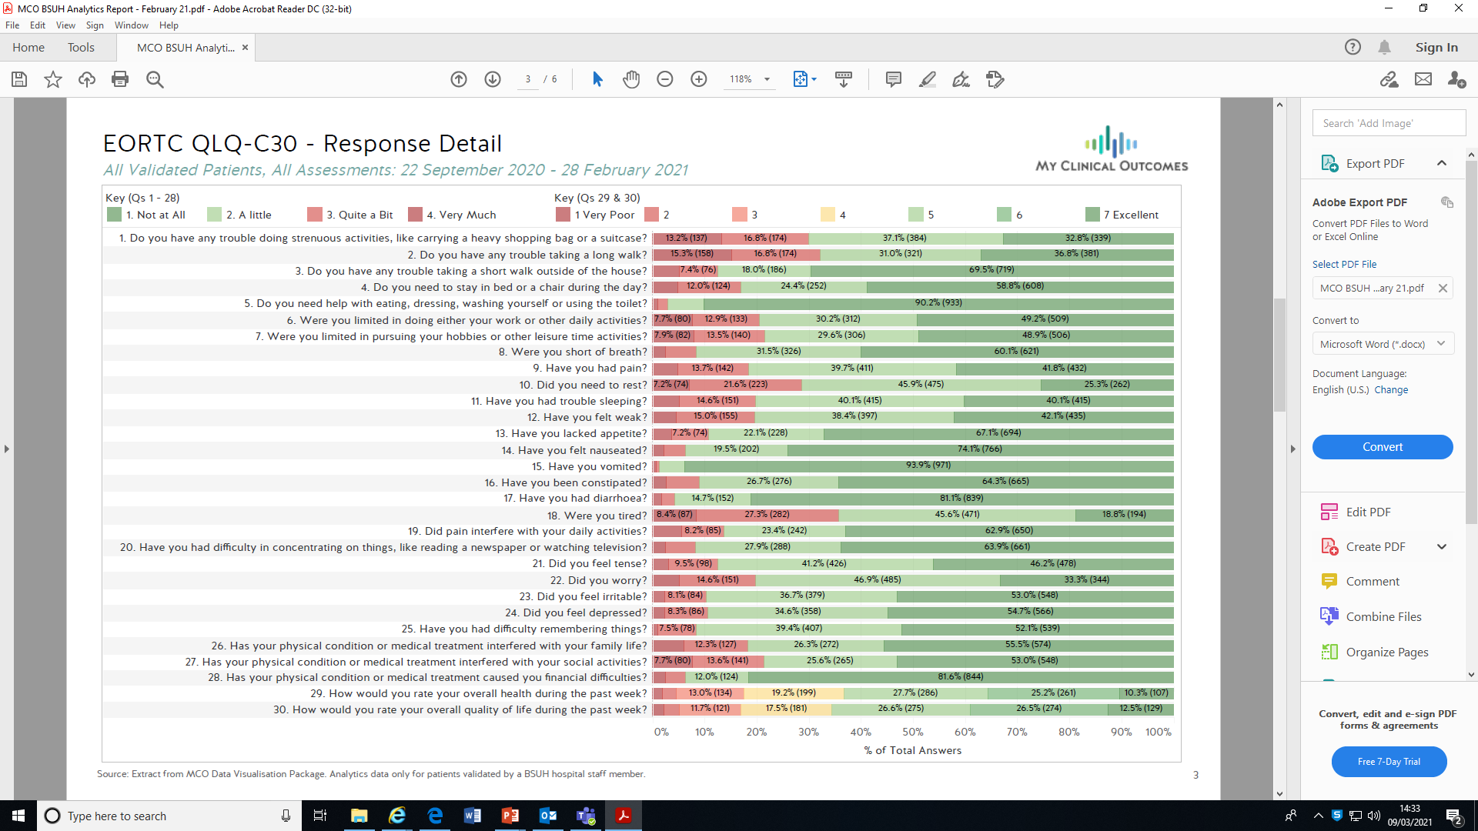
Latest data 300 patients

Slide 6
Case Study 1
46y male, 1 month of early morning headaches presenting to UCC
CT brain: mass, cerebral oedema with midline shift, likely brain tumour → referred to medics
Needed urgent MRI brain and discussion in Neuro MDT
Proactively identified via Medway PAS
Able to expedite scan to same-day imaging
Liaised with AOS for urgent review

Slide 7
Case Study 2
64y female, recent admission with new diagnosis of lung primary with brain metastases
Discharged on Dexamethasone weaning regime, with outpatient EBUS and Oncology clinic follow-up
Referred by Oncology for clinical review in interim before OP appointment
Seen on EACU for symptom / clinical review, also able to review incidental knee haematoma and provide further prescription for PPI

Slide 8
Ongoing aims
Use PROMs to identify patients in virtual follow up
Specific changes for oncology day ward review
Avoid admissions
Earlier recognition of likely disease progression / response
Business as usual

